Slide 1

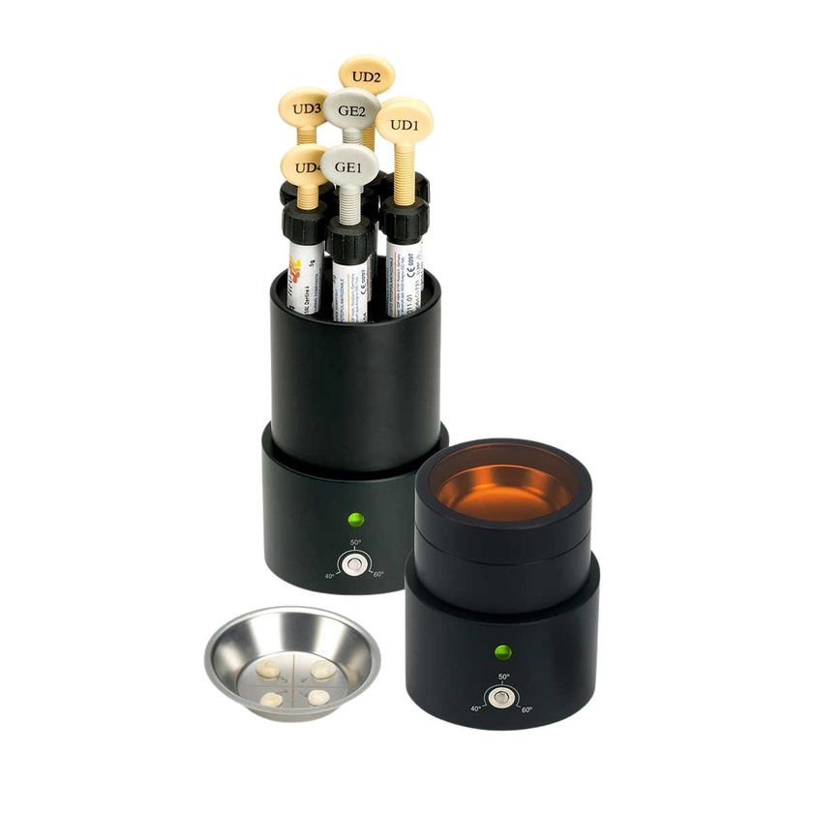
DESIGNED FOR PRECISION. MADE FOR TRUST.
EASE-IT™
Composite Softener
Improved handling through controlled composite warming
Optimise flow, adaptation and efficiency in restorative procedures

Slide 2
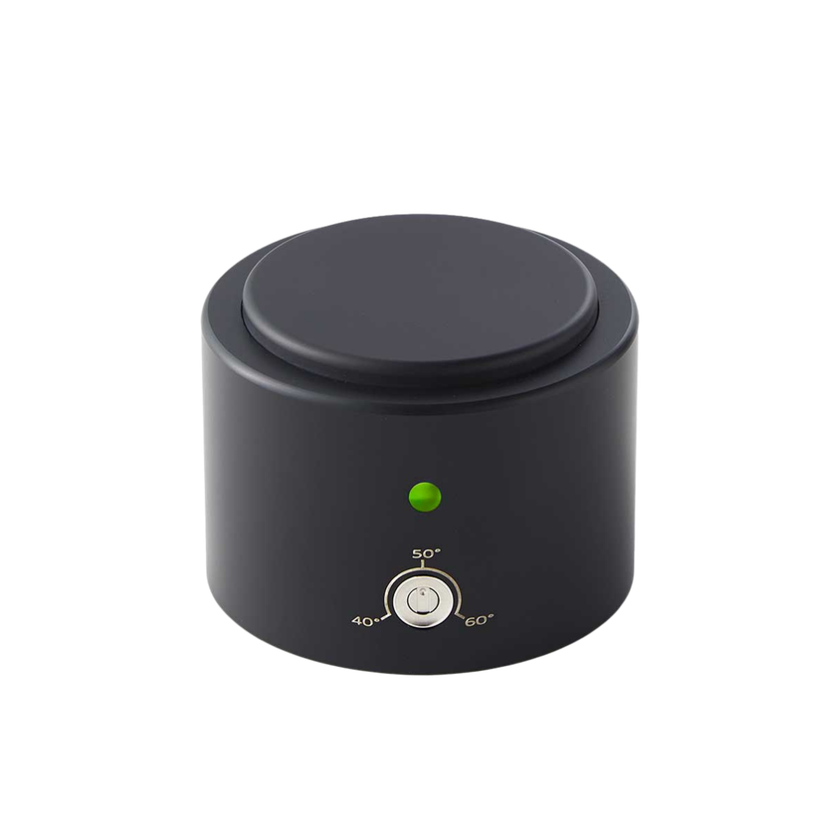
DESIGNED FOR PRECISION. MADE FOR TRUST.
About EASE-IT™
EASE-IT™ is a composite warming system designed to improve handling, flowability and adaptation of dental composites.
→ Warms composite material before application.
→ Select temperature between 40 - 60 degrees.
→ Improves consistency and adaptability.
→ Suitable for unit-dose tips and syringes
→ Reduces the risk of incorporating air bubbles in the
material.
→ Even grainy and highly viscous composites become shiny,
smooth and manageable

Slide 3
DESIGNED FOR PRECISION. MADE FOR TRUST.
Safety & Material Performance
PROVEN SAFE FOR COMPOSITE MATERIALS
→ No negative impact from repeated heating
→ Maintains material properties
→ Tested under laboratory conditions

Slide 4
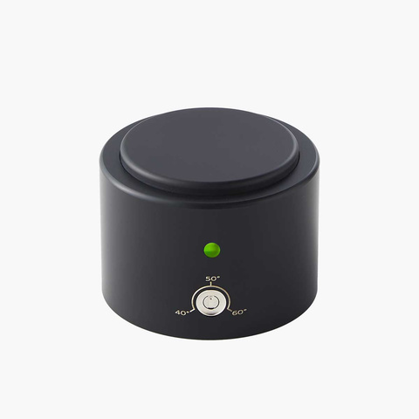
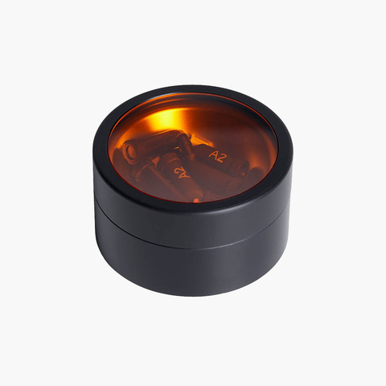
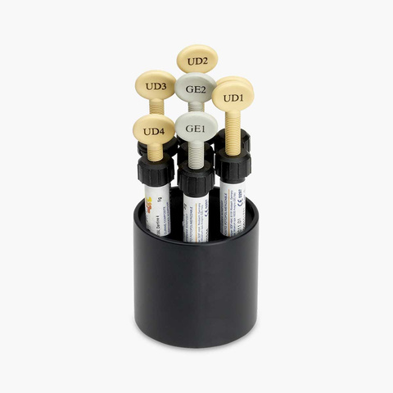
DESIGNED FOR PRECISION. MADE FOR TRUST.
System Components
FLEXIBLE SETUP FOR DIFFERENT NEEDS
→ Heating unit with electronic temperature control
→ Jar with lid
→ Thermo-block
→ The containers can be removed from the heating unit and
placed at work site.

Slide 5
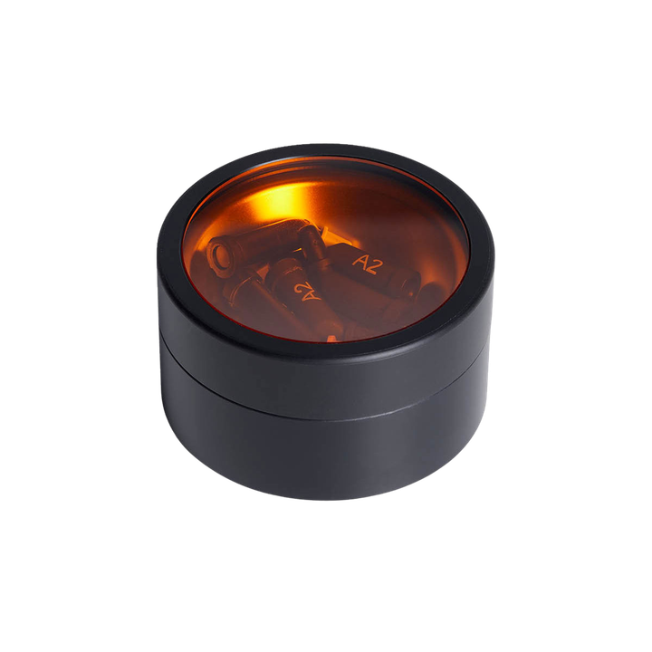
DESIGNED FOR PRECISION. MADE FOR TRUST.
EASE-IT™ Jar
Jar for heating composite tips - and for composite placed directly
→ Comes with a sterilizable inner plate and a light protecting lid to
prevent premature curing.

Slide 6
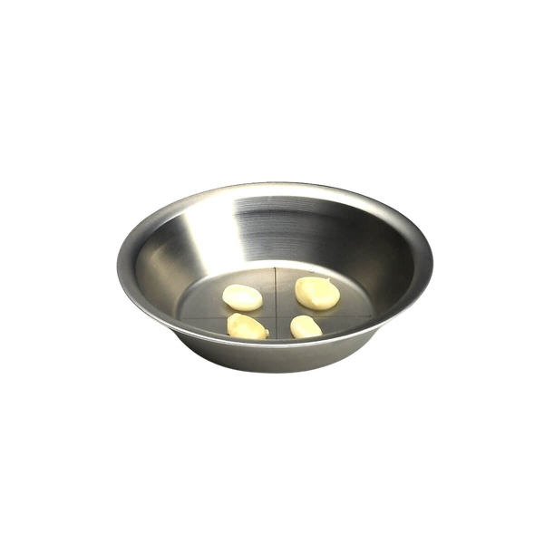
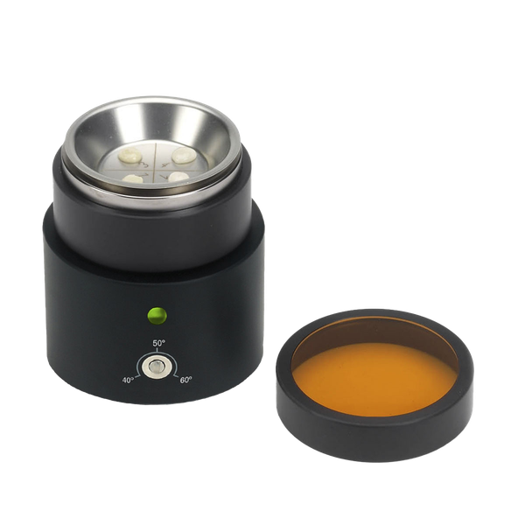
DESIGNED FOR PRECISION. MADE FOR TRUST.
EASE-IT™ Inner plate
→ Plate designed with four fields for easy organization of
the composite colors.
→ The inner plate is autoclavable and fits into the Ease-It™
Jar, so that the light protecting lid can still be put on top

Slide 7
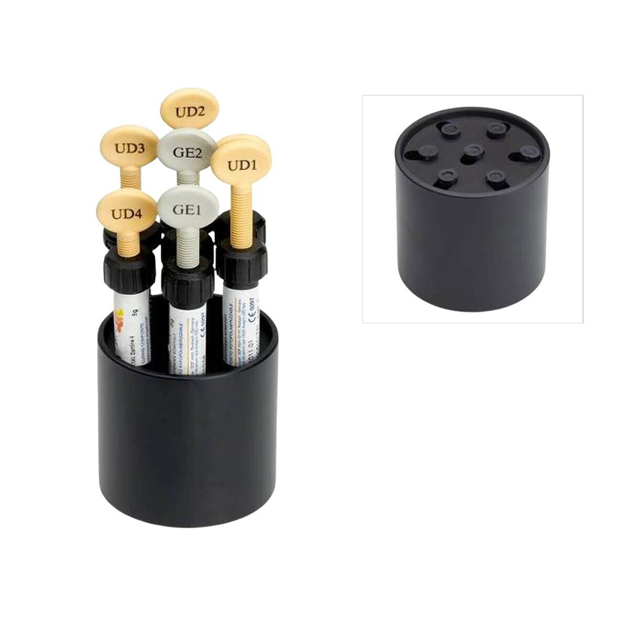
DESIGNED FOR PRECISION. MADE FOR TRUST.
EASE-IT™ Thermo-Block
For composite syringes or pre-filled unit-dose tips
→ The Thermo-Block is designed for composite syringes at
one end – and when you turn it, the design fits
unit-dose tips
→ For either seven composite syringes or pre-filled unit-
dose tips

Slide 8
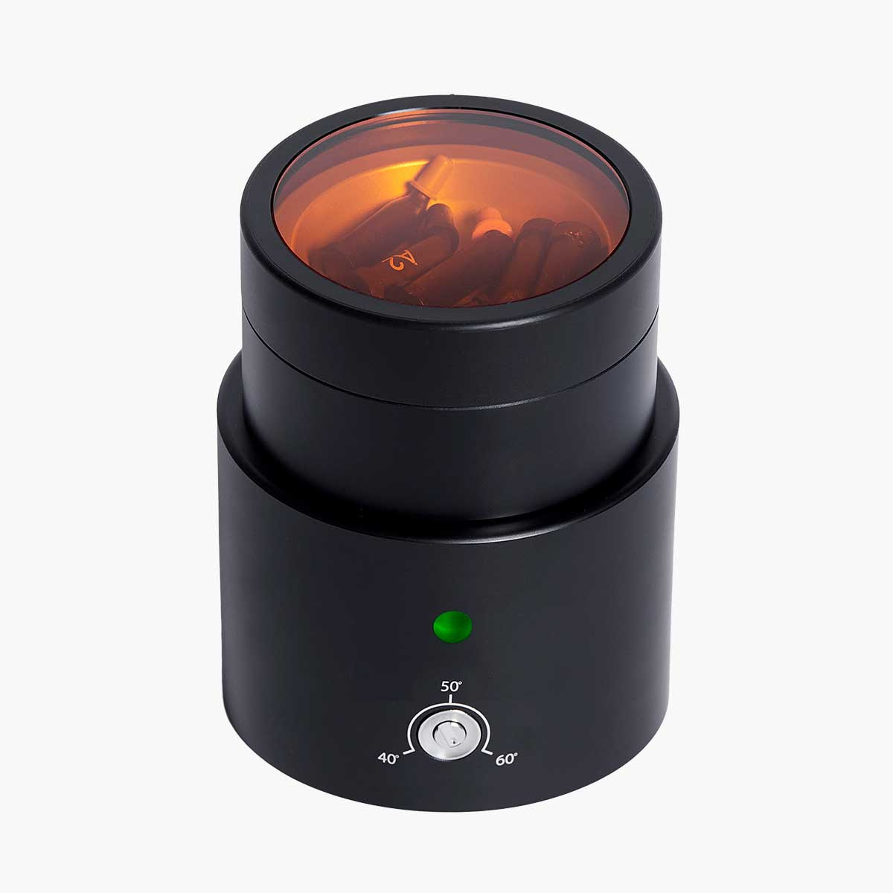
DESIGNED FOR PRECISION. MADE FOR TRUST.
How to use EASE-IT™
Simple and efficient workflow
  Connect the unit to power supply
  Place composite in jar or thermo-block
  Wait until ready (LED turns green)

Slide 9

DESIGNED FOR PRECISION. MADE FOR TRUST.
Maintenance & Warranty
SIMPLE AND RELIABLE MAINTENANCE
→ All parts can be wiped over with a cloth disinfectant
→ Do not immerse in liquid - do not autoclave
→ Autoclavable inner plate
→ 2-year warranty

Slide 10
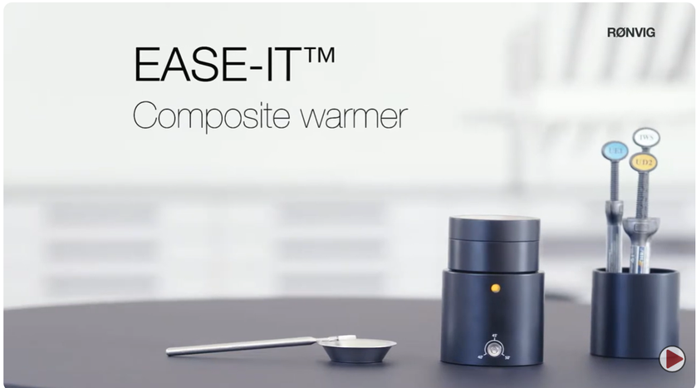

DESIGNED FOR PRECISION. MADE FOR TRUST.
Watch it in action
SEE HOW EASE-IT™ WORKS IN PRACTICE

Slide 11
DESIGNED FOR PRECISION. MADE FOR TRUST.
Try the difference with EASE-IT™
BETTER HANDLING. BETTER RESULTS.

