Slide 1

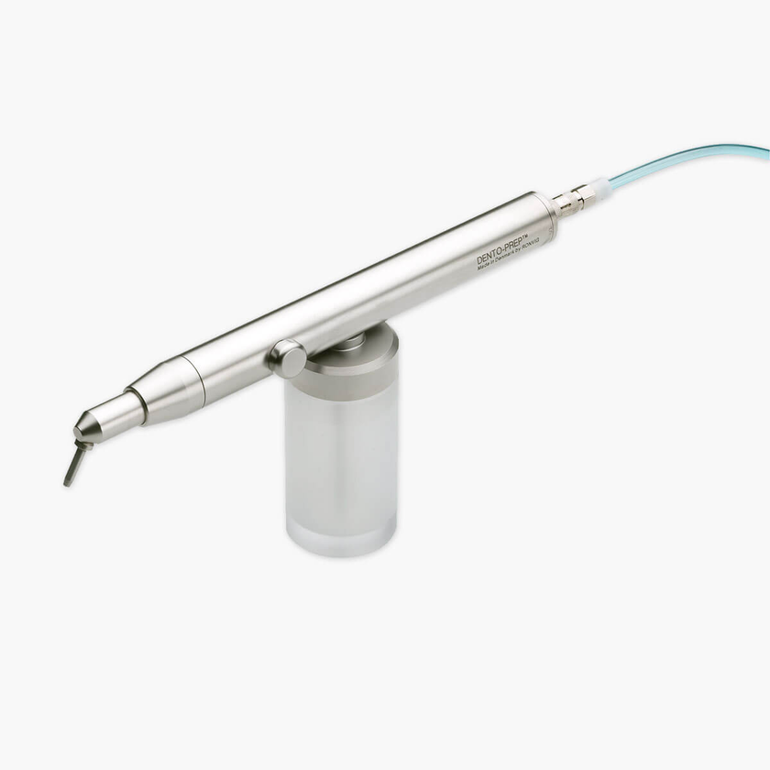
DESIGNED FOR PRECISION. MADE FOR TRUST.
DENTO-PREP™
Precision micro-roughening for optimal bonding
Efficient surface preparation for dental restorations

Slide 2
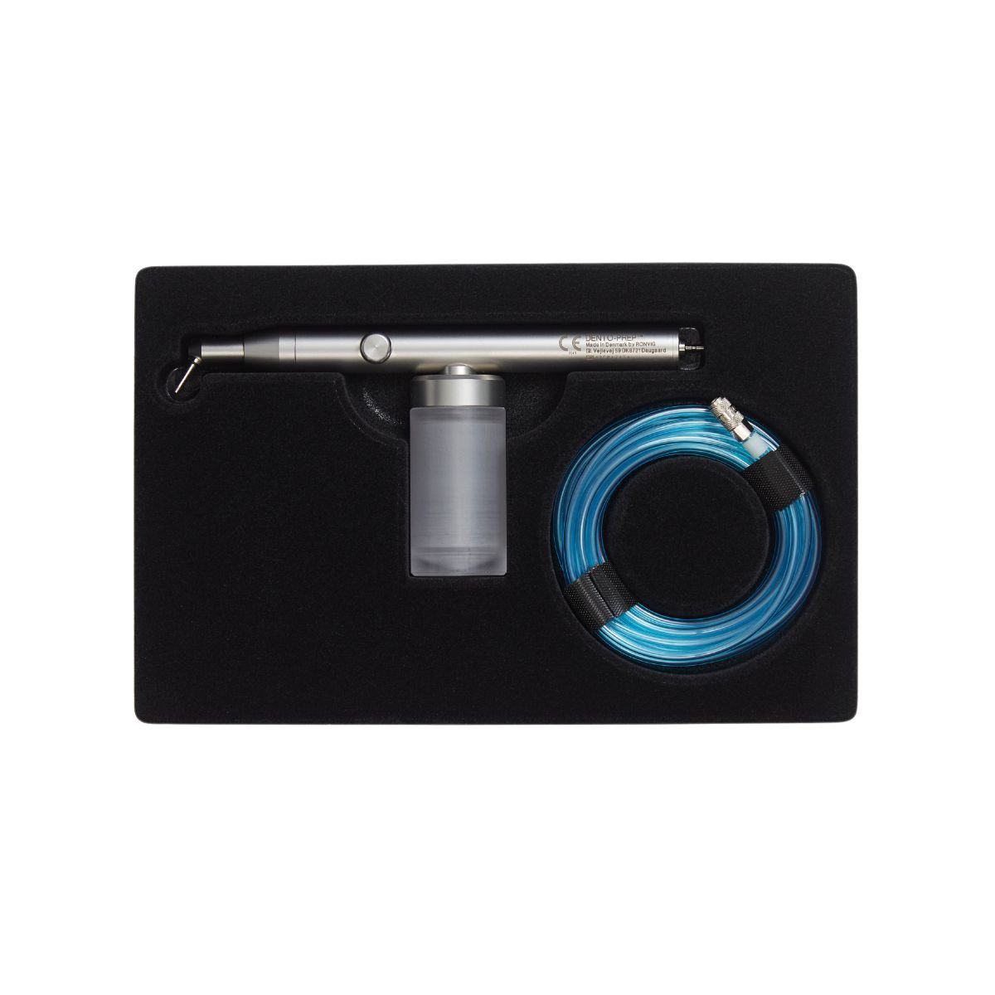
DESIGNED FOR PRECISION. MADE FOR TRUST.
About DENTO-PREP™?
DENTO-PREP™ is a microblasting system designed for micro-roughening, cleaning and activating surfaces prior to bonding.
→ Uses aluminium oxide powder for surface treatment
→ Increases surface area for stronger adhesion
→ Suitable for ceramic, composite and metal
→ Easy to install and use

Slide 3
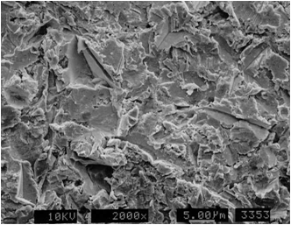
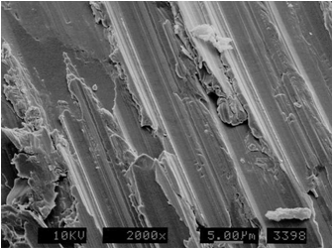
DESIGNED FOR PRECISION. MADE FOR TRUST.
DENTO-PREP™ creates
a rough and receptive surface
Scanning Electron Microscope (SEM) images show the effect on a metal surface when prepared with a diamond bur vs. sandblasting with 50 µm Al₂O₃ powder.
Sandblasted metal surface with 50 µm Al₂O₃
Metal surface prepared with diamond bur

Slide 4
DESIGNED FOR PRECISION. MADE FOR TRUST.
Applications
VERSATILE USE – INTRA- AND EXTRA-ORAL
Extra-oral application
→ Cleaning components before re-cementation
→ Verifying metal restoration fit (Contact points become clearly visible
→ Surface cleaning and preparation of: Crowns; Inlays/Onlays; Posts; Maryland bridges;
Orthodontic bands and brackets
Intra-oral application
→ Surface preparation before cementing metal or ceramic
→ Surface cleaning/preparation of natural tooth structure somposite restorations

Slide 5
DESIGNED FOR PRECISION. MADE FOR TRUST.
Flexible installation
Adapt to any clinical setup
  Connected to the turbine quick connector
  Connected to the turbine hose
  Connected directly to the air supply line

Slide 6
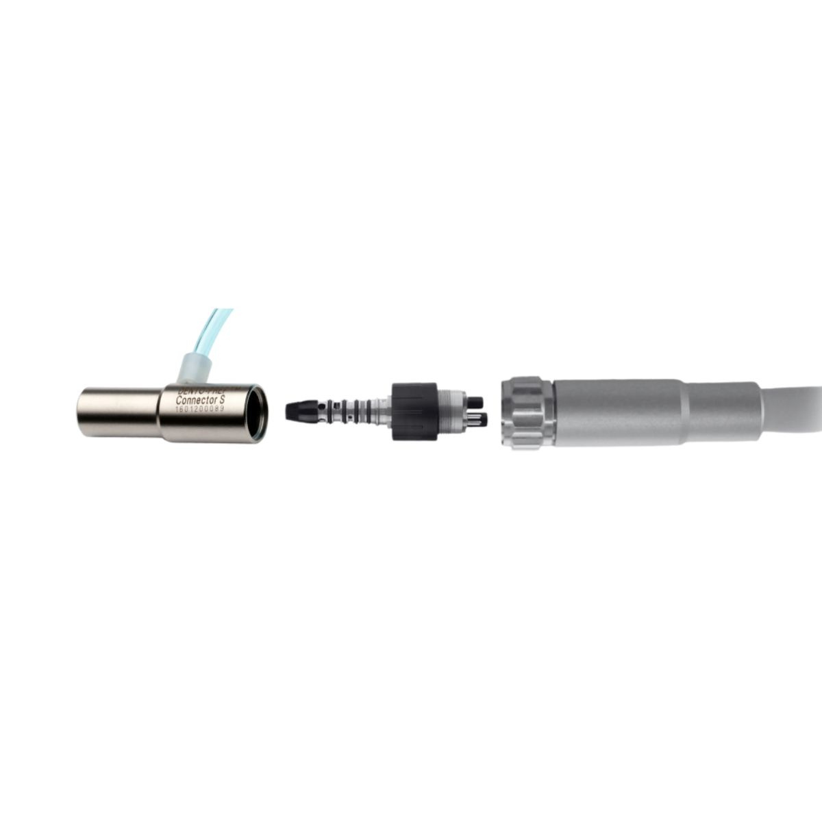
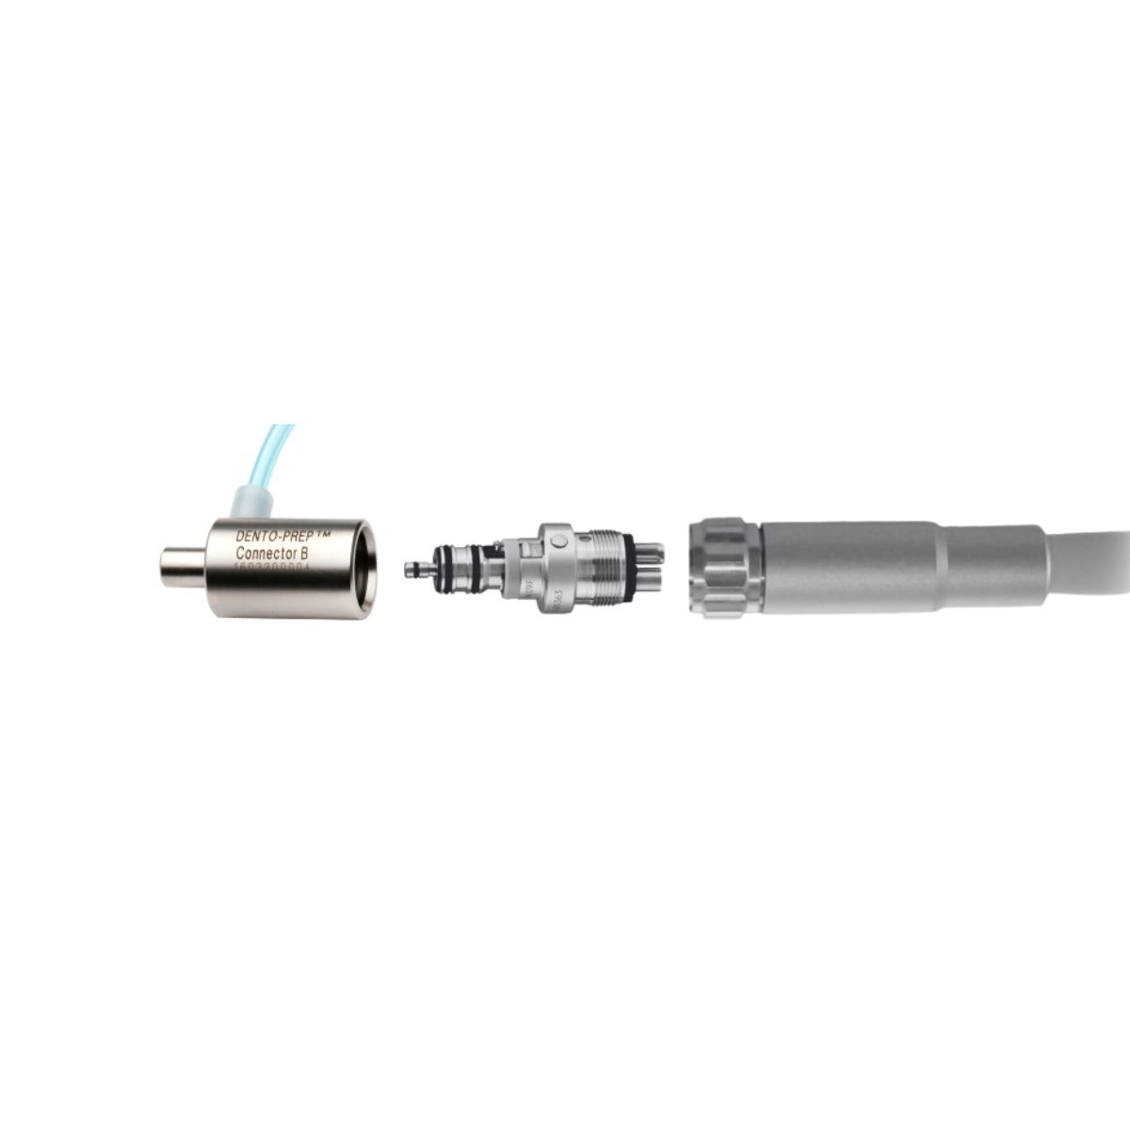
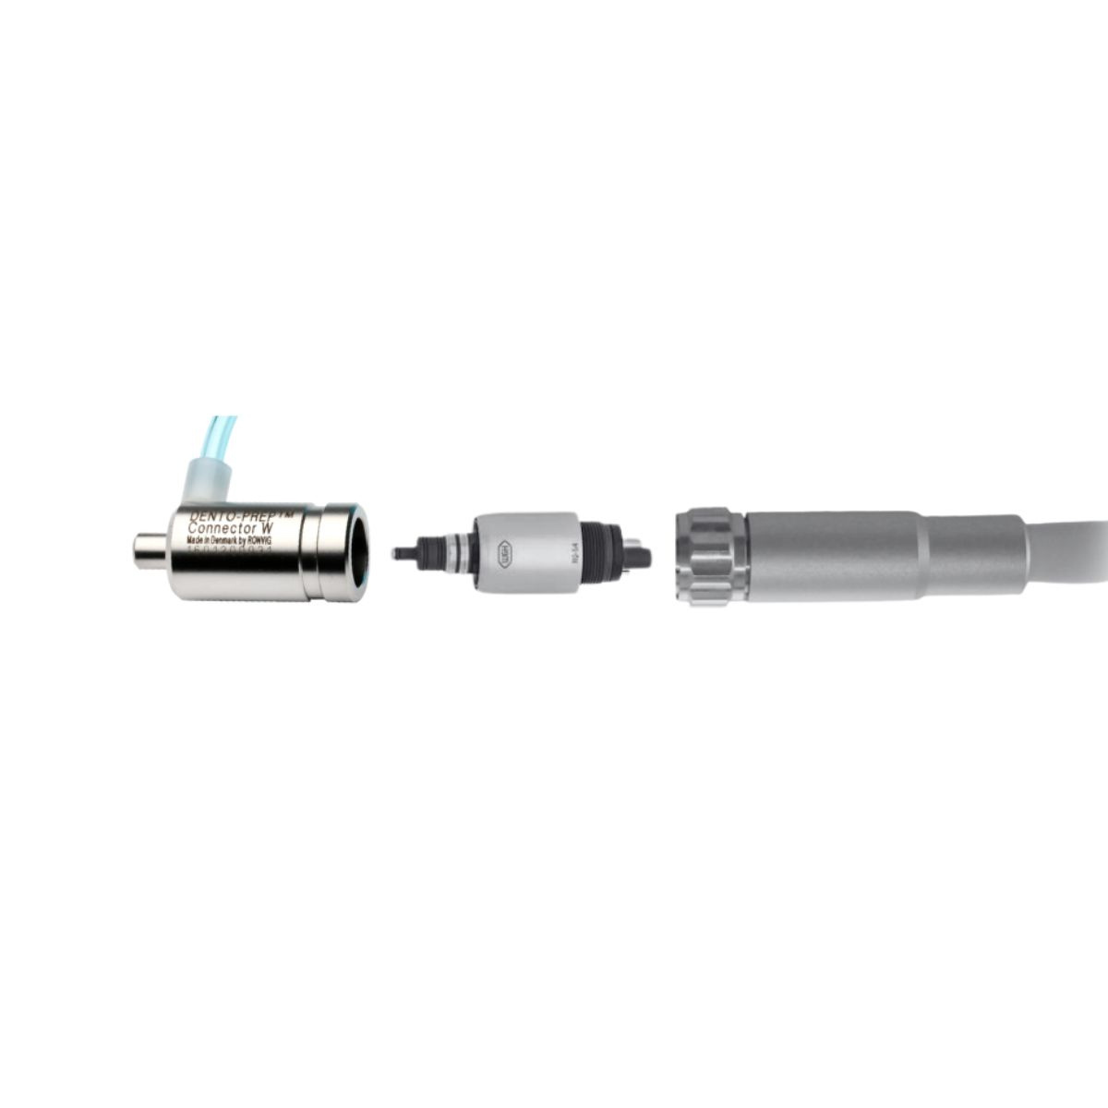
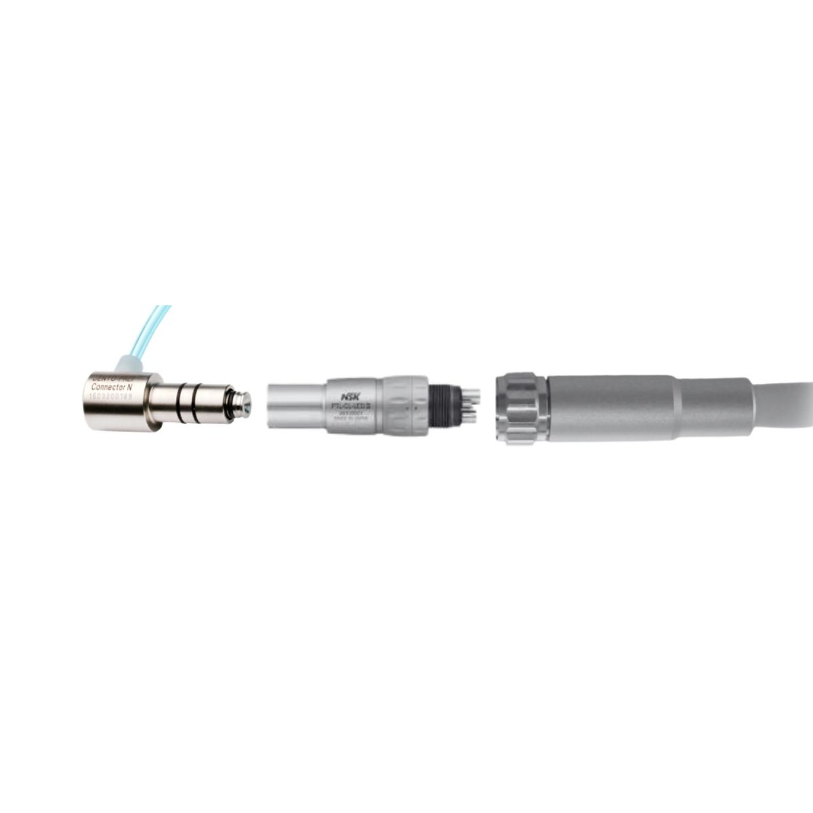
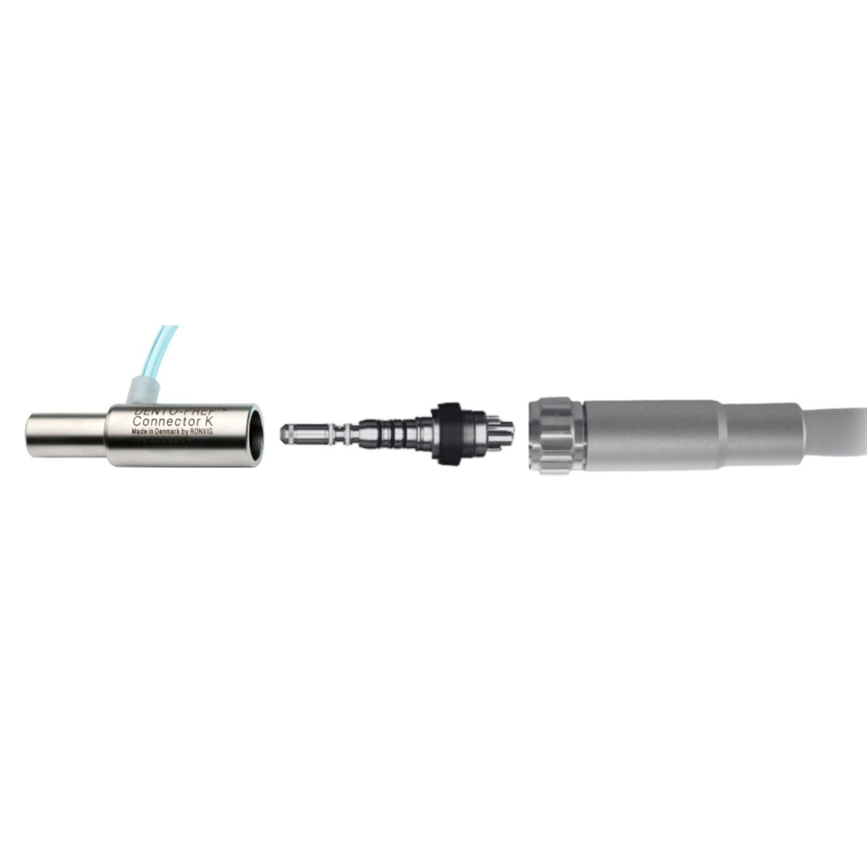
DESIGNED FOR PRECISION. MADE FOR TRUST.
Quick connection to the turbine coupling
Connector S for Sirona
Connector B for BienAir Unifix
Connector W for RotoQuick
Connector N forNSK PTL-CL-LED and FM-CL-M4
Connector K for KaVo Multiflex

Slide 7
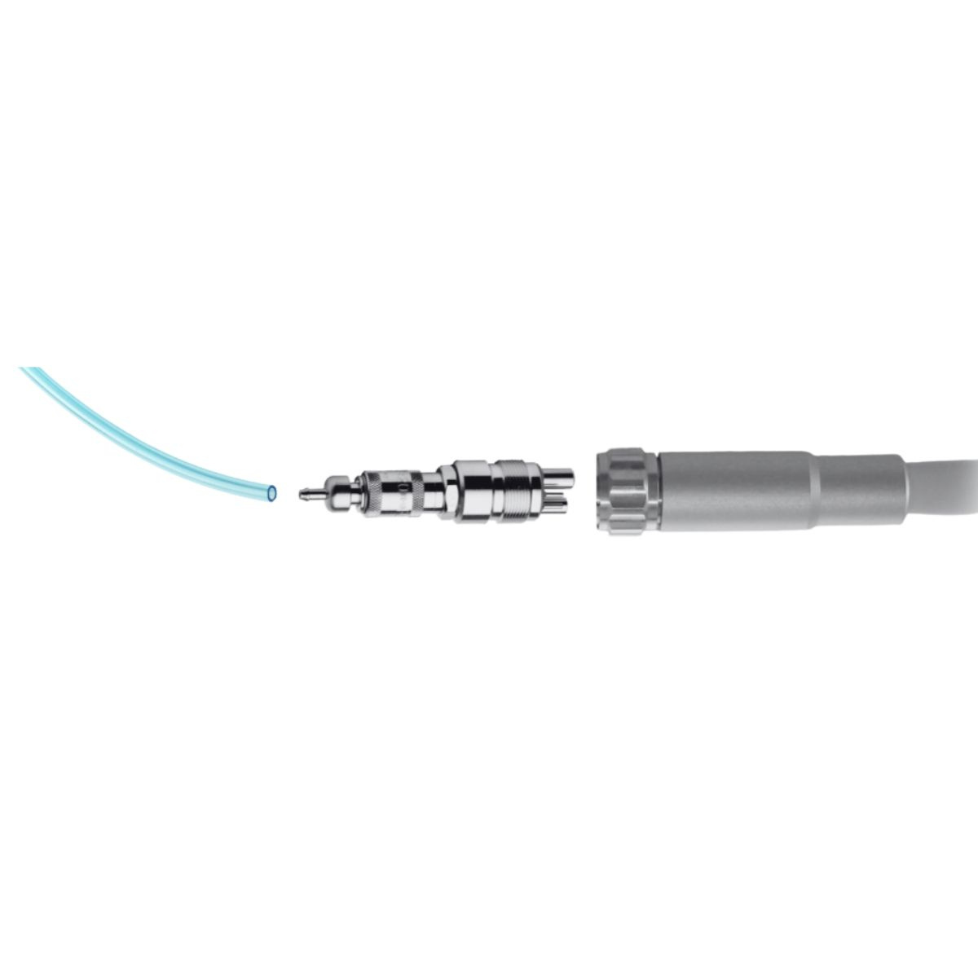
DESIGNED FOR PRECISION. MADE FOR TRUST.
Connection to the turbine hose
→ The Midwest Connector is made for the standard 4-
hole air turbine hoses
→ The Midwest Connector is universal and can be used
with the majority of standard units
MidWest connector

Slide 8
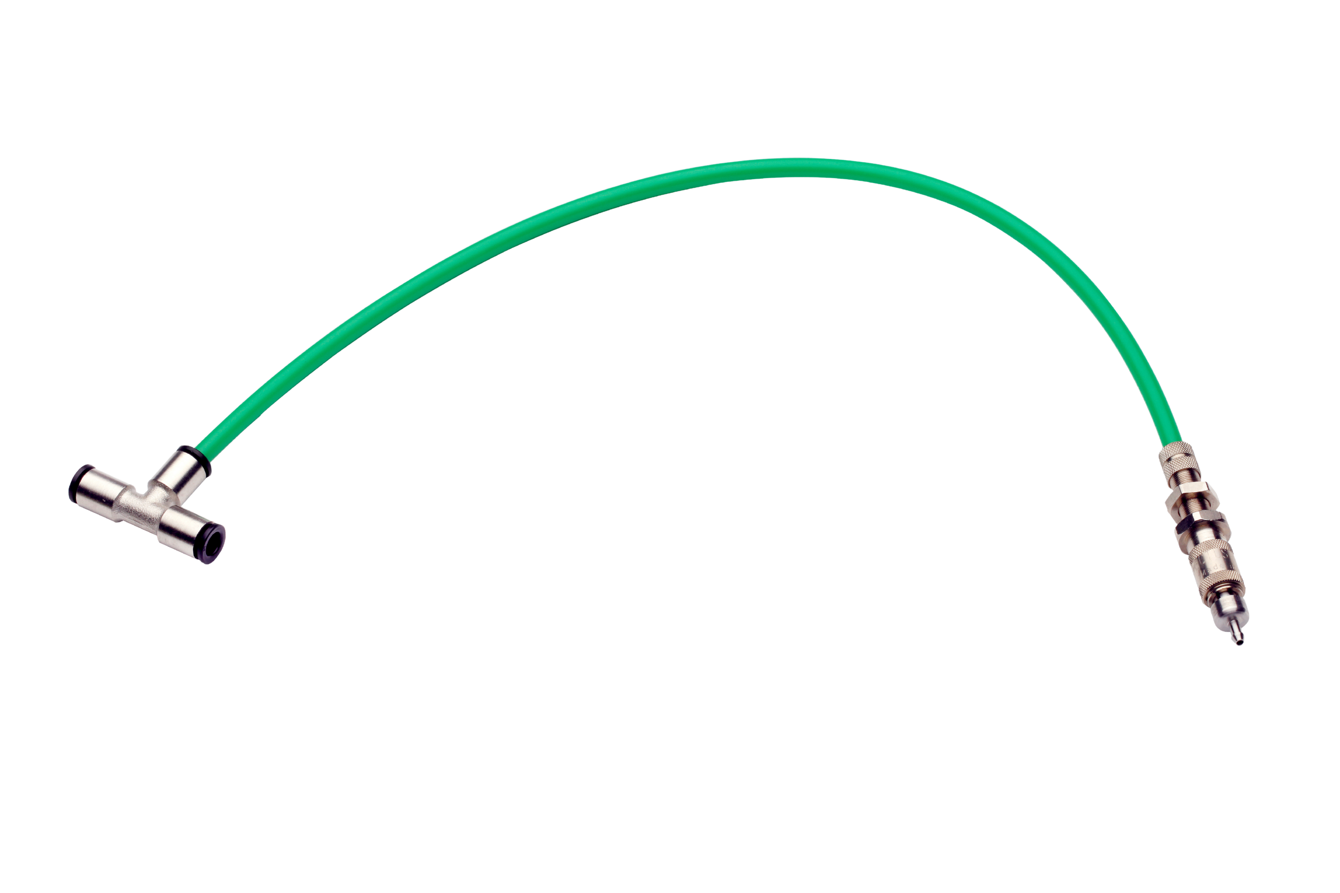
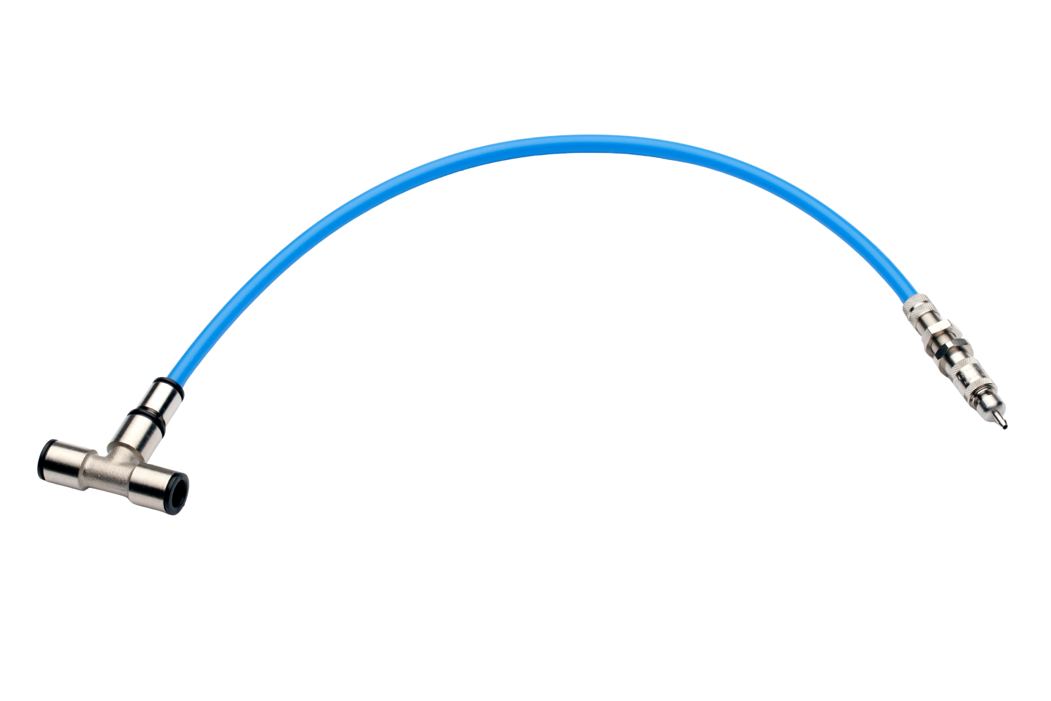
DESIGNED FOR PRECISION. MADE FOR TRUST.
Connection directly to the compressed air
1925 for hose diameter 5 mm
1926 for hose diameter 6 mm
1928 for hose diameter 8 mm
1929 for hose diameter 10 mm

Slide 9
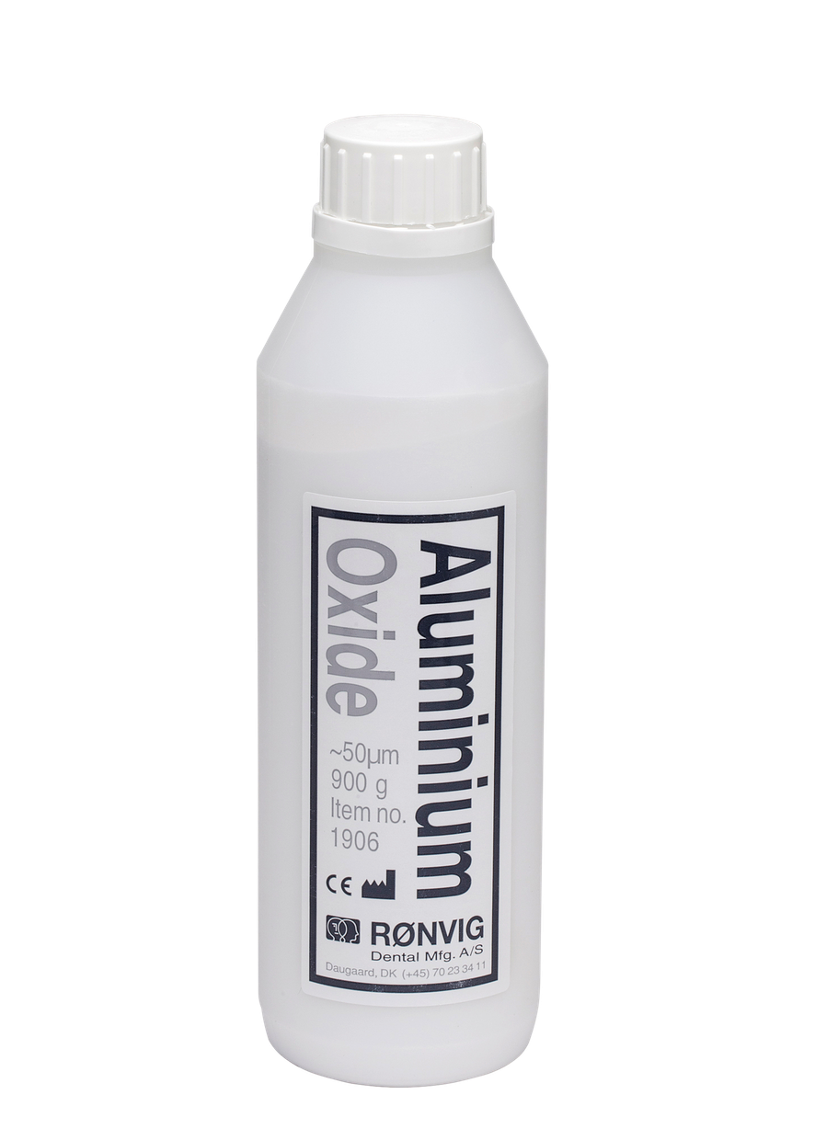
DESIGNED FOR PRECISION. MADE FOR TRUST.
Aluminium Oxide
Purified aluminium oxide powder for intra- and extra-oral blasting.
→ Content: 900g Aluminium Oxide.
→ Particle size 50 um.

Slide 10
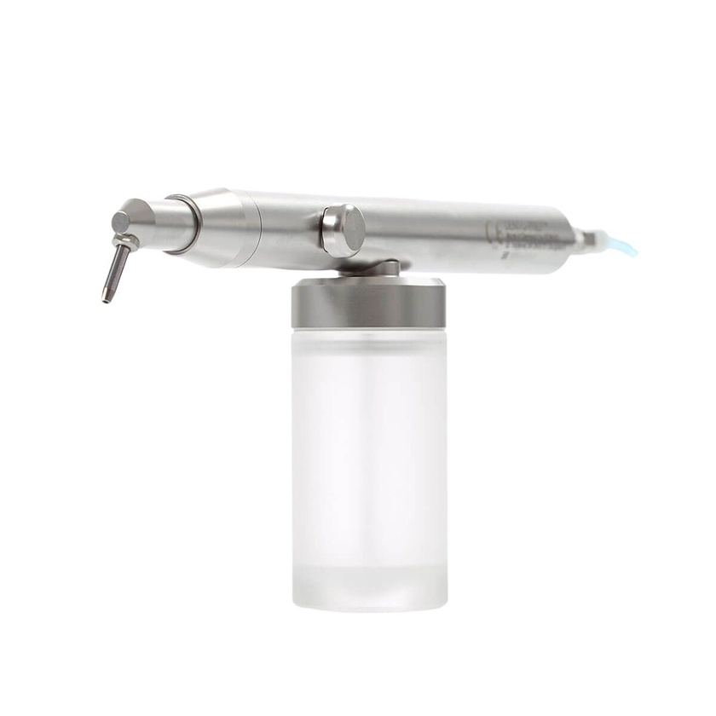
DESIGNED FOR PRECISION. MADE FOR TRUST.
Refined functional design
→ Perfectly balanced for stable handling
→ Powder jar acts as handle
→ Comfortable grip for precise work
→ Stands upright when not in use
→ The nozzle rotates 360° and can be placed in any position.
→ Solid construction of high grade stainless steel – also the inner parts

Slide 11
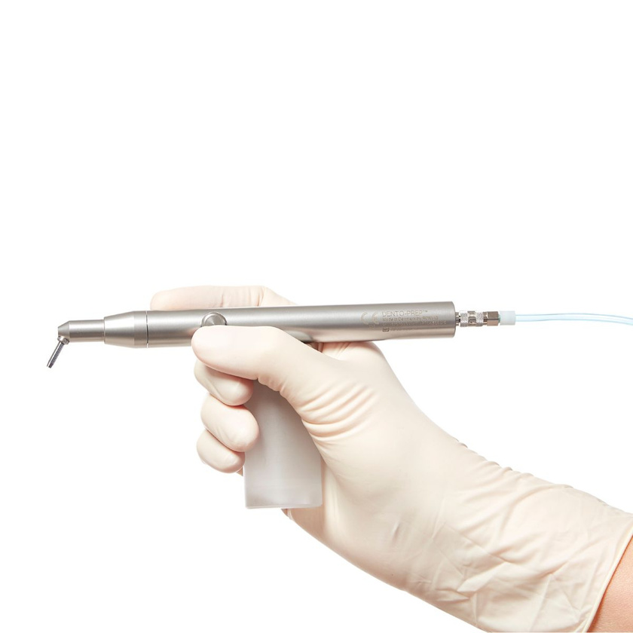
DESIGNED FOR PRECISION. MADE FOR TRUST.
Durability & Simplicity
BUILT TO LAST – EASY TO USE
→ High-grade stainless steel construction
→ Autoclavable up to 135°C
→ Smooth, hygienic surfaces
→ Easy cleaning and maintenance

Slide 12

DESIGNED FOR PRECISION. MADE FOR TRUST.
Maintenance & Warranty
RELIABLE PERFORMANCE OVER TIME
→ Easy to clean after use
→ Autoclavable components
→ Durable materials
→ 2-year warranty

Slide 13
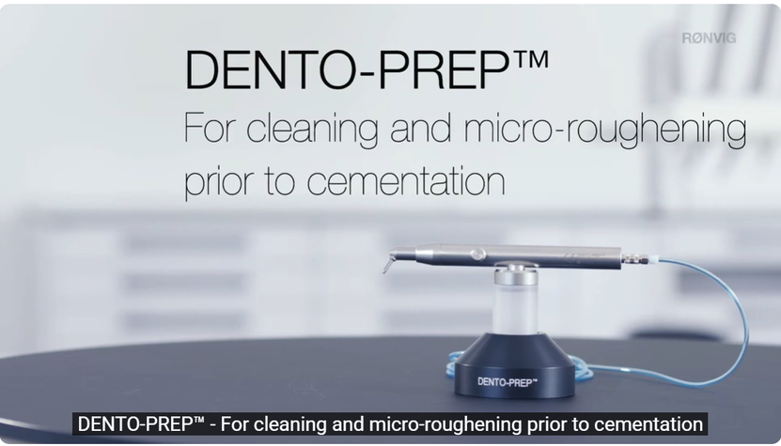

DESIGNED FOR PRECISION. MADE FOR TRUST.
Watch it in action
SEE HOW DENTO-PREP™ WORKS IN PRACTICE

Slide 14
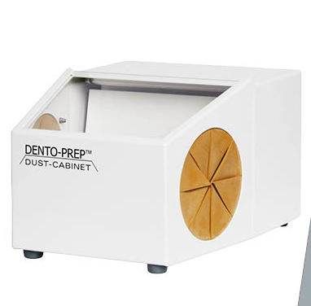
DESIGNED FOR PRECISION. MADE FOR TRUST.
DENTO-PREP™ Dust Cabinet
CLEAN AND CONTROLLED WORKING ENVIRONMENT
→ Prevents powder dispersion
→ Ensures clear visibility
→ Integrated suction system
→ Easy to clean and maintain

Slide 15
DESIGNED FOR PRECISION. MADE FOR TRUST.
Try the difference with DENTO-PREP™
PRECISION SURFACE PREPARATION – MADE SIMPLE

