Slide 1

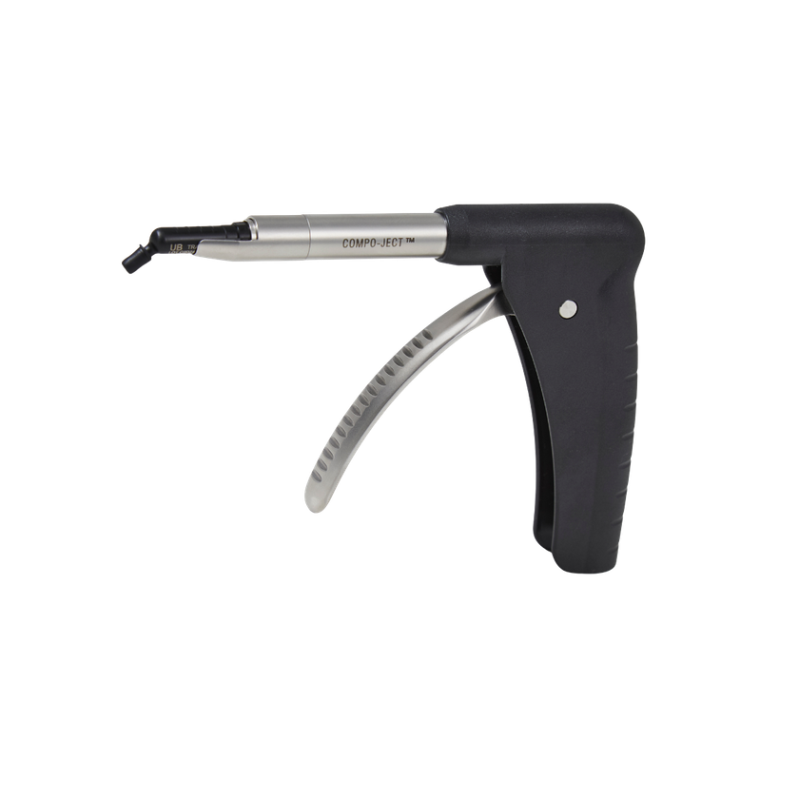
DESIGNED FOR PRECISION. MADE FOR TRUST.
COMPO-JECT
TM
Precision, Comfort, Control.
Composite dispensing gun for easy and effortless application of filling materials in unit-dose tips

Slide 2
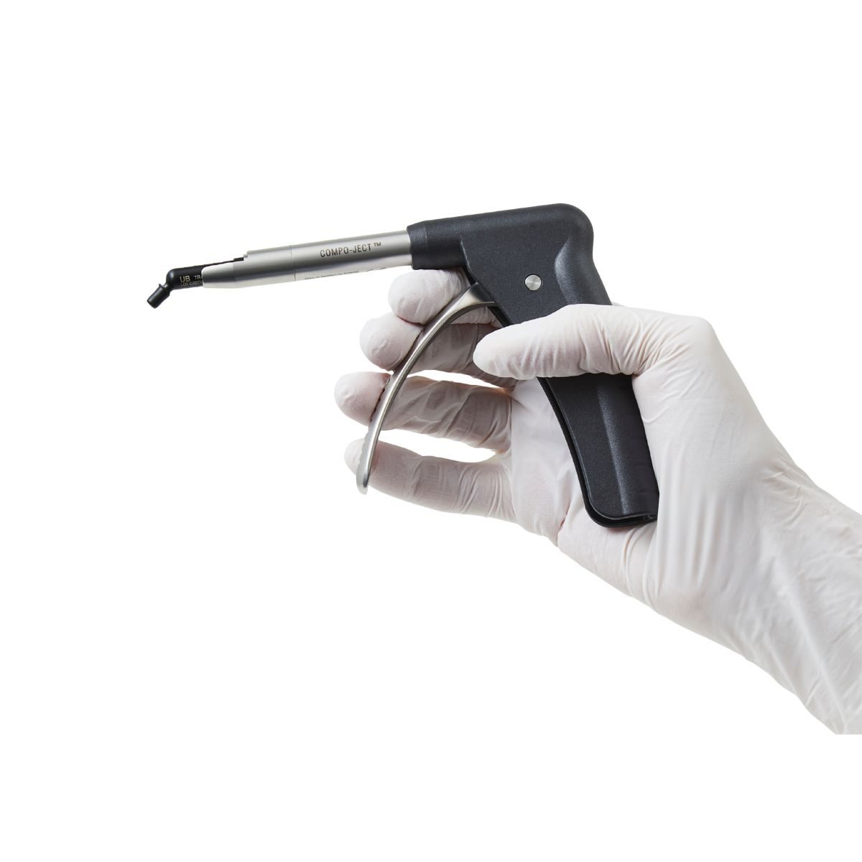
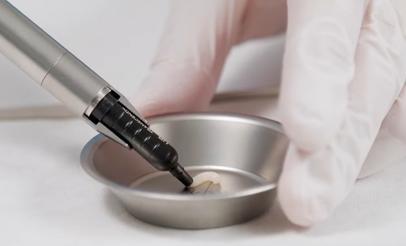
DESIGNED FOR PRECISION. MADE FOR TRUST.
Control & Balance
BUILT FOR PRECISION YOU CAN FEEL INSTANTLY
→ Perfectly balanced instrument
→ Effortless dispensing - gentle on the hand and wrist
→ High precision during composite placement

Slide 3
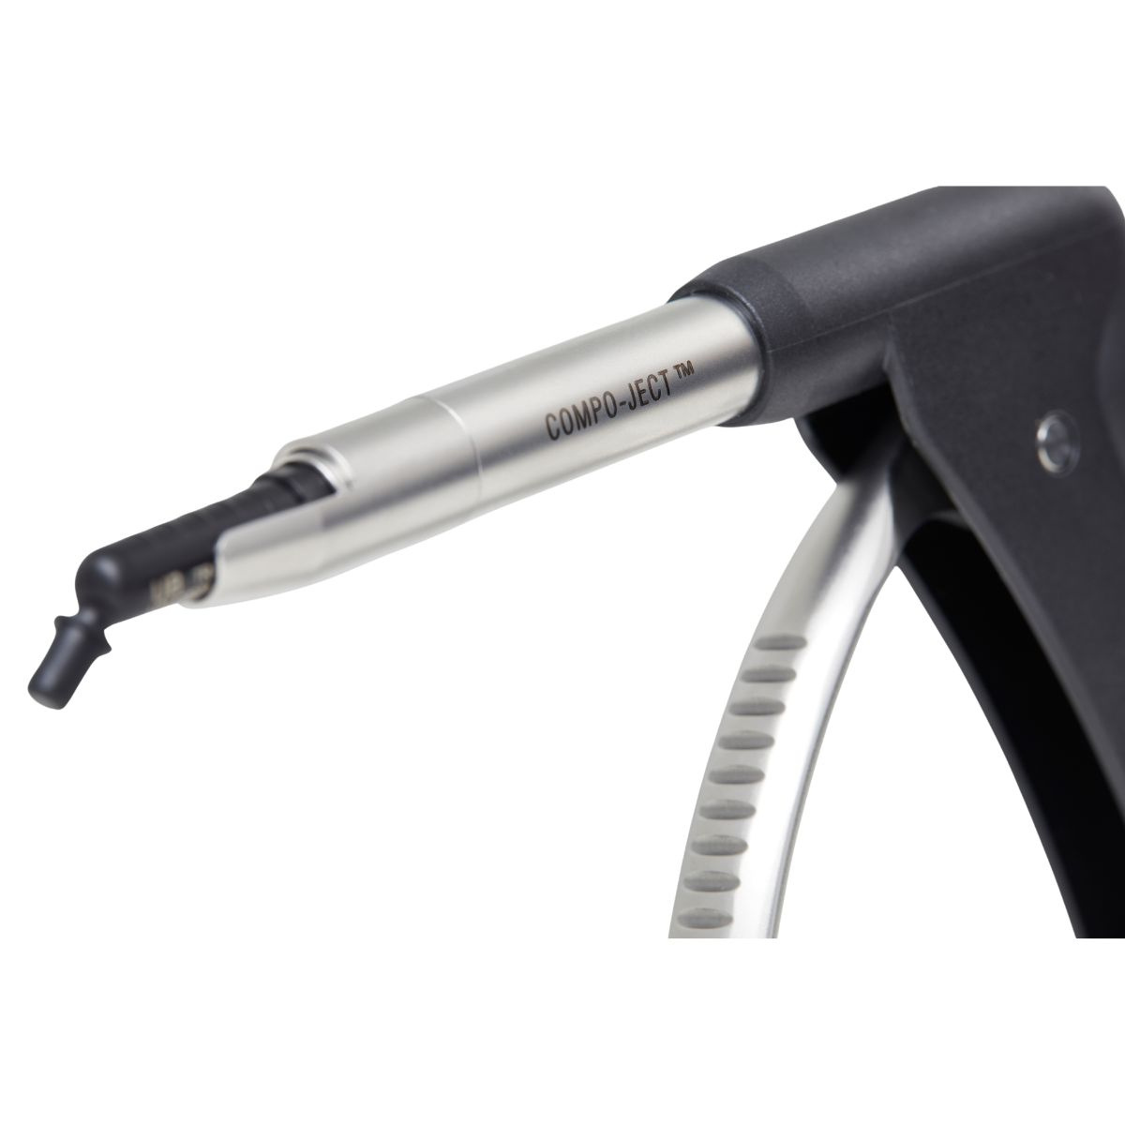
DESIGNED FOR PRECISION. MADE FOR TRUST.
Ergonomic Design
LESS STRAIN. MORE COMFORT. BETTER PERFORMANCE
→ Reduced weight for a more comfortable working experience
→ Well-balanced
→ Minimizes strain on hand and fingers

Slide 4
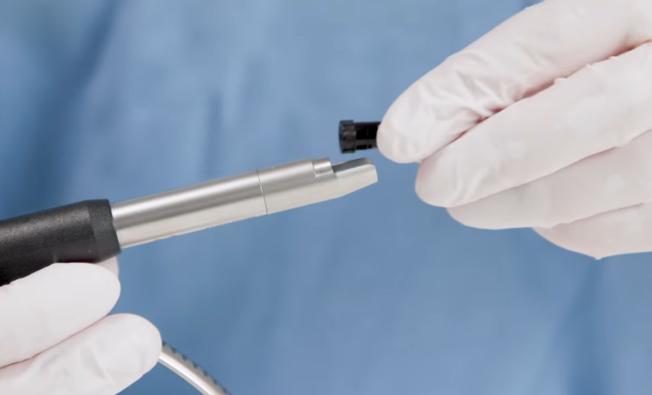
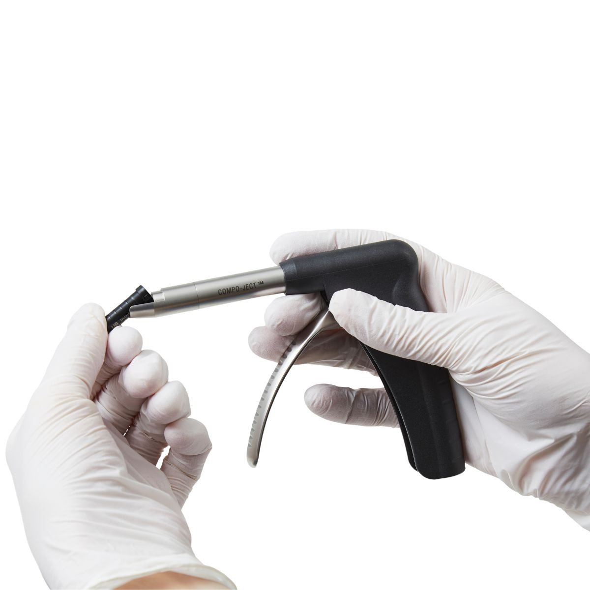
DESIGNED FOR PRECISION. MADE FOR TRUST.
Easy to load and unload
DESIGNED FOR FAST WORKFLOW
→ Unique clip-in lock system
→ Fast and easy tip replacement
→ No piston drawback
→ Takes universal pre-filled unit-dose tips
→ Just snap in and go!

Slide 5
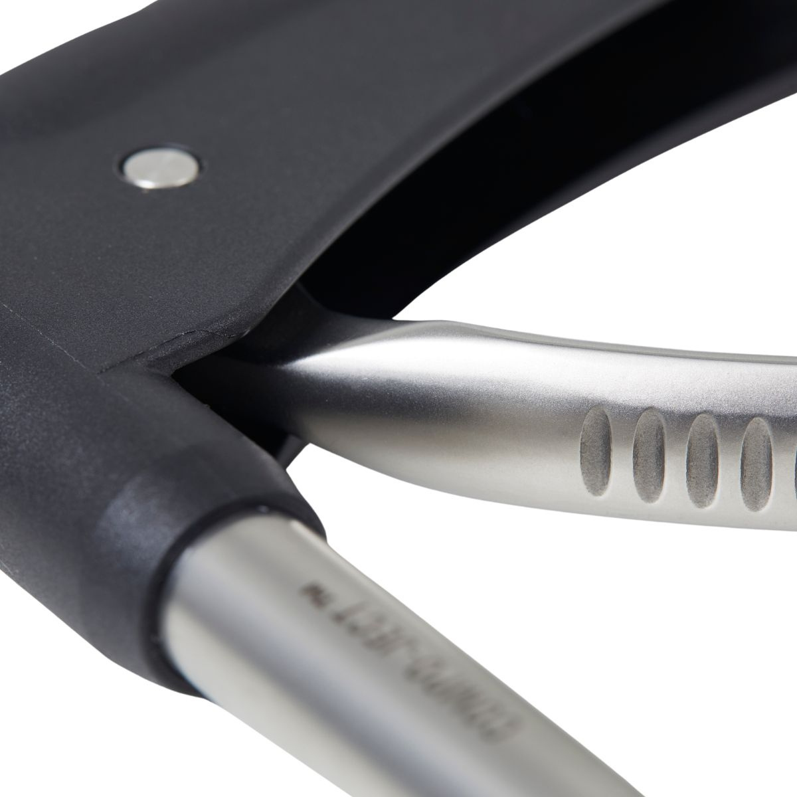
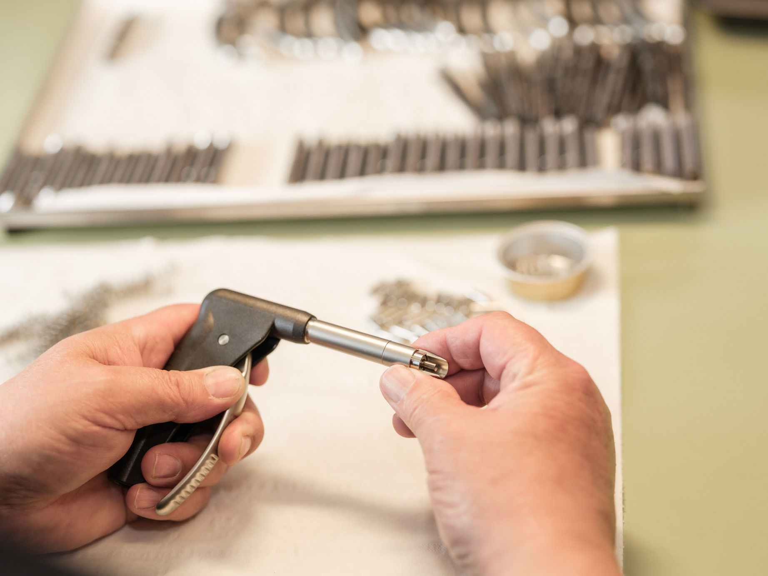
DESIGNED FOR PRECISION. MADE FOR TRUST.
Proven quality
BUILT TO LAST
→ Made from wear-resistant engineering and stainless steel
→ Designed for frequent reprocessing cycles

Slide 6

DESIGNED FOR PRECISION. MADE FOR TRUST.
Maintenance & Warranty
SAFE AND EASY TO MAINTAIN
→ Full autoclavable
→ Withstands repeated sterilization cycles
→ Designed for clinical safty
→ 5-year guarantee on material and construction

Slide 7
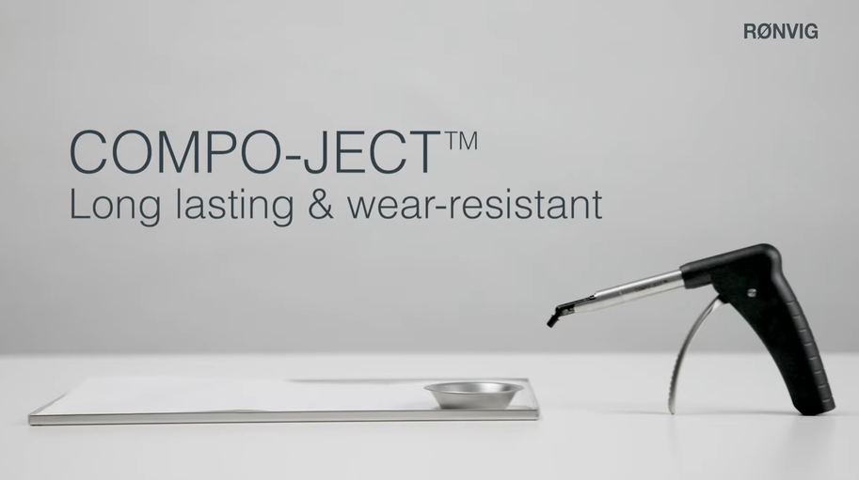

DESIGNED FOR PRECISION. MADE FOR TRUST.
Watch it in action
SEE HOW COMPO-JECT WORKS IN PRACTICE

Slide 8
DESIGNED FOR PRECISION. MADE FOR TRUST.
Try the difference with COMPO-JECT
TM
A NATURAL EXTENSION OF YOUR HAND

