Slide 1

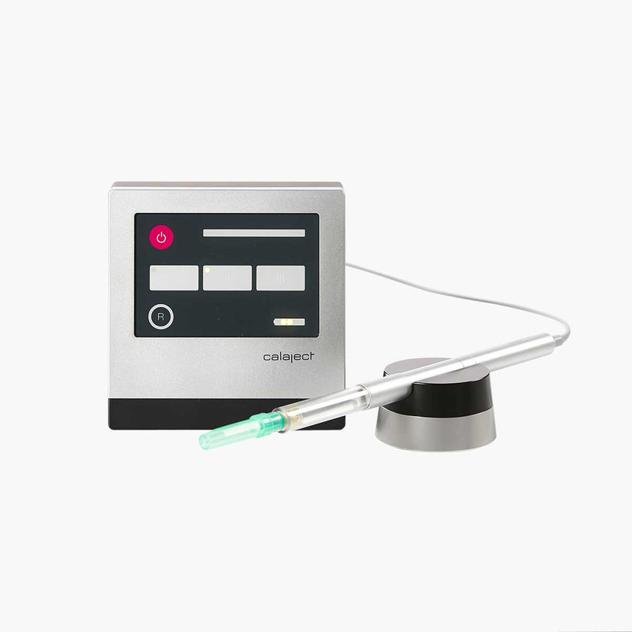
DESIGNED FOR PRECISION. MADE FOR TRUST.
CALAJECT
®
Computer-controlled local anesthesia
Precise, gentle and stress-free injections

Slide 2
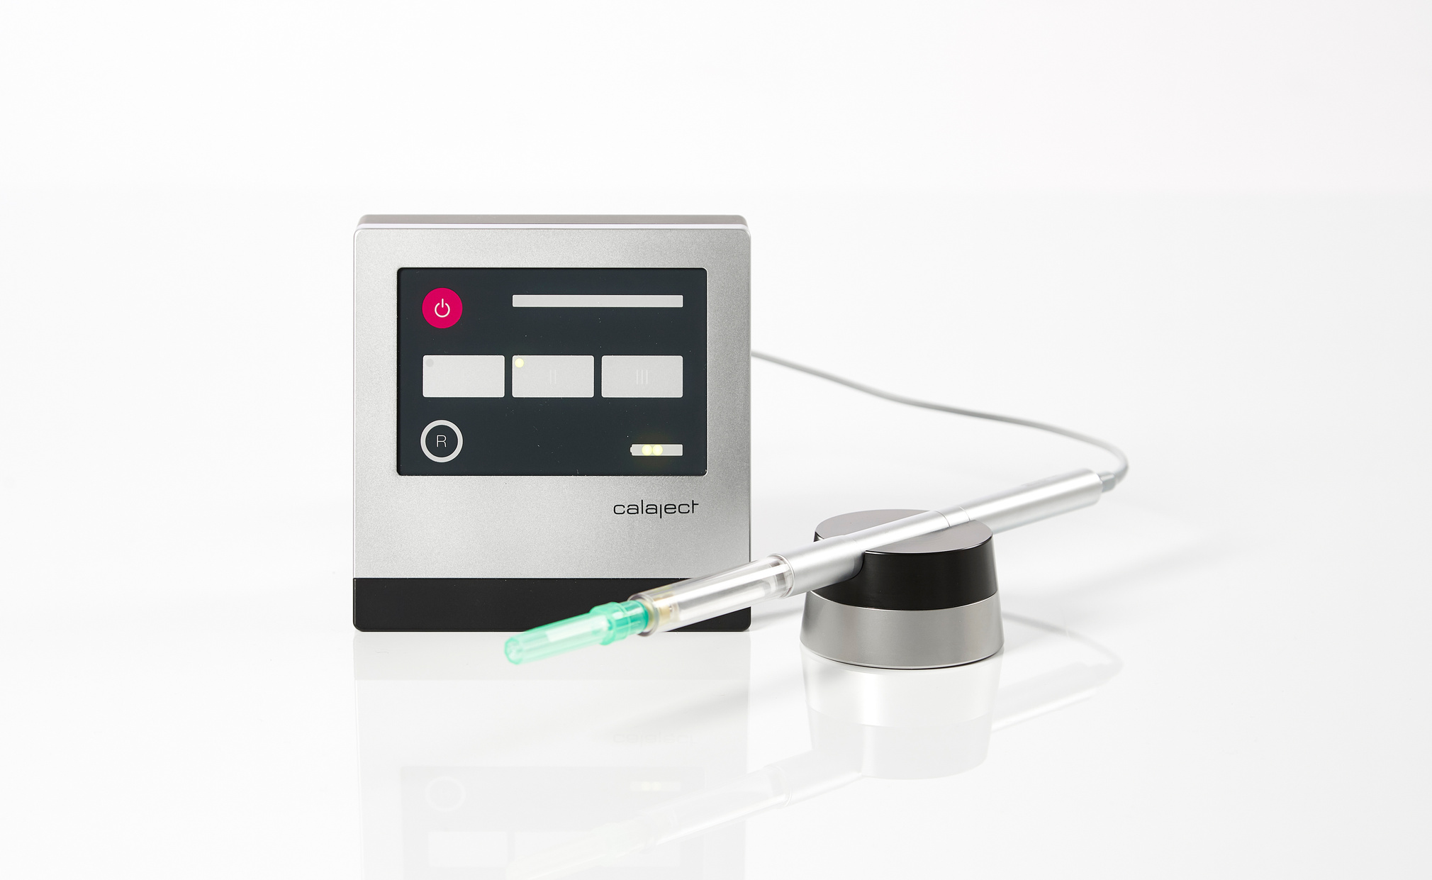
DESIGNED FOR PRECISION. MADE FOR TRUST.
What is CALAJECT?
A computer-controlled local anesthesia system
designed to deliver smooth, precise and comfortable injections.
The system controls the flow rate of the anesthetic,
ensuring a gentle and consistent delivery every time.

Slide 3
DESIGNED FOR PRECISION. MADE FOR TRUST.
Why it matters
BETTER EXPERIENCE FOR BOTH PATIENT AND DENTIST
Less pain & discomfort
Reduced patient anxiety
Full control & precision
Less strain for the dentist
Slow, controlled flow reduces pressure in the tissue
Gentler injections create a more relaxed experience
Reproducible injections with consistent results
Reduced stress on hand, wrist and shoulder

Slide 4
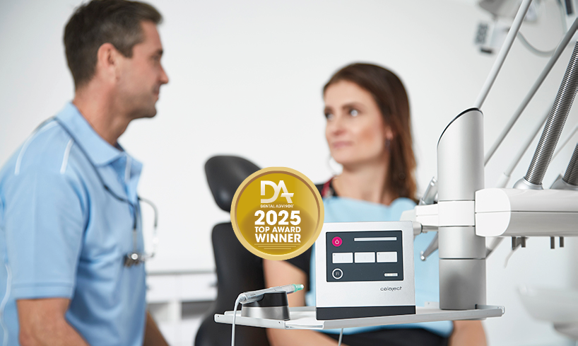
DESIGNED FOR PRECISION. MADE FOR TRUST.
Key benefits
Designed for precision, comfort and control
→ Computer-controlled flow rate
→ Automatic aspiration
→ Smooth and gentle injection
→ No manual force needed
→ Consistent and predictable performance

Slide 5
DESIGNED FOR PRECISION. MADE FOR TRUST.
How it works
THREE INTELLIGENT PROGRAMS
→ Precision
→ Infiltration
→ Nerve blocks
Slow flow for intraligamental and palatal injections
Automatic flow increase for smooth injections
Flexible speed control for advanced procedures

Slide 6
DESIGNED FOR PRECISION. MADE FOR TRUST.
Key benefits
Designed for precision, comfort and control
→ Computer-controlled flow rate
→ Automatic aspiration
→ Smooth and gentle injection
→ No manual force needed
→ Consistent and predictable performance

Slide 7
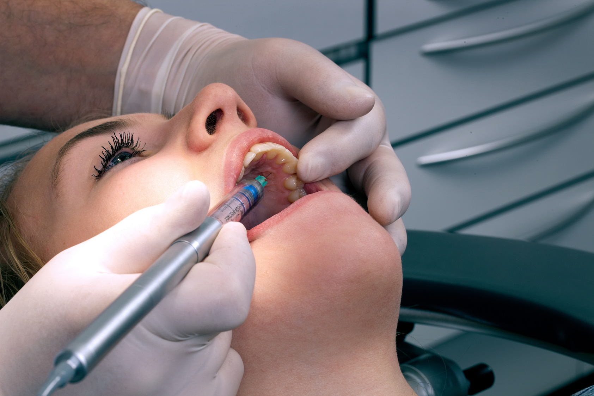
DESIGNED FOR PRECISION. MADE FOR TRUST.
Program I
Intraligamental and palatal injections
→ Hold pedal down
→ Injects slowly approx. 0.006 ml/sec
→ Optional speed increase to 0.009 ml/sec by quick tap
→ Aspirates whenever pedal is released (=anti-drip)

Slide 8
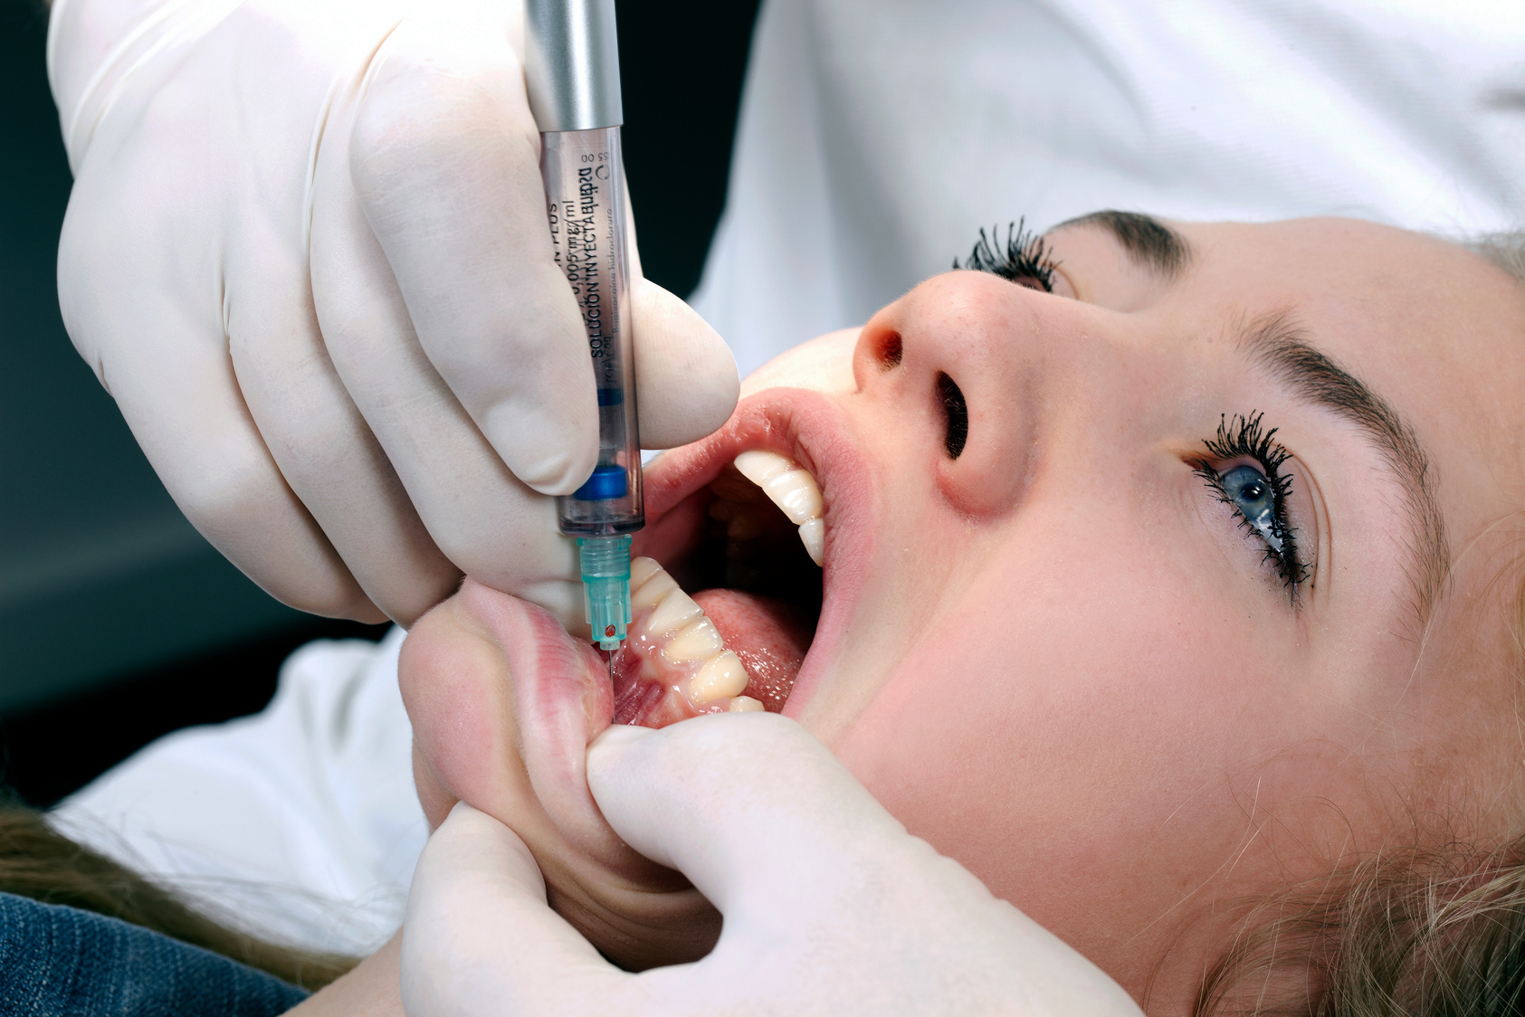
DESIGNED FOR PRECISION. MADE FOR TRUST.
Program II
Infiltrations
→ Hold pedal down
→ This program runs a fixed sequence:
→ 10 sec slowly→gradual speed increase to 0.03 ml/sec.
→ Aspirates whenever pedal is released

Slide 9
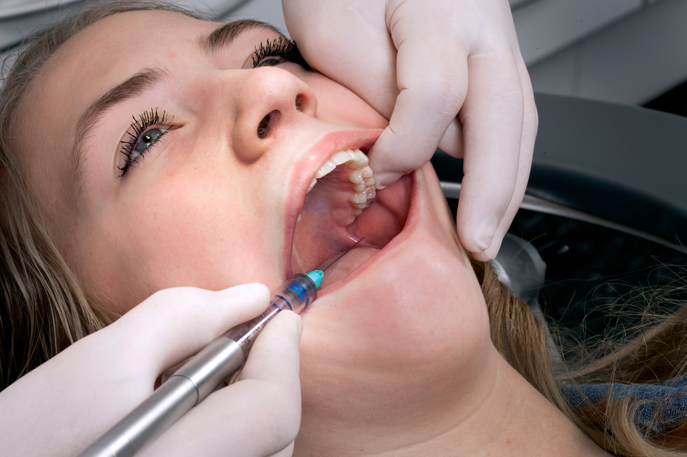
DESIGNED FOR PRECISION. MADE FOR TRUST.
Program III
Nerve blocks
→ Hold pedal down
→ Flexible program = operator activates speed increase himself
→ 10 sec slowly → gradual speed increase to 0.04 ml/sec.
→ Aspirates whenever pedal is released

Slide 10
DESIGNED FOR PRECISION. MADE FOR TRUST.
How to use: setup
  Attach needle to the barrel
  Insert cartridge
  Connect barrel to handpiece
  Turn on the unit
  Tap pedal to prime
Ready to inject

Slide 11
DESIGNED FOR PRECISION. MADE FOR TRUST.
Handling during use
  Control injection via foot pedal
  Release pedal to aspirate automatically
  Maintain steady grip throughout
  Focus on patient – not on force

Slide 12
DESIGNED FOR PRECISION. MADE FOR TRUST.
Product demonstration
THE EXPERIENCE SELLS THE PRODUCT
→
Smooth delivery
→
Automatic safety
→
Feel the difference
→
Less force, more control
Demonstrate smooth injection with pedal control
Show automatic aspiration
Let the dentist feel the difference
Highlight reduced force and improved control

Slide 13
DESIGNED FOR PRECISION. MADE FOR TRUST.
Features
DESIGNED FOR EVERYDAY CLINICAL USE
→ Works with standard cartridges (1.8 ml)
→ Compatible with standard dental needles
→ Battery powered and portable
→ Foot switch activation
→ Autoclavable component

Slide 14
DESIGNED FOR PRECISION. MADE FOR TRUST.
Safety & hygiene
DESIGNED FOR SAFE AND HYGIENIC CLINICAL USE
→ Automatic aspiration improves safety
→ One-handed recapping with holder
→ Reduces risk of needle stick injuries
→ Easy cleaning and sterilization
→ Autoclavable barrels

Slide 15
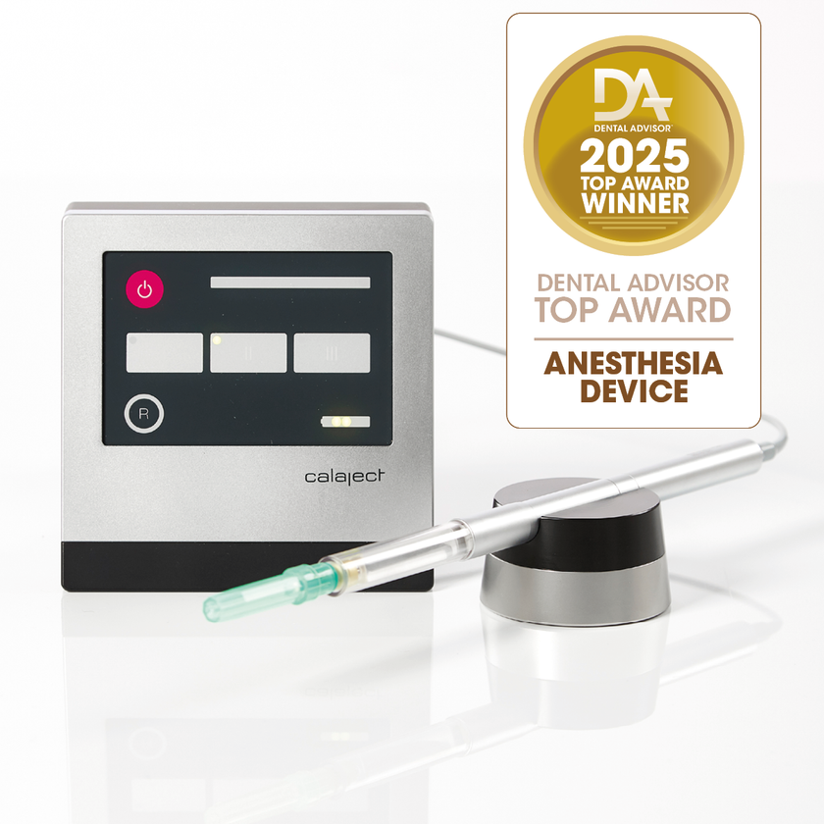
DESIGNED FOR PRECISION. MADE FOR TRUST.
Maintenance & warranty
RELIABLE AND DURABLE DESIGN
→ Built for long-term clinical use
→ Easy daily cleaning
→ Autoclavable components
→ 2-year manufacturer warranty

Slide 16

DESIGNED FOR PRECISION. MADE FOR TRUST.
TRUSTED BY DENTAL PROFESSIONALS WORLDWIDE
→
Dental Advisor Top Award Winner
→
Dentistry Today – Readers’ Choice
→
Catapult – trusted by experts
→
Top 100 Dental Products

Slide 17
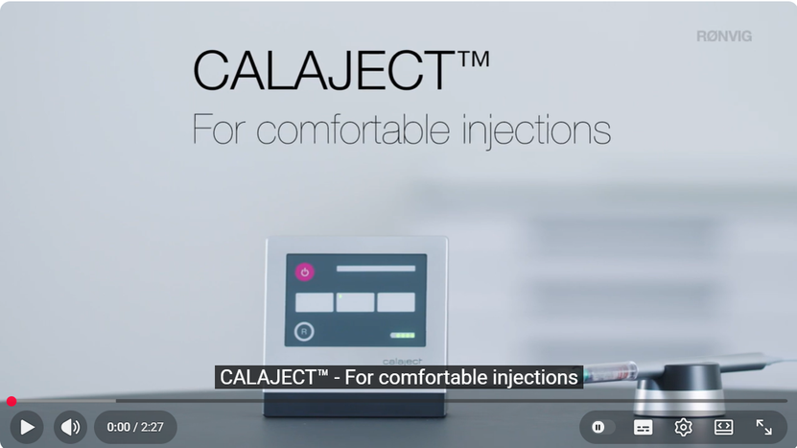

DESIGNED FOR PRECISION. MADE FOR TRUST.
See it in action
WATCH HOW CALAJECT WORKS IN PRACTICE

Slide 18
DESIGNED FOR PRECISION. MADE FOR TRUST.
®
Experience the difference with CALAJECT
A SMARTER, GENTLER WAY TO INJECT

