Slide 1

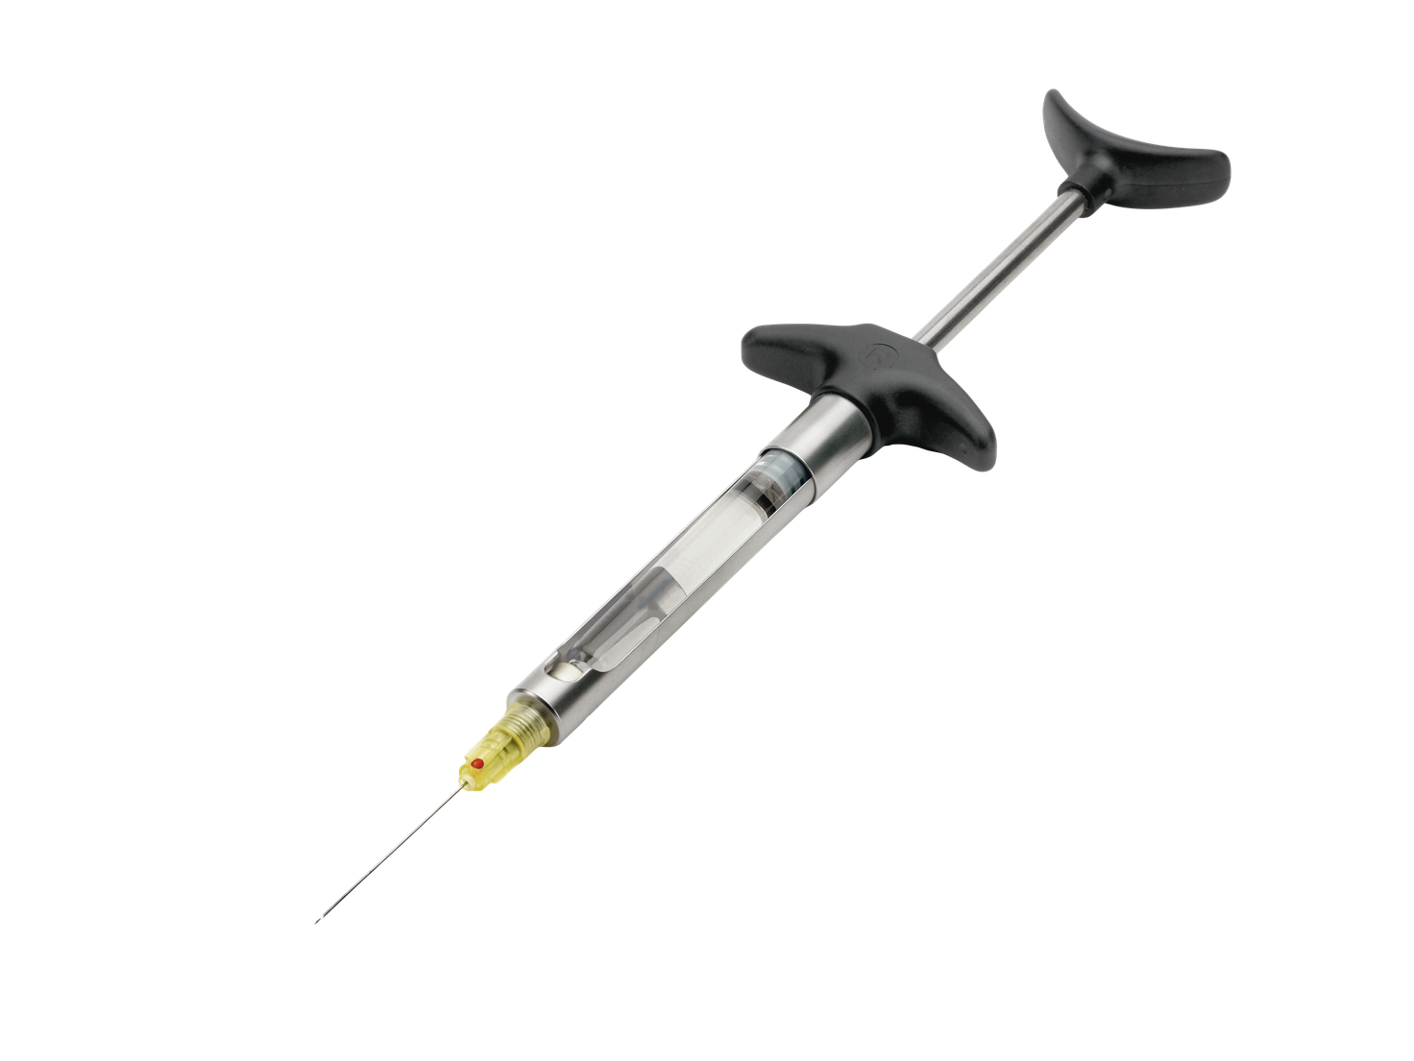
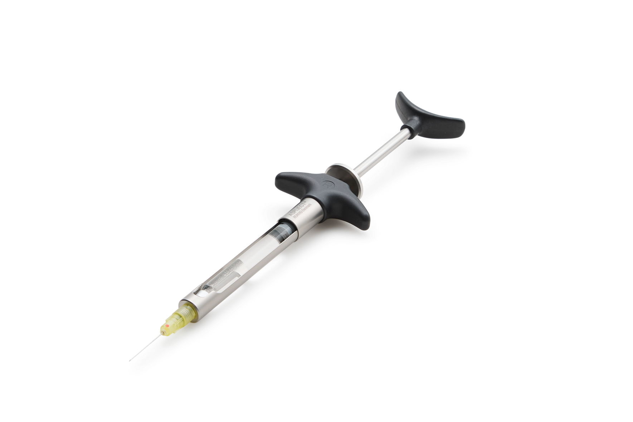
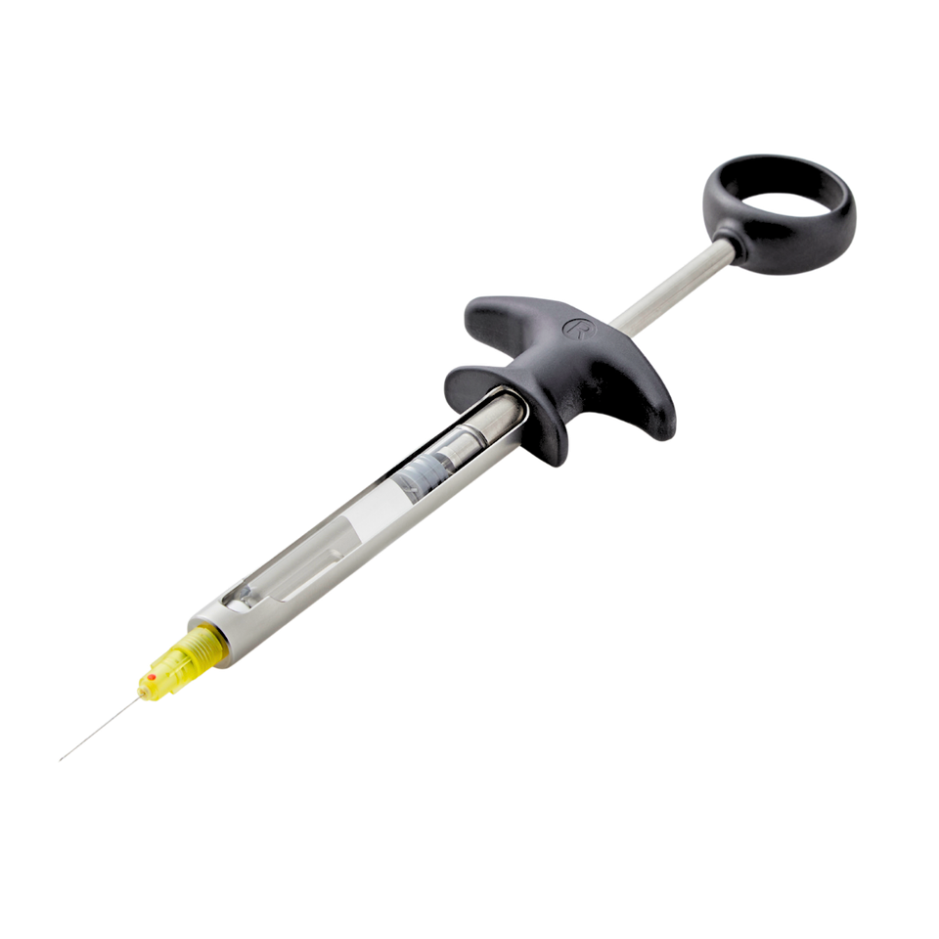
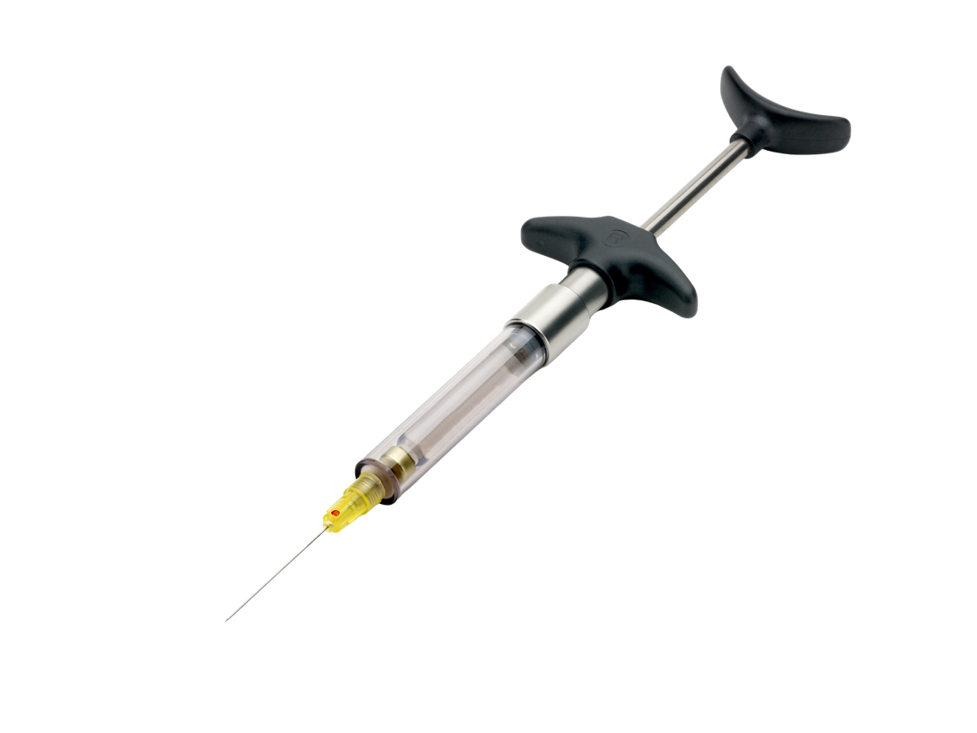
DESIGNED FOR PRECISION. MADE FOR TRUST.
ASPIJECT
®
The world of ASPIJECTs
For dental local anaesthesia

Slide 2
DESIGNED FOR PRECISION. MADE FOR TRUST.
The ASPIJECT variants
®
ASPIJECT PASSIVE
Let’s go into the world of ASPIJECT
ASPIJECT ACTIVE COMPACT
→ We offer ASPIJECT versions
→ ASPIJECT PASSIVE
→ ASPIJECT ACTIVE COMPACT - With Harpoon plunger tip
→ ASPIJECT ACTIVE COMPACT - With Threaded plunger tip
→ ASPIJECT PLUS
→ ASPIJECT SIS
ASPIJECT PLUS
ASPIJECT SIS

Slide 3
DESIGNED FOR PRECISION. MADE FOR TRUST.
THE DNA OF ALL ASPIJECT
®
ENGINEERED FOR PRECISION, COMFORT AND CONTROL

Slide 4
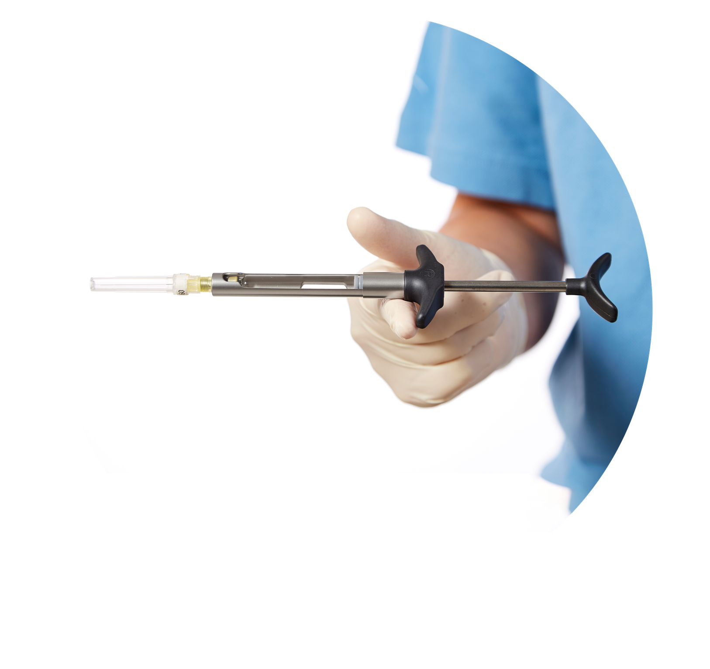
DESIGNED FOR PRECISION. MADE FOR TRUST.
Control & Balance
DESIGNED FOR PRECISION YOU CAN FEEL
→ Perfectly balanced instrument
→ Stable handling during injection
→ High tactile feedback
→ Smooth delivery - frictionless movement of the piston

Slide 5
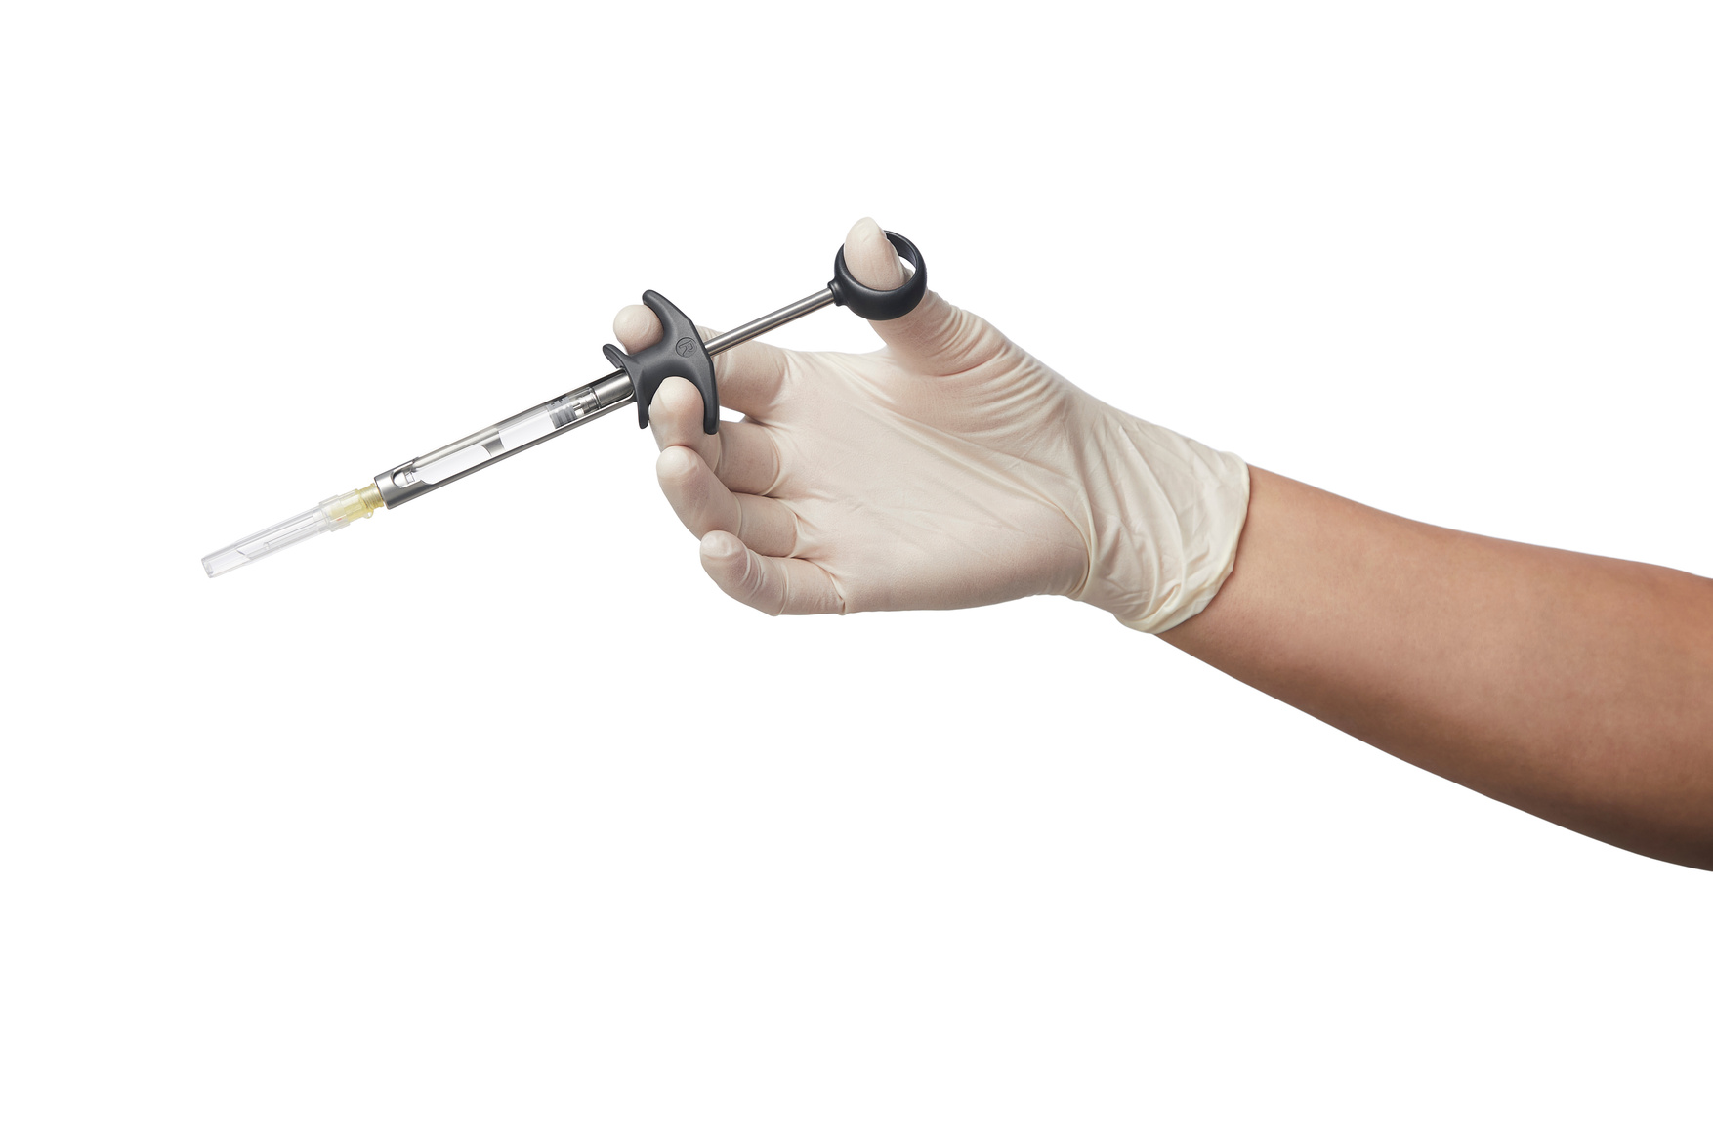
DESIGNED FOR PRECISION. MADE FOR TRUST.
Ergonomic design
BUILT FOR DAILY CLINICAL USE
→ Made from acid-resistant stainless steel
→ Heat-resistant high-performance polymer
→ Unobstructed view of cartridge
→ Surface of the syringe has a matt finish - does not reflect sharp light.
→ Lightweight
→ Short finger distance – ideal for smaller hands
→ Proven quality and very long lifetime

Slide 6
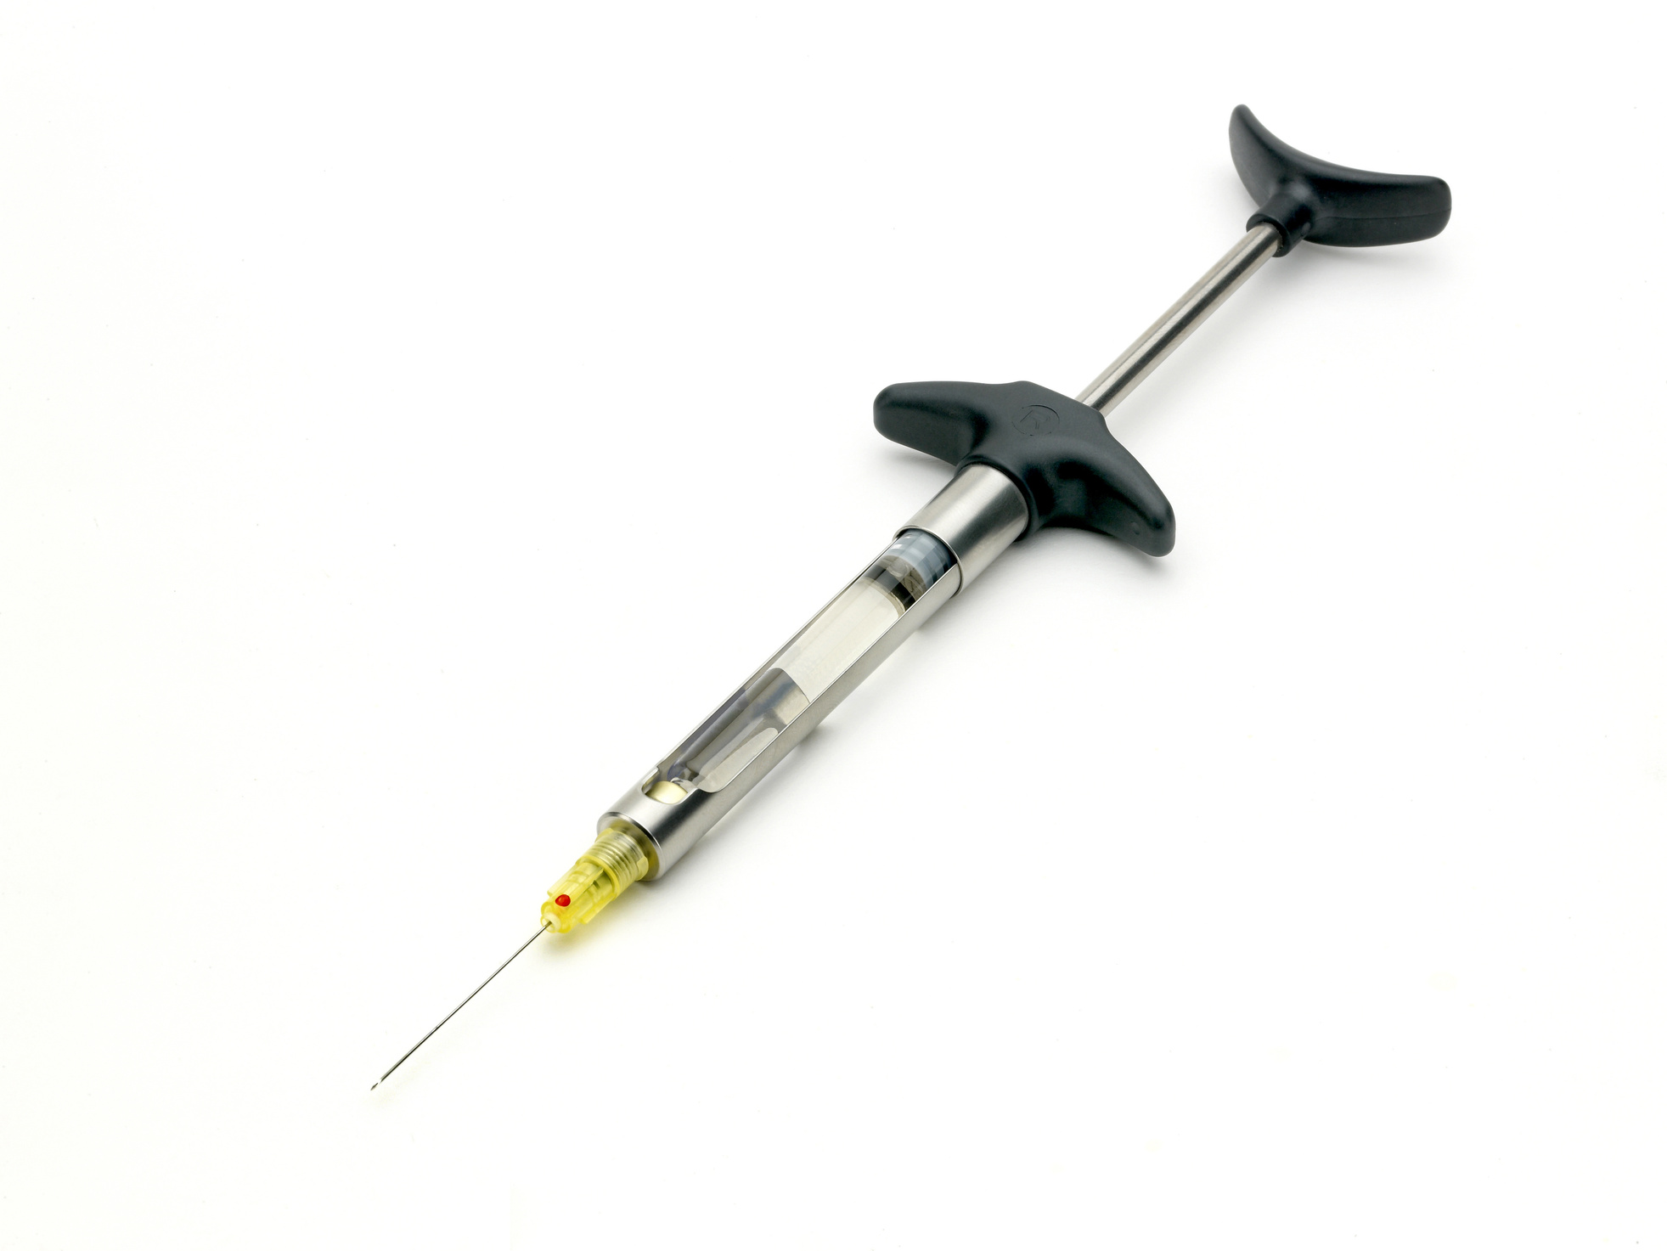
DESIGNED FOR PRECISION. MADE FOR TRUST.
Full flexibility
ADAPTS TO YOUR DAILY CLINICAL NEEDS
→ Works with standard dental cartridges 1,8 ml and 2,2 ml
→ For infiltration and block anaesthesia

Slide 7
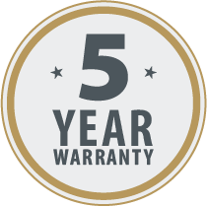
DESIGNED FOR PRECISION. MADE FOR TRUST.
Maintenance & Warranty
MADE FOR LONG-LASTING USE
→ Durable materials for repeated use
→ Tolerates processing in washer-disinfector and autoclave
→ 5-year warranty on material and construction

Slide 8
DESIGNED FOR PRECISION. MADE FOR TRUST.
ASPIJECT PASSIVE
®
Self-aspirating dental cartridge syringe for infiltration and block anaesthesia.

Slide 9
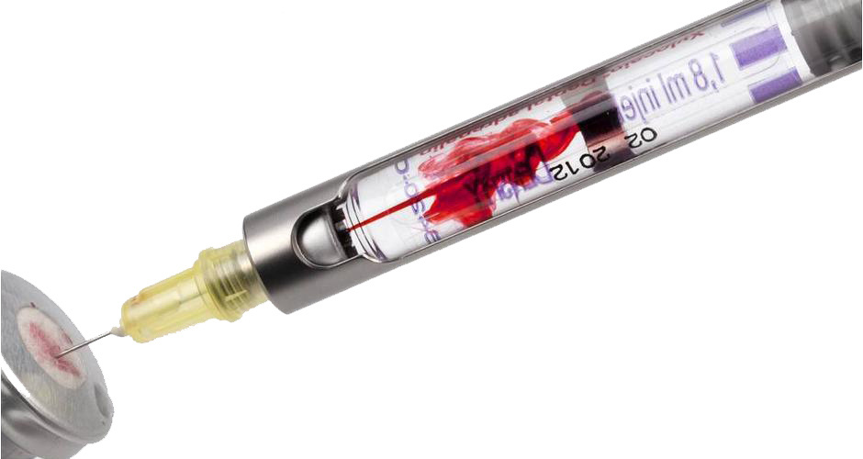
DESIGNED FOR PRECISION. MADE FOR TRUST.
Self-Aspiration
→ Self-aspirating without pullback
→ Self-aspiration activated by light pressure
→ No manual retraction required
→ Stable needle position during aspiration

Slide 10
DESIGNED FOR PRECISION. MADE FOR TRUST.
About ASPIJECT PASSIVE
®
→ The first ASPIJECT
→ ASPIJECT was introduced in 1981
→ The original ASPIJECT dental cartridge syringe was
developed by Rønvig in collaboration with Dr. odont. h.c.
Hans Evers, Sweden.

Slide 11
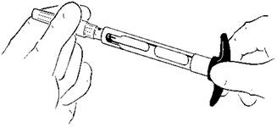
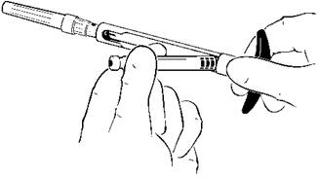
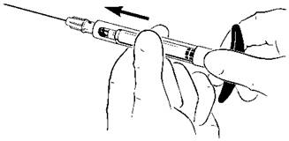
DESIGNED FOR PRECISION. MADE FOR TRUST.
How to load ASPIJECT
Quick and simple preparation
  Attach the needle before inserting the cartridge
  Insert the cartridge by the rear first
  Push the cartridge forward before injection
  Ensure correct needle positioning

Slide 12
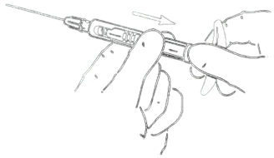
DESIGNED FOR PRECISION. MADE FOR TRUST.
How to unload
Quick removal and cartridge replacement
  Slide the cartridge back from the needle
  Invert the syringe
  Remove the cartridge safely

Slide 13
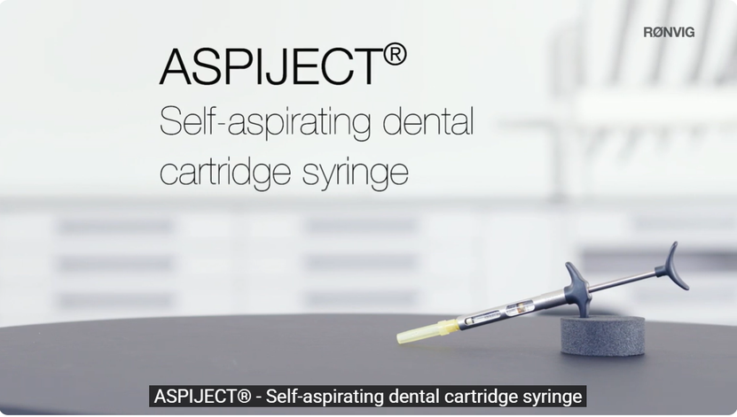
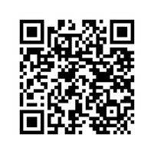
DESIGNED FOR PRECISION. MADE FOR TRUST.
Watch it in action
SEE HOW ASPIJECT WORKS IN PRACTICE

Slide 14
DESIGNED FOR PRECISION. MADE FOR TRUST.
ASPIJECT PLUS
®
Injection syringe with extra powerful aspiration
Achieve an extra aspiration option with ASPIJECT® PLUS - independant of cartridge brand used.

Slide 15
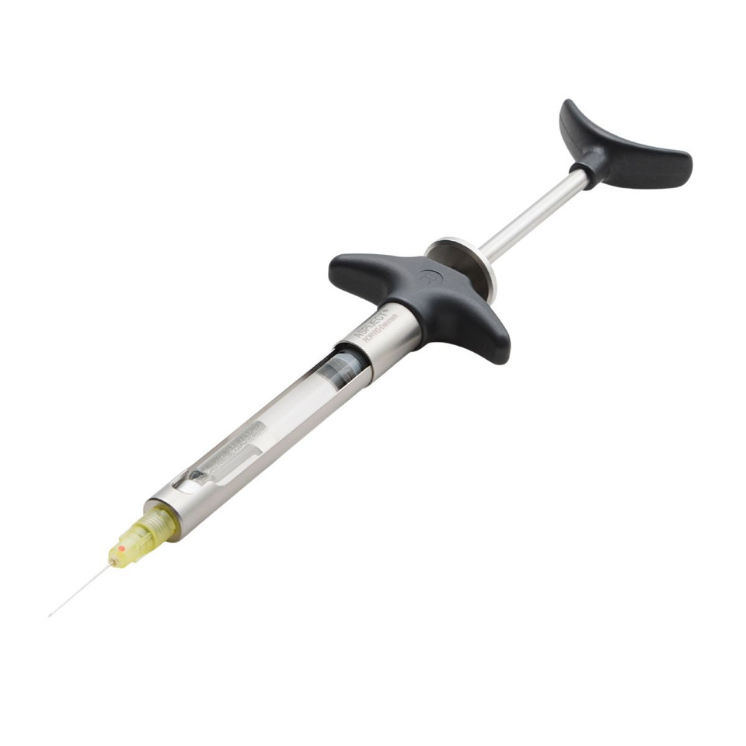

DESIGNED FOR PRECISION. MADE FOR TRUST.
Extra Aspiration Power
→ Self-aspirating without pullback
→ Independent aspiration mechanism
→ Overcomes variations in rubber stopper friction
→ Activated via aspiration disc
→ Consistent and visible aspiration feedback
→ ASPIJECT® PLUS features an extra aspiration possibility which is
completely independent of the elastic properties and friction of the
rubber plunger. By pressing the aspiration disc, a very clear aspiration
result is produced, regardless of used cartridge brand.

Slide 16
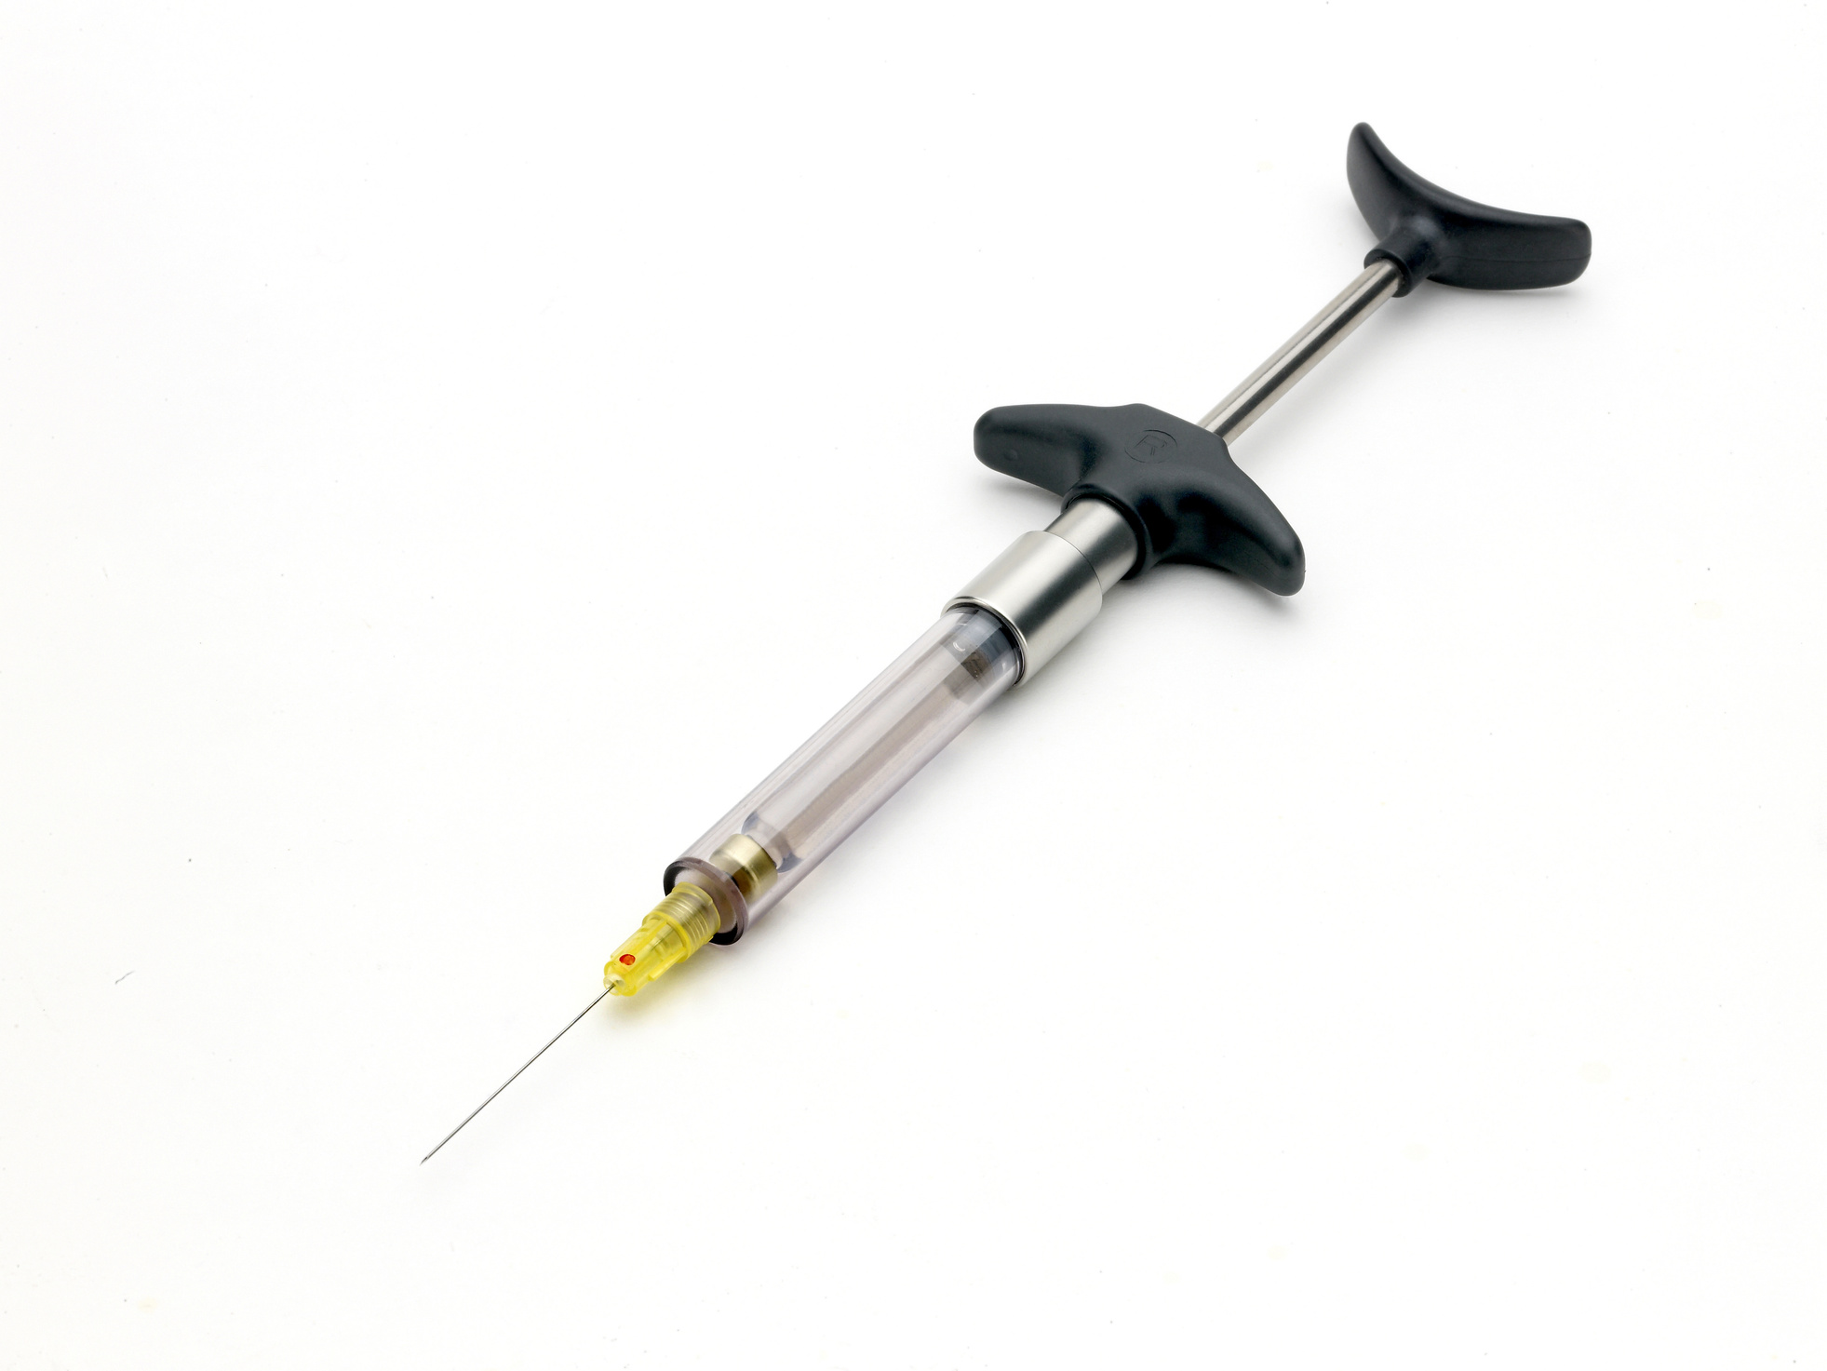
DESIGNED FOR PRECISION. MADE FOR TRUST.
ASPIJECT SIS
®
Sterile Injection System
Specially designed for use during surgical procedures.

Slide 17
DESIGNED FOR PRECISION. MADE FOR TRUST.
Self-Aspiration
→ Self-aspirating without pullback
→ Automatic aspiration occurs whenever the piston is
released.

Slide 18
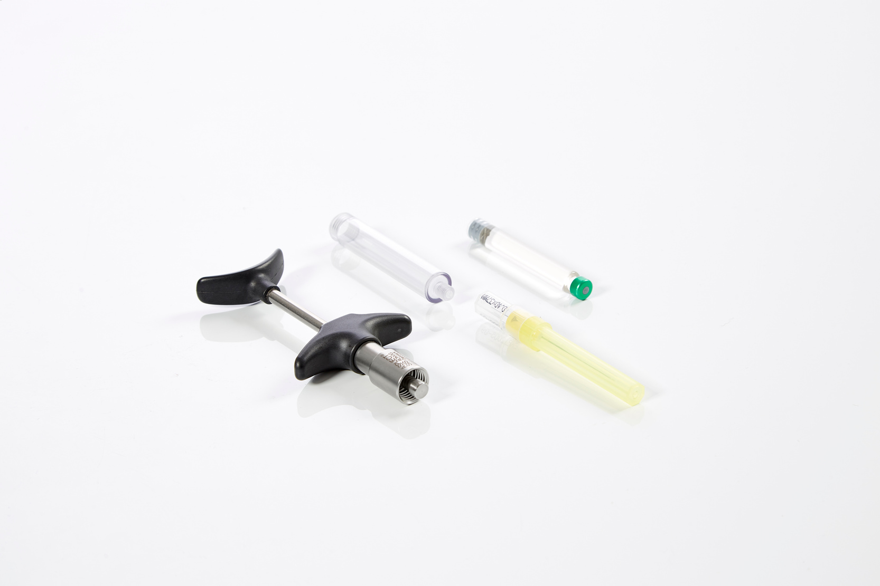
DESIGNED FOR PRECISION. MADE FOR TRUST.
About ASPIJECT SIS
→ The sterile injection system is obtained while the
cartridge is completely encapsulated in the sterile,
transparent cartridge barrel
→ The cartridge barrels are supplied in packs of three pcs.
Autoclavable at max. 135°/275°F.
→ Takes standard dental cartridges and needles

Slide 19
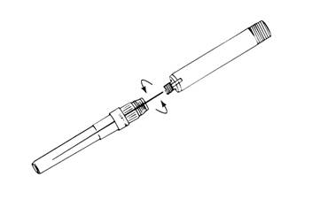
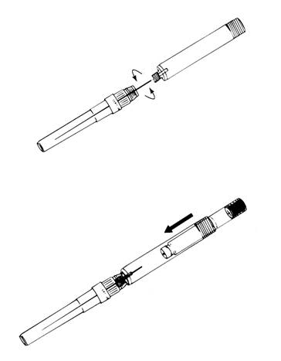
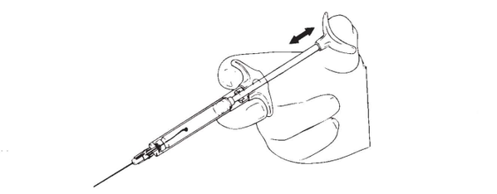
DESIGNED FOR PRECISION. MADE FOR TRUST.
How to load ASPIJECT SIS
Quick and safe preparation
  The non-sterile assistant screws on needle while sterile surgeon holds the barrel.
  The non-sterile assistant inserts the cartridge from the rear.
  The sterile surgeon screws on the barrel onto the sterile finger-grip

Slide 20
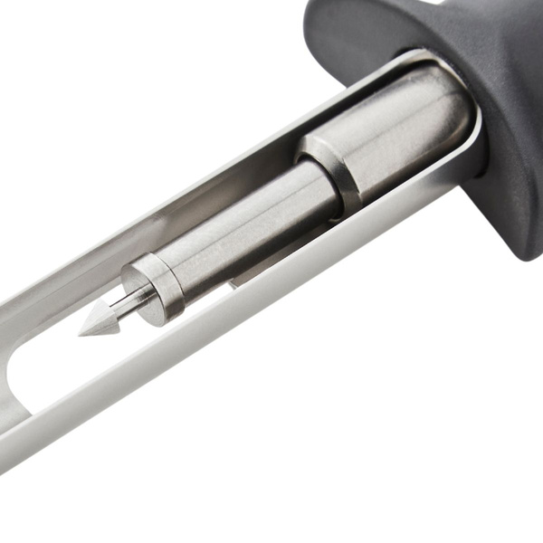
DESIGNED FOR PRECISION. MADE FOR TRUST.
ASPIJECT
ACTIVE COMPACT
®
With harpoon plunger tip
Cartridge syringe with active aspiration and unique ergonomic benefits

Slide 21
DESIGNED FOR PRECISION. MADE FOR TRUST.
Active Aspiration
Controlled aspiration with in every injection
→ Active aspiration (pull-back) - only a slight pull-back is needed
→ The ergonomic grip allows for a excellent control over the
syringe during aspiration and injection.

Slide 22
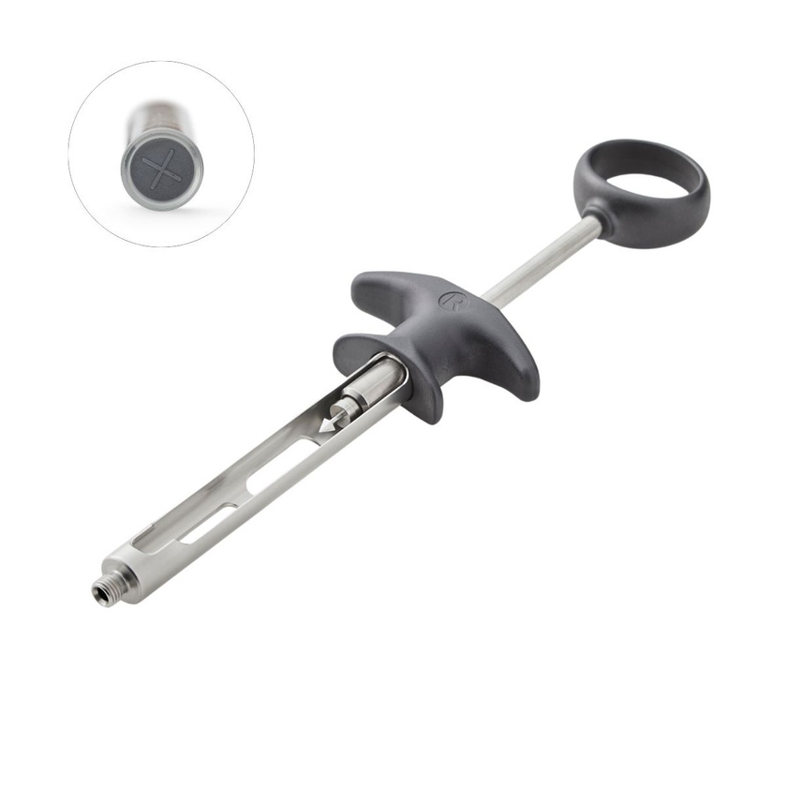
DESIGNED FOR PRECISION. MADE FOR TRUST.
About ASPIJECT ACTIVE COMPACT
With harpoon plunger tip
→ Harpoon plunger tip for flat rubber stoppers
→ Compact design fitting all hand sizes
→ Smooth delivery: The frictionless movement of the piston
permits a smooth and steady delivery of the anesthetic,
enhancing tactile control and patient comfort.

Slide 23
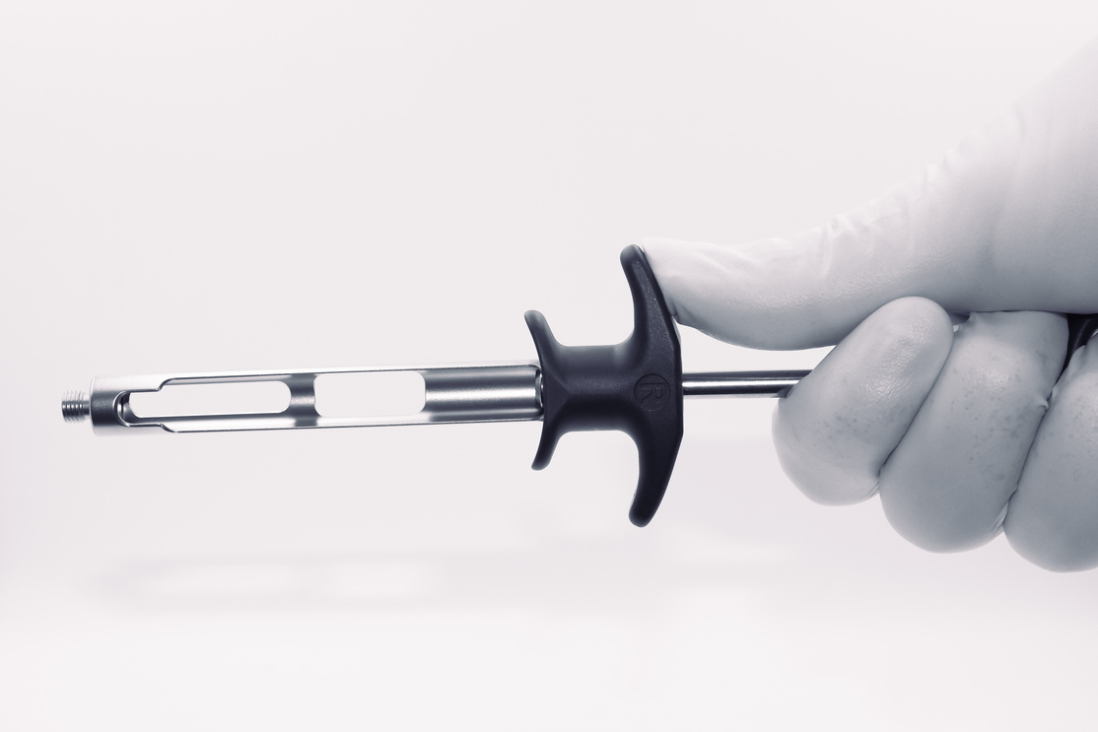
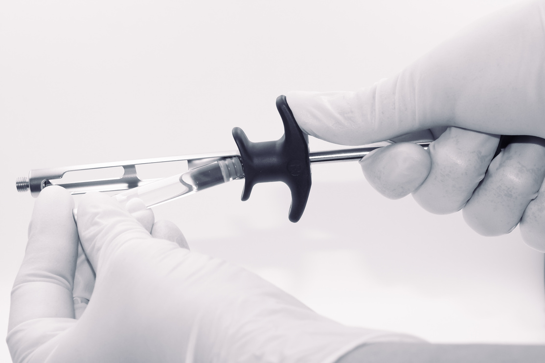
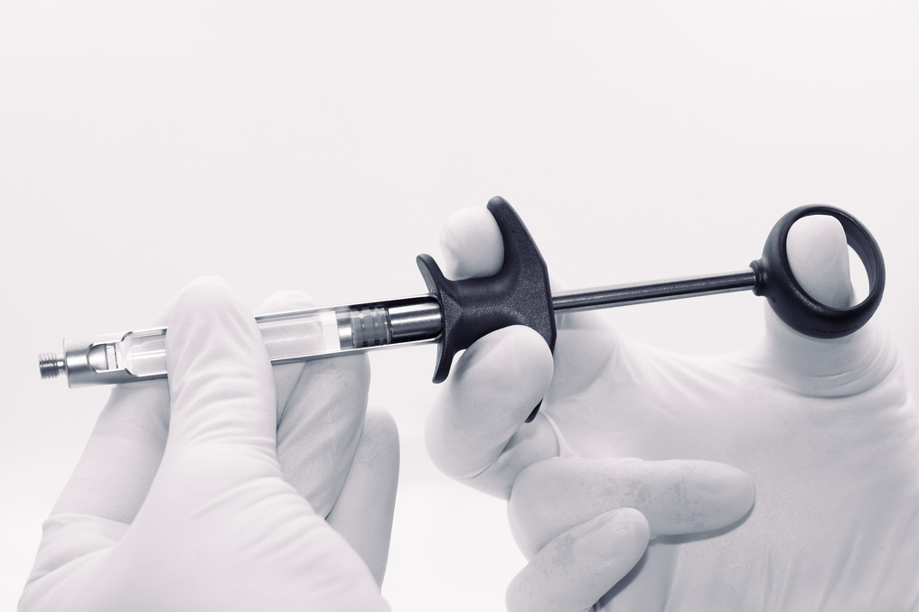
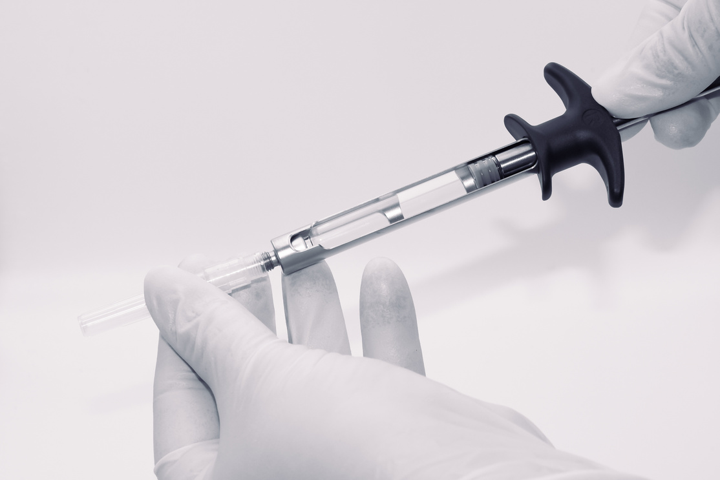
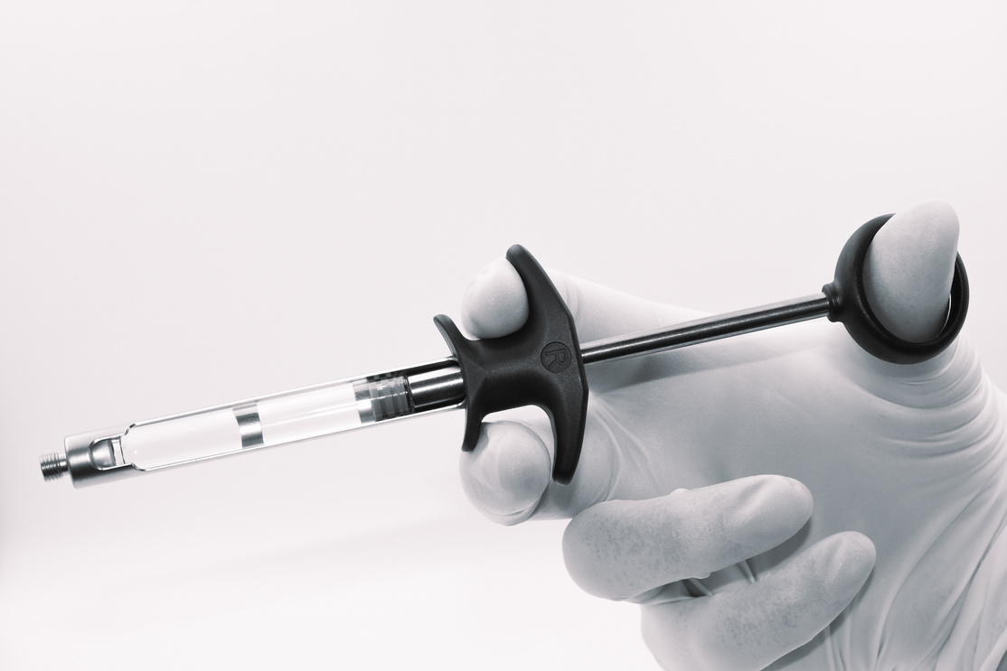
DESIGNED FOR PRECISION. MADE FOR TRUST.
How to load ASPIJECT ACTIVE COMPACT
With harpoon plunger tip
Quick and simple preparation
Fig. 1
  Retract piston rod fully, fig. 1.
  Insert a cartridge with the rubber plunger first, fig. 2.
  Hold the cartridge firmly in place. Push the piston rod forward to attach the harpoon to the rubber plunger, fig. 3.
  Screw on a standard dental needle, fig. 4.
  Active aspiration is achieved by pulling back on the thumb ring, fig. 5.
Fig. 2
Fig. 3
Fig. 4
Fig. 5

Slide 24
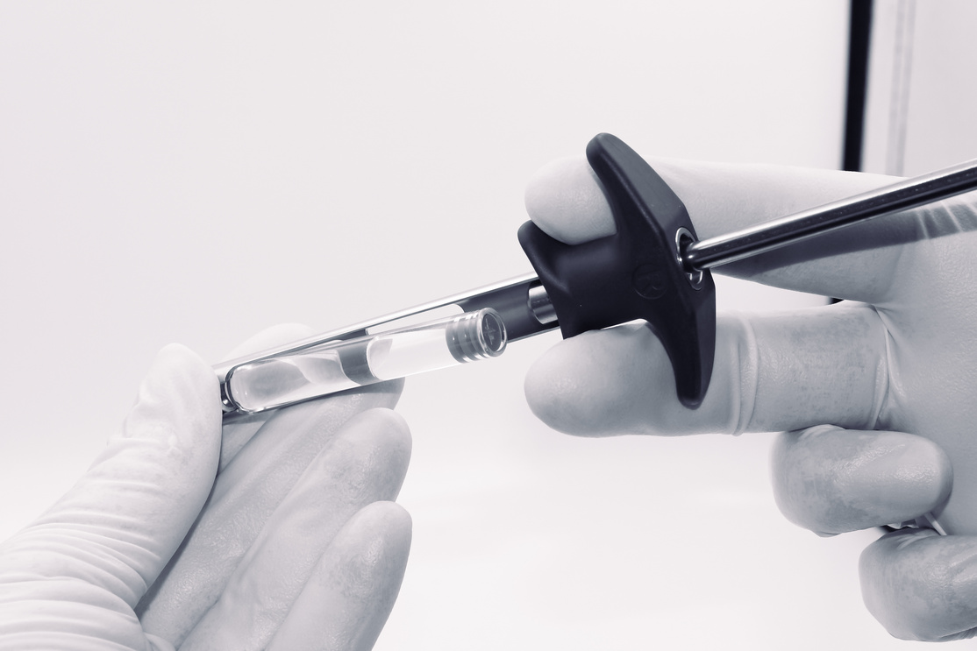
DESIGNED FOR PRECISION. MADE FOR TRUST.
How to unload
Simple and hygienic removal
  After the injection, unscrew the needle, fig. 1.
  Draw the piston rod completely back. Tilt syringe to let the cartridge fall into your other hand, fig. 2.
Fig. 1
Fig. 2

Slide 25
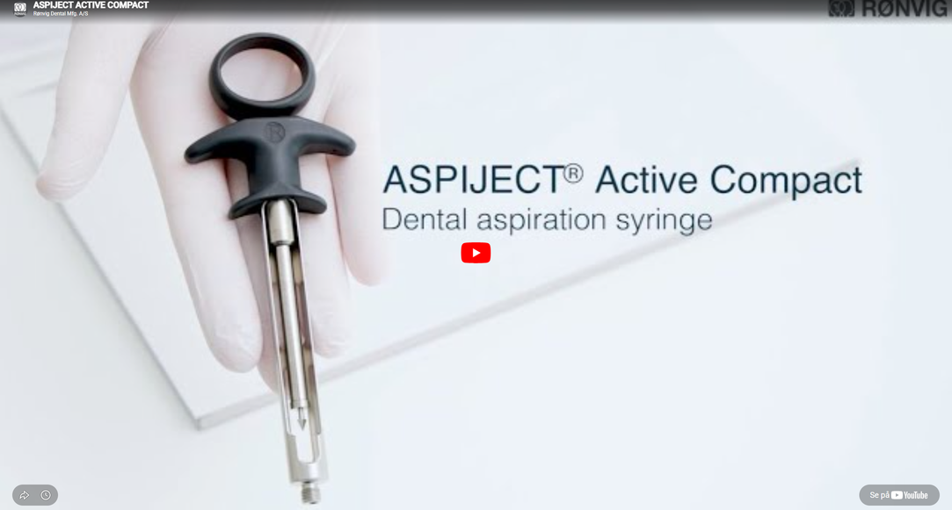
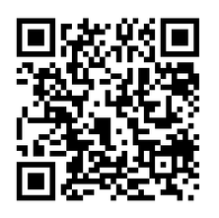
DESIGNED FOR PRECISION. MADE FOR TRUST.
Watch it in action
SEE HOW ASPIJECT WORKS IN PRACTICE

Slide 26
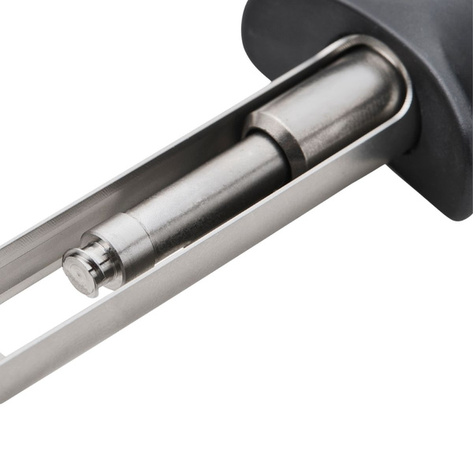
DESIGNED FOR PRECISION. MADE FOR TRUST.
ASPIJECT
ACTIVE COMPACT
®
With threaded plunger tip
Cartridge syringe with active aspiration and unique ergonomic benefits

Slide 27
DESIGNED FOR PRECISION. MADE FOR TRUST.
Active Aspiration
Controlled aspiration in every injection
→ Active aspiration (pull-back) - only a slight pull-back is needed
→ The ergonomic grip allows for a excellent control over the
syringe during aspiration and injection.

Slide 28
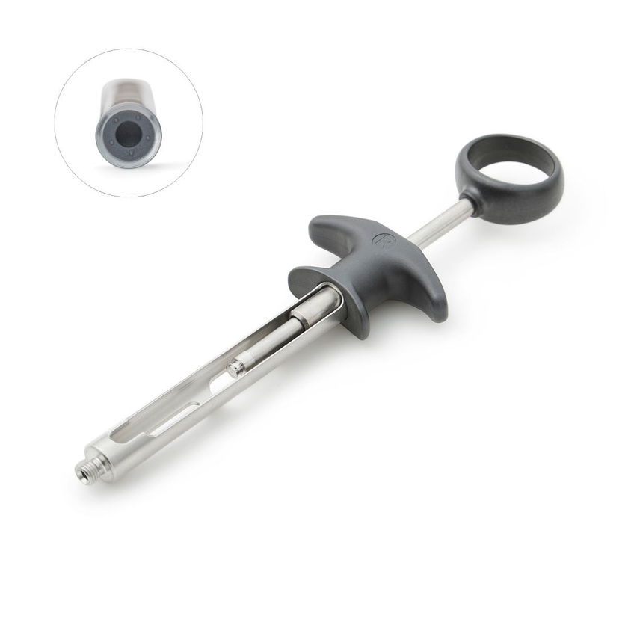
DESIGNED FOR PRECISION. MADE FOR TRUST.
About ASPIJECT ACTIVE COMPACT
With threaded plunger tip
→ Threaded plunger tip for recessed rubber stoppers
→ Compact design fitting all hand sizes.
→ Smooth delivery: The frictionless movement of the piston
permits a smooth and steady delivery of the anesthetic,
enhancing tactile control and patient comfort.

Slide 29
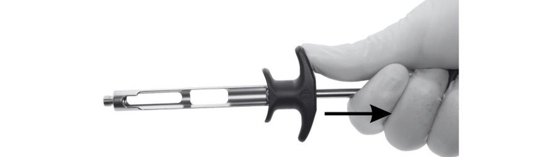
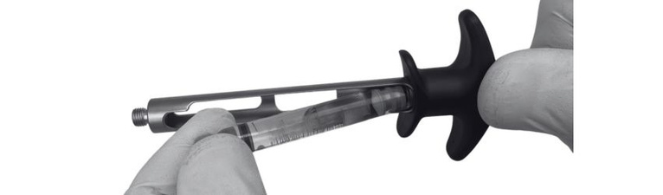
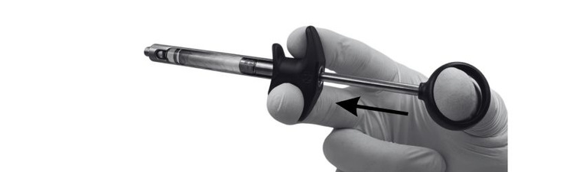
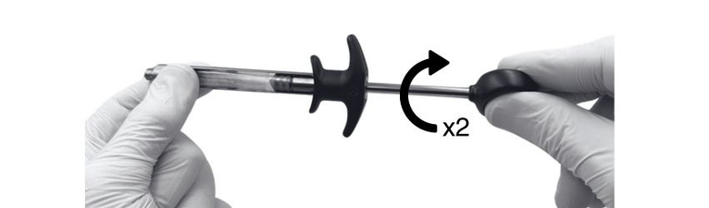
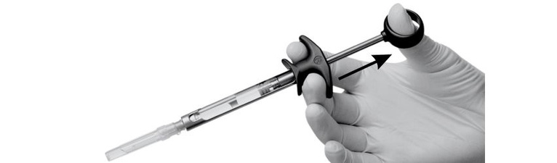
DESIGNED FOR PRECISION. MADE FOR TRUST.
How to load ASPIJECT ACTIVE COMPACT
With threaded plunger tip
Quick and simple preparation
Fig. 1
  Retract piston rod fully, fig. 1.
  Insert a cartridge with the rubber plunger first, fig. 2.
  Hold the cartridge firmly in place. Push the piston rod forward to attach the threaded plunger tip to the rubber plunger, fig. 3.
  Engage the threaded plunger tip by turning the plunger two half rotations clockwise, fig. 4. Screw on a standard dental needle.
  Active aspiration is achieved by pulling back on the thumb ring, fig. 5.
Fig. 2
Fig. 3
Fig. 4
Fig. 5

Slide 30
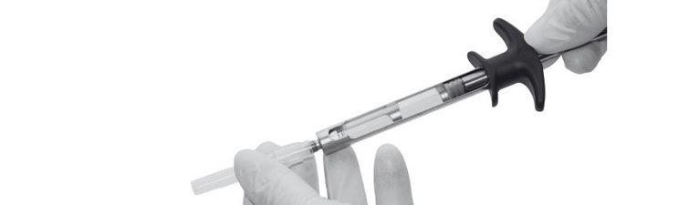
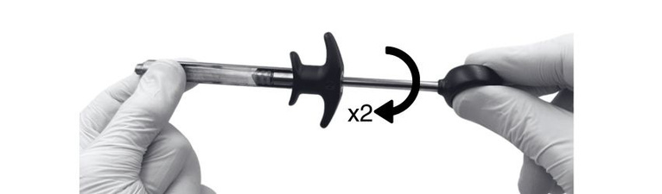
DESIGNED FOR PRECISION. MADE FOR TRUST.
How to unload
Easy removal
  After the injection, unscrew the needle, fig. 1.
  Rotate the plunger two half rotations counterclockwise. Draw the piston rod completely back. Tilt syringe to let the cartridge fall into your other hand, fig. 2.
Fig. 1
Fig. 2

Slide 31
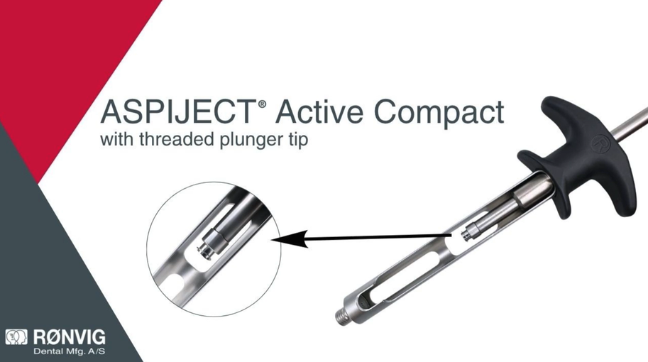
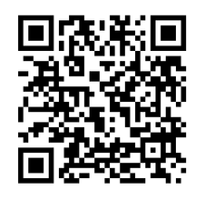
DESIGNED FOR PRECISION. MADE FOR TRUST.
Watch it in action
SEE HOW ASPIJECT WORKS IN PRACTICE

Slide 32
DESIGNED FOR PRECISION. MADE FOR TRUST.
Try the difference with ASPIJECT
®
A NATURAL EXTENSION OF YOUR HAND

