Slide 1

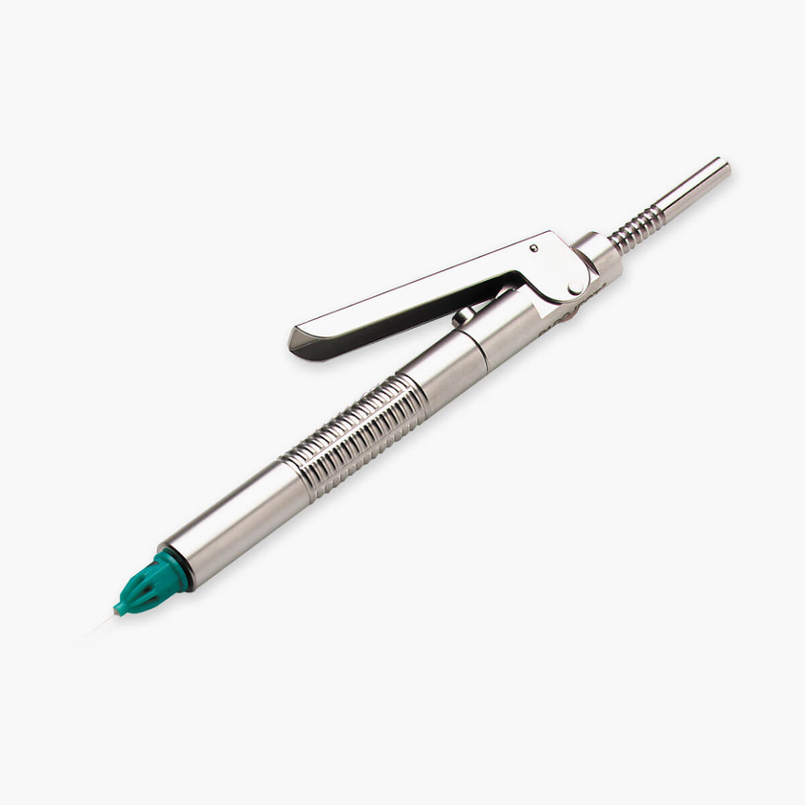
DESIGNED FOR PRECISION. MADE FOR TRUST.
®
PAROJECT
Precision in periodontal ligament anesthesia
Intraligamental syringe for controlled PDLA injections

Slide 2
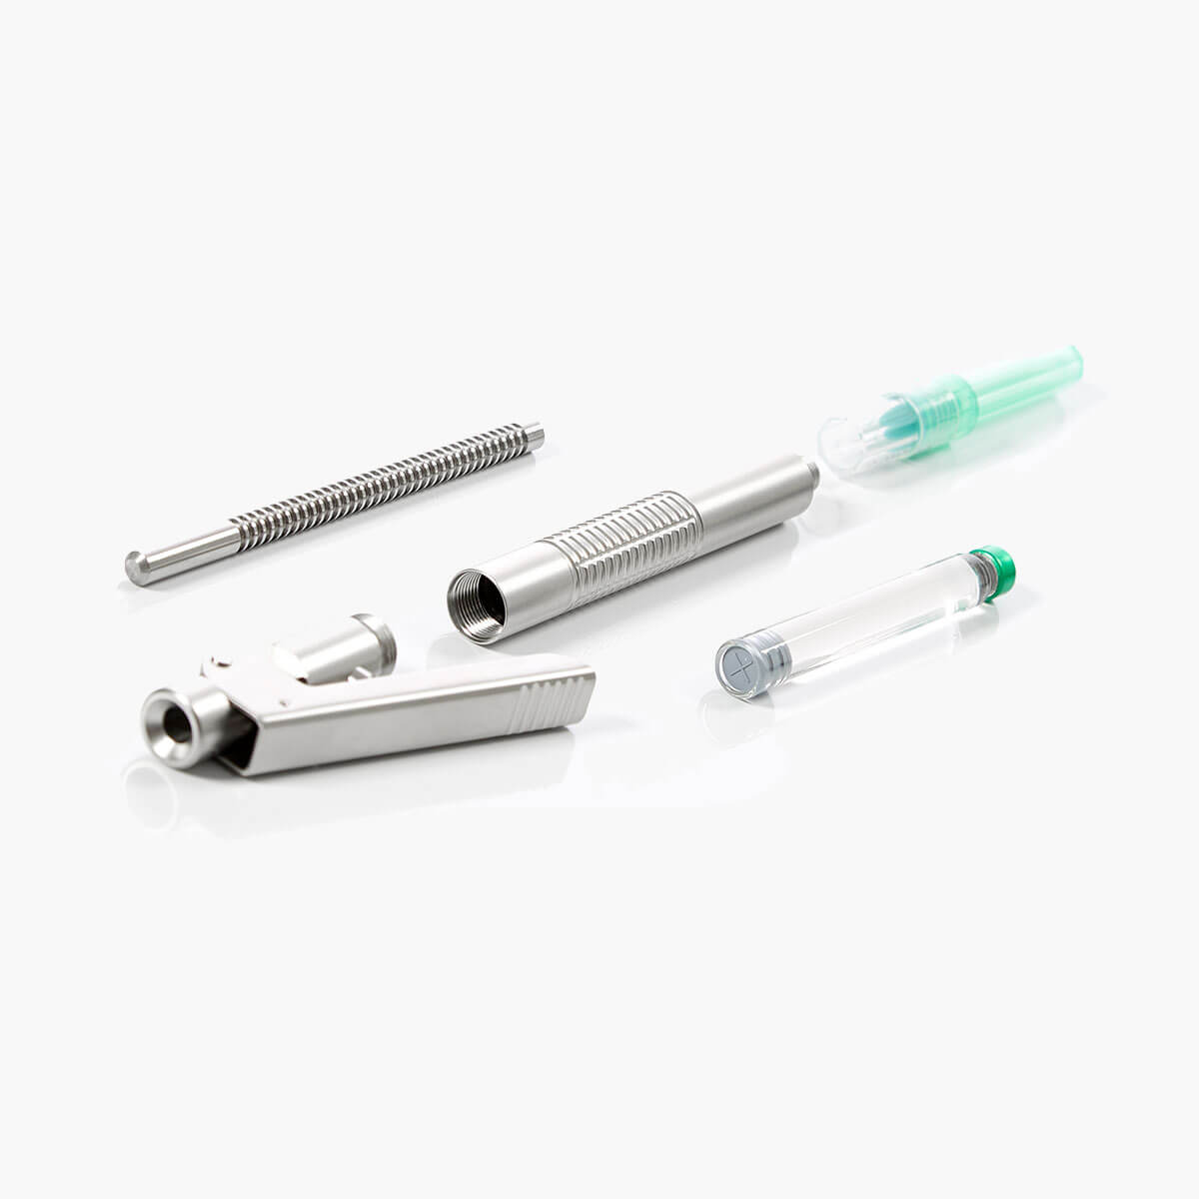
DESIGNED FOR PRECISION. MADE FOR TRUST.
About PAROJECT?
→ Designed for PDLA (intraligamental anesthesia)
→ Patientfriendly appearance - does not look like a syringe
→ Targets a single tooth with high precision
→ Uses standard cartridges and needles
→ A compact and user-friendly PDLA syringe with a controlled
small dosage permitting a slow non-traumatic injection.
Dosing 0.06 ml per click.

Slide 3
DESIGNED FOR PRECISION. MADE FOR TRUST.
What is PDLA?
PerioDontal Ligament Anesthesia
→ The anaesthetic solution is injected into the periodontal space
→ The anaesthetic solution diffuses through the spongious bone and blocks the pulpal nerve at the apex
→ Provides a very local effect – also known as “single tooth anaesthesia”
→ Used as a supplement or alternative to infiltration and block anaesthesia
→ No soft tissue anaesthesia - less risk of self-injury
→ Requires controlled pressure and should be performed with a syringe designed for PDLA
→ Efficient and patient friendly when performed correctly

Slide 4
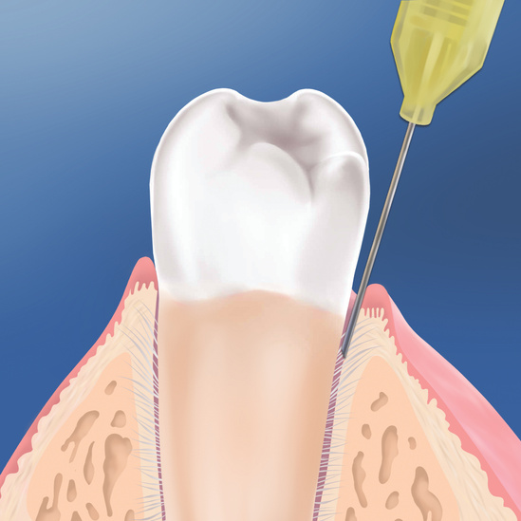
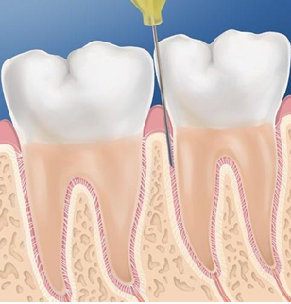
DESIGNED FOR PRECISION. MADE FOR TRUST.
®
PDLA with PAROJECT
→ Disinfect the injection site before treatment.
→ Insert the needle into gingival sulcus until contact with alveolar bone crest
→ Make sure bevel is facing the root surface
→ At the bottom of the sulcus, withdraw the needle slightly, rotate it, and direct the
opening toward the alveolar bone for optimal anaesthetic absorption.

Slide 5
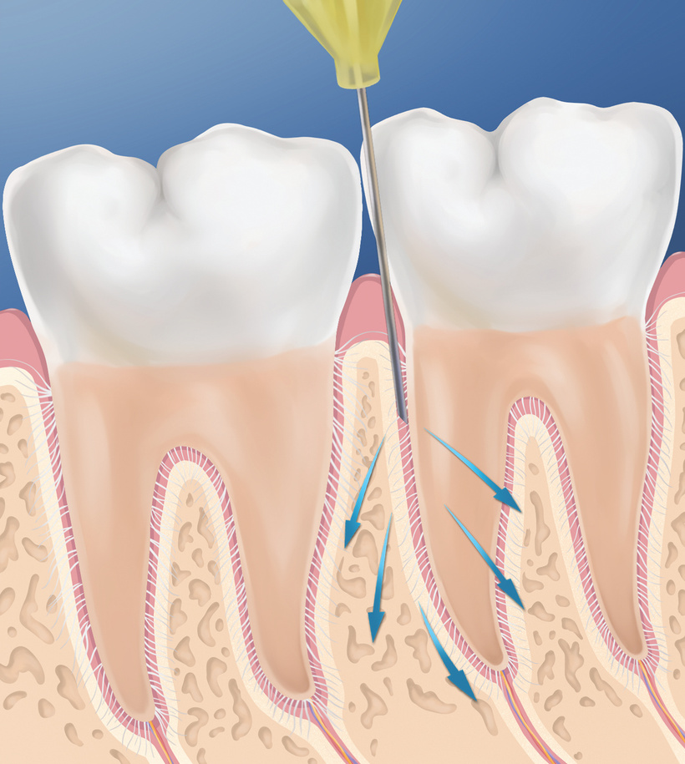
DESIGNED FOR PRECISION. MADE FOR TRUST.
®
PDLA with PAROJECT
→ Slowly deposit 0.2-0.9 ml of the anesthetic solution.
→ Have patience - 10-15 seconds per click.
→ During injection, slight tissue resistance should be felt; the
gingiva should turn pale at the injection site.
→ Pull out the needle; repeat the procedure for multi-rooted teeth.
→ Anaesthesia should take effect in 15-30 seconds and last for 30-
60 minutes.

Slide 6
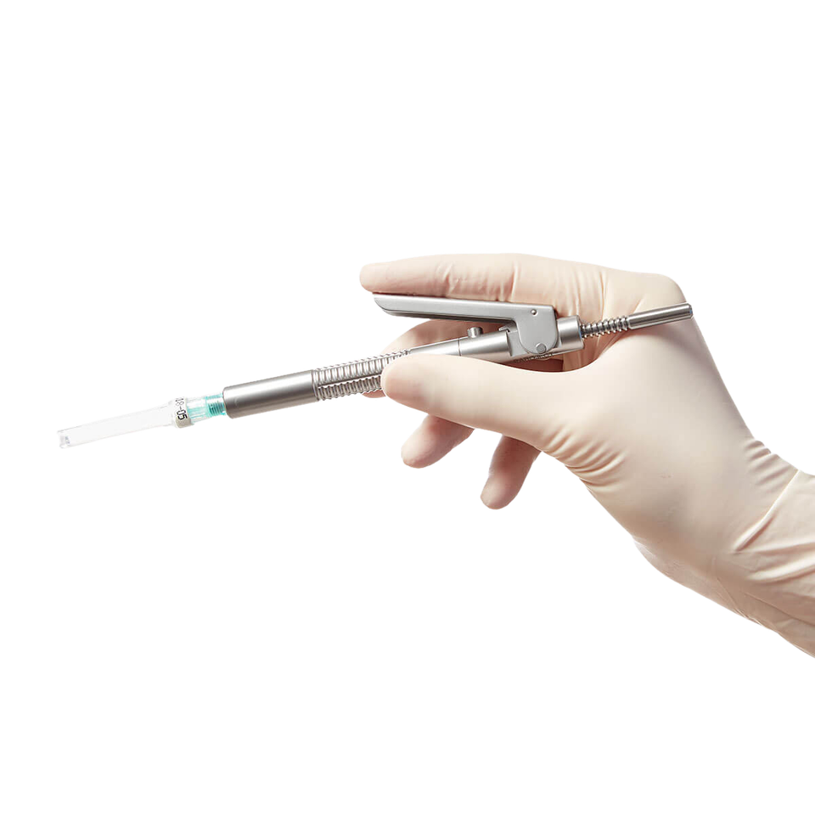
DESIGNED FOR PRECISION. MADE FOR TRUST.
Ergonomic Design
→ Made from high-grade acid resistant stainless steel
→ User friendly pen-grip design
→ Lightweight and balanced design
→ Excellent tactile feedback during injection

Slide 7
DESIGNED FOR PRECISION. MADE FOR TRUST.
Durability & Simplicity
BUILT TO LAST – DESIGNED FOR EASY HANDLING
→ High-grade stainless steel construction
→ No coating that can wear off
→ Simple design – easy to clean and maintain
→ Takes standard dental cartridges and needles

Slide 8
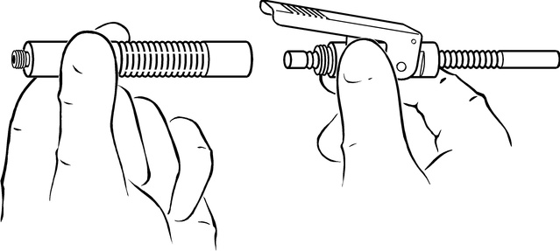
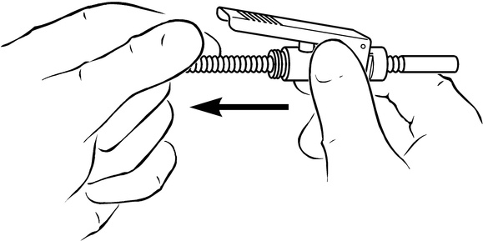
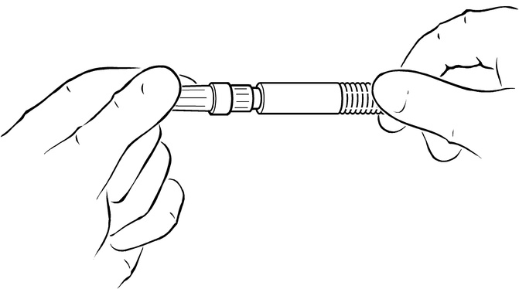
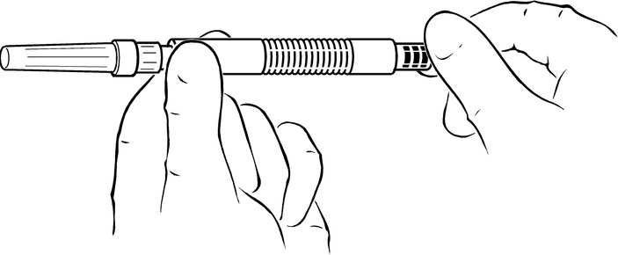
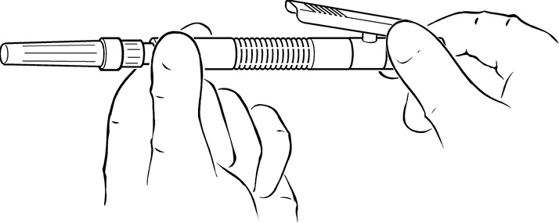
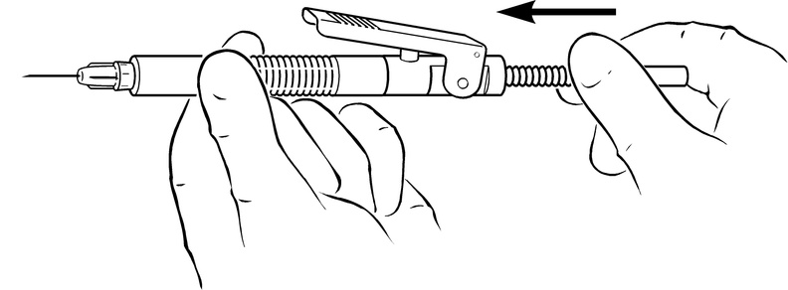
DESIGNED FOR PRECISION. MADE FOR TRUST.
How to load PAROJECT
Fig. 1
Quick and simple setup
Fig. 2
  Disassemble the syringe into two parts: front (barrel) and rear (lever housing), fig. 1.
  Remove the plunger by pulling the plunger through the lever housing, fig. 2.
  Screw on the disposable dental needle, fig. 3.
  Insert a standard dental cartridge into the barrel, fig. 4.
  Reassemble the syringe by screwing the barrel onto the lever housing, fig. 5.
  Insert the plunger into the lever housing and push it until contact is made with the cartridge, fig. 6.
NB! The plunger can only be inserted by the rear end of the lever housing, and with the smallest smooth part first.
Fig. 3
Fig. 4
Fig. 5
Fig. 6

Slide 9

DESIGNED FOR PRECISION. MADE FOR TRUST.
Maintenance & warranty
DESIGNED FOR LONG-TERM, RELIABLE USE
→ Sterilizable up to 134°C
→ Easy cleaning after each use
→ Durable materials for repeated use
→ 5-year warranty on material and construction

Slide 10
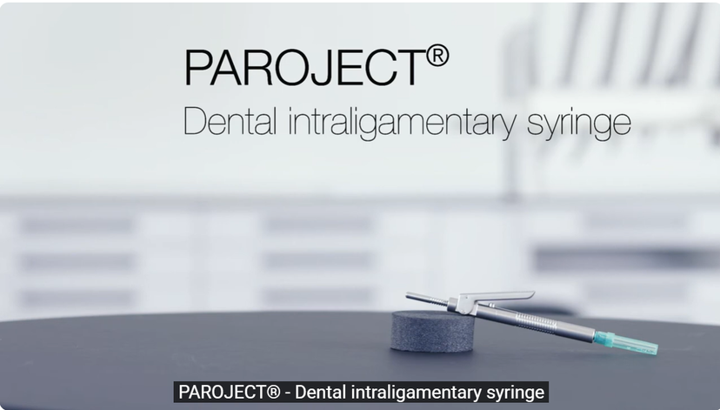
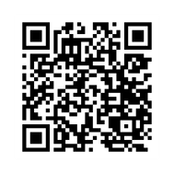
DESIGNED FOR PRECISION. MADE FOR TRUST.
Watch it in action
SEE HOW PAROJECT WORKS IN PRACTICE

Slide 11
DESIGNED FOR PRECISION. MADE FOR TRUST.
Try the difference with PAROJECT
®
PRECISION WHERE IT MATTERS MOST

