Slide 1
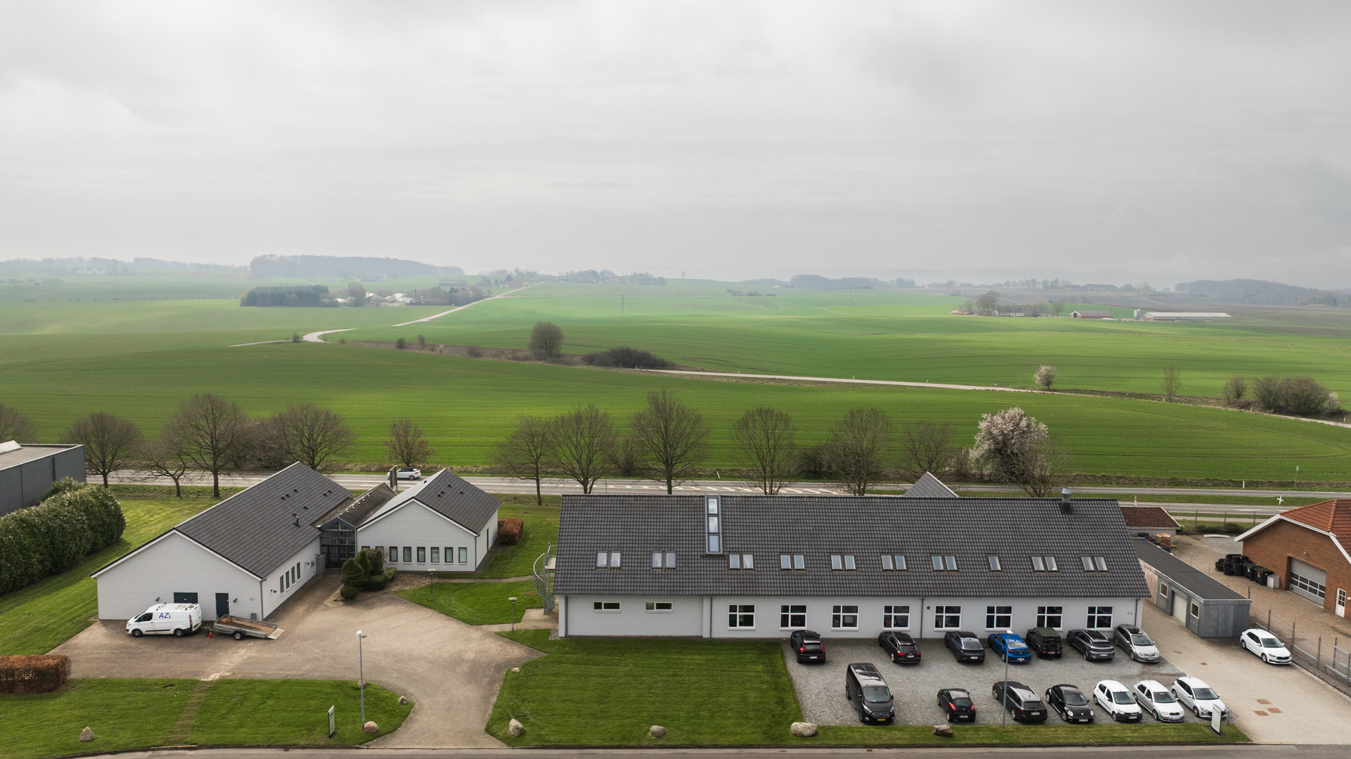

DESIGNED FOR PRECISION. MADE FOR TRUST.
RØNVIG Dental
Dental instruments • Handcrafted in Denmark

Slide 2

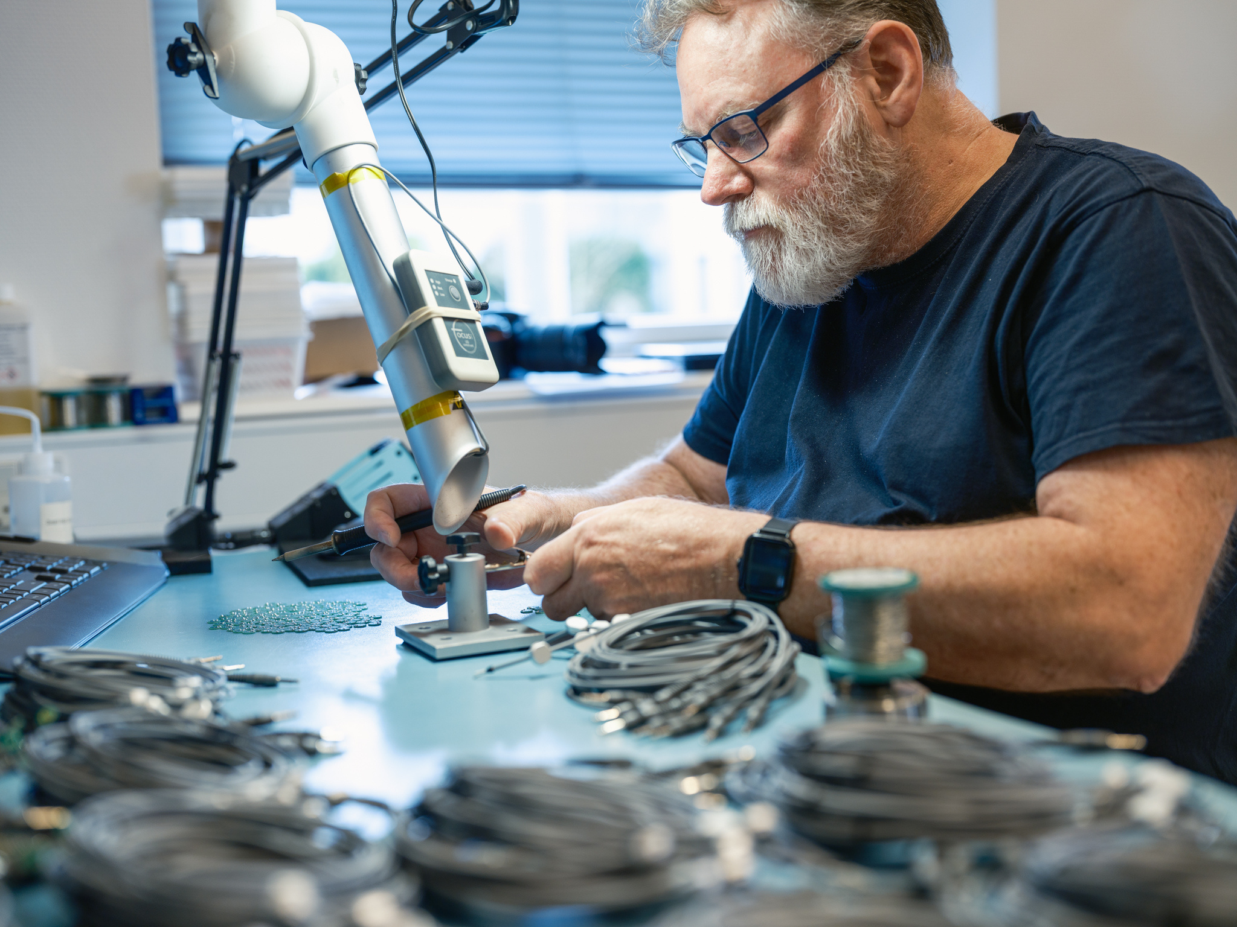
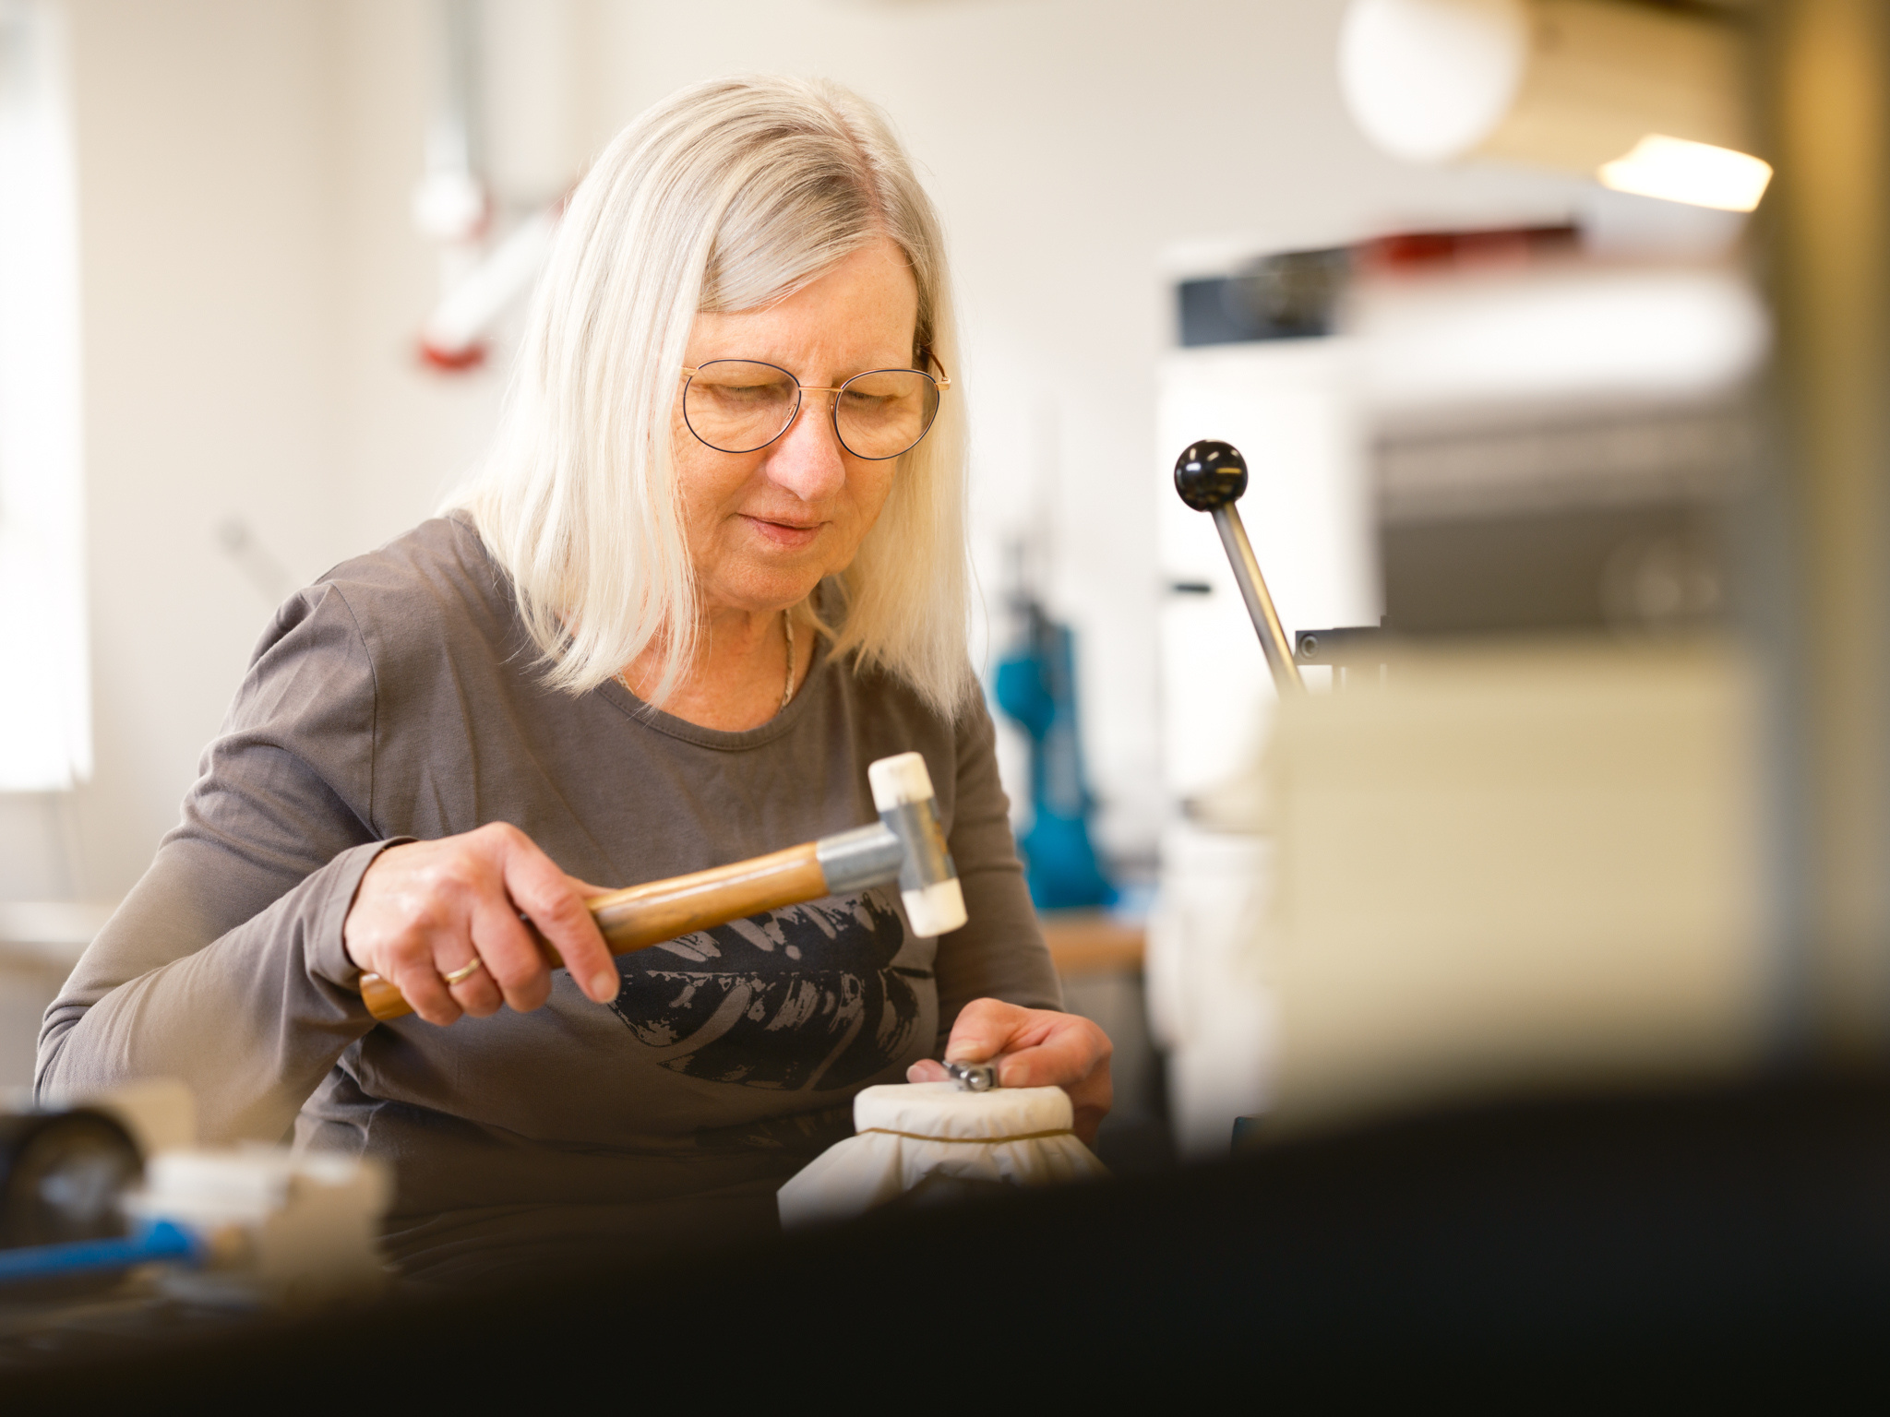
DESIGNED FOR PRECISION. MADE FOR TRUST.
About Rønvig
Danish dental quality since 1981
RØNVIG develops and manufactures high-quality dental instruments in Denmark.
Since 1981, we have focused on creating functional, reliable solutions that improve everyday clinical work – for both dentists and patients.
With full control of development and production, we ensure consistent quality and instruments that professionals trust.

Slide 3
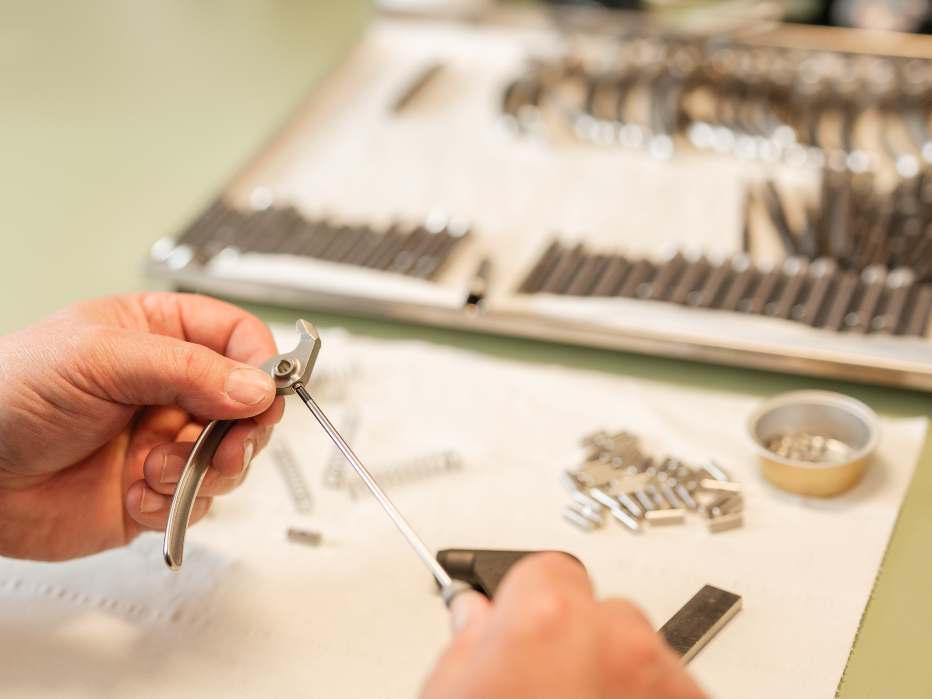
DESIGNED FOR PRECISION. MADE FOR TRUST.
Danish design. Dental precision.
RØNVIG is built on a simple idea:
better tools create better experiences.
We combine Danish design with precision engineering to create instruments that enhance both performance and comfort in everyday clinical work.

Slide 4
DESIGNED FOR PRECISION. MADE FOR TRUST.
Why RØNVIG stands out
A DIFFERENT APPROACH TO DENTAL INSTRUMENTS
Made in
Denmark
Designed for everyday use
Built
to last
Human-centered design
Full control of development and production.
Ergonomic tools for efficient workflows.
Built for durability and precision.
Developed with both the dentist and the patient in mind.

Slide 5
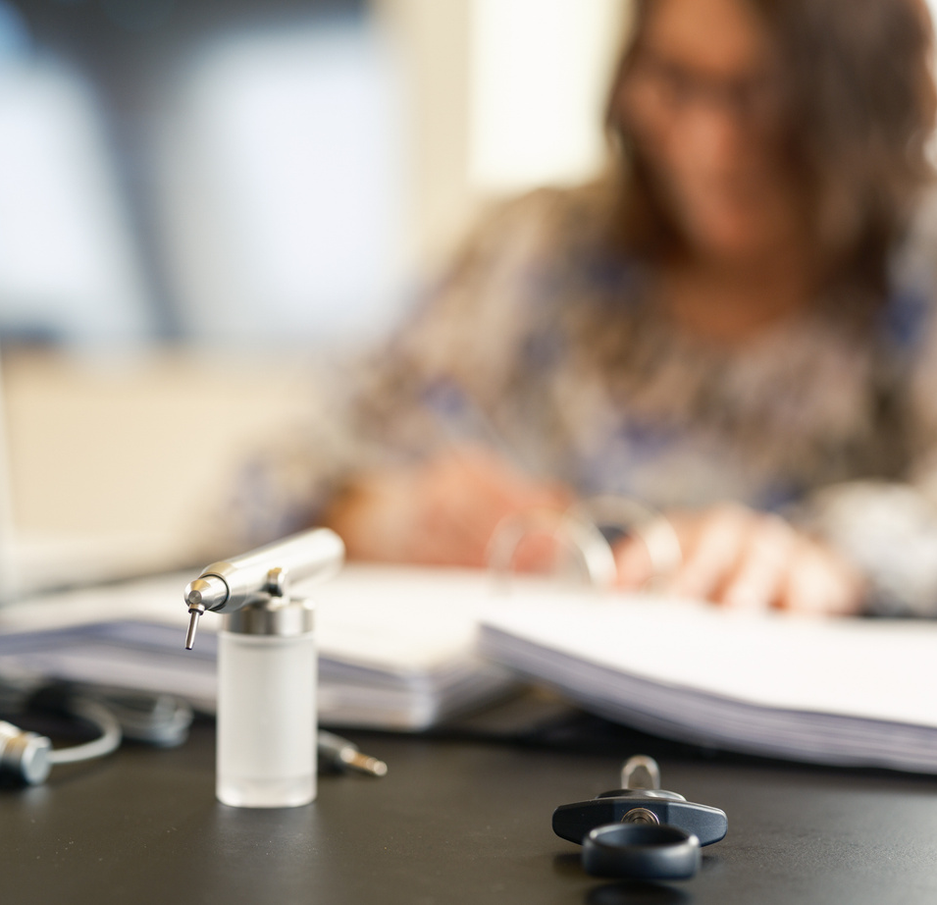
DESIGNED FOR PRECISION. MADE FOR TRUST.
Made in Denmark
From idea to finished instrument
All RØNVIG instruments are developed and manufactured at our facility in Denmark.
With full control of every step, we ensure precision and consistent quality.
Our instruments are assembled with care and undergo rigorous quality control – so professionals can rely on them every day.

Slide 6
DESIGNED FOR PRECISION. MADE FOR TRUST.
A brand professionals trust
TRUSTED BY DENTAL PROFESSIONALS WORLDWIDE
Global
presence
Export
strength
Long-term partnerships
Part of Directa Group
Trusted in 30+ countries
95% of production exported worldwide
Partnerships built over decades
Part of the Directa Dental Group
HE

Slide 7
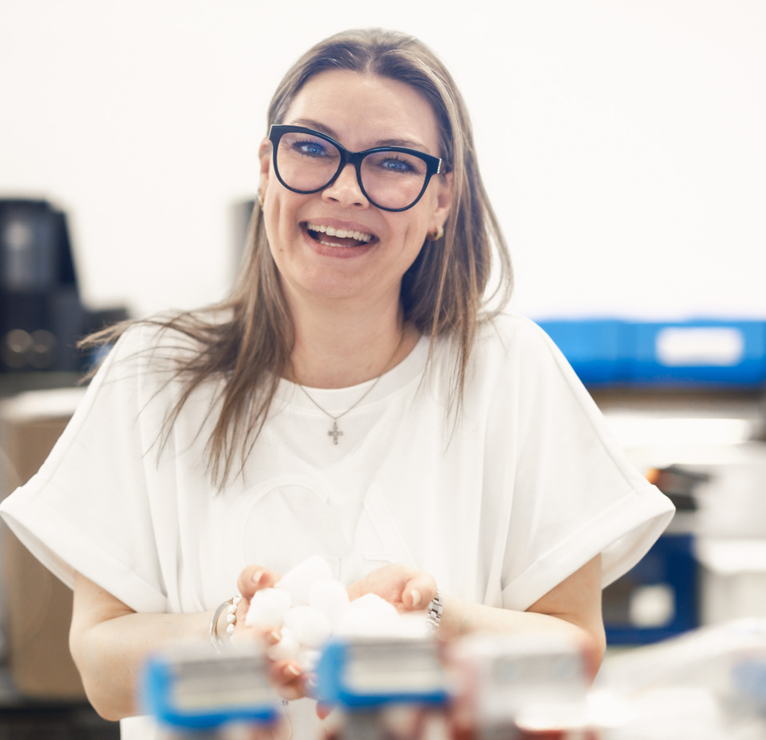
DESIGNED FOR PRECISION. MADE FOR TRUST.
Why it matters for
your business
A strong partner for long-term growth
→ Trusted instruments used in clinics worldwide.
→ Stable production and reliable delivery.
→ Durable products that drive repeat business.
→ A partner that supports your long-term growth

Slide 8
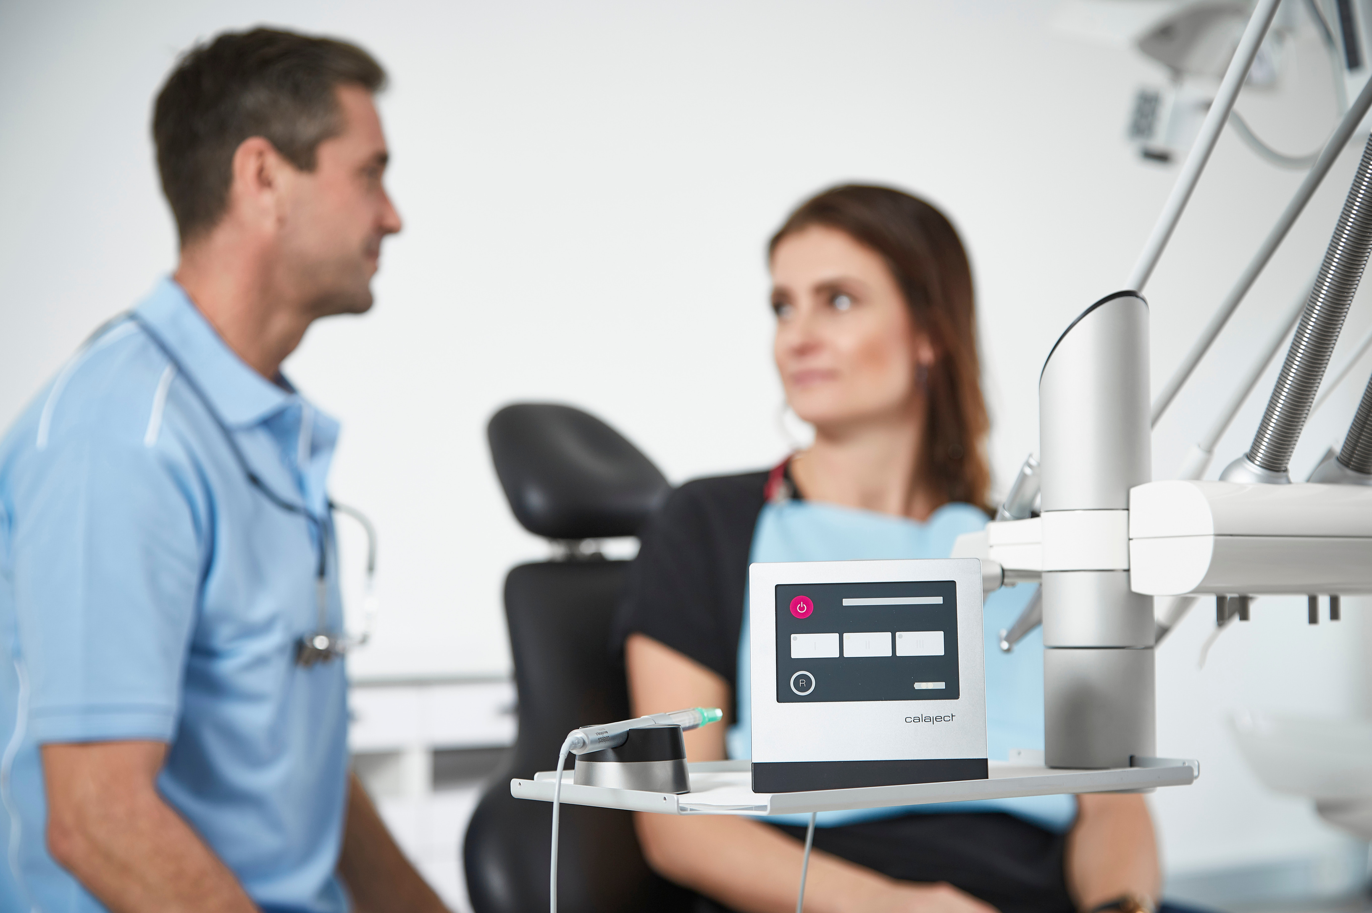
DESIGNED FOR PRECISION. MADE FOR TRUST.
Better tools. Better experiences.
At RØNVIG, we believe that better tools create better experiences –
for the hands that work – and the patients they care for.
We design with purpose, produce with care,
and partner for the long term.

Slide 9
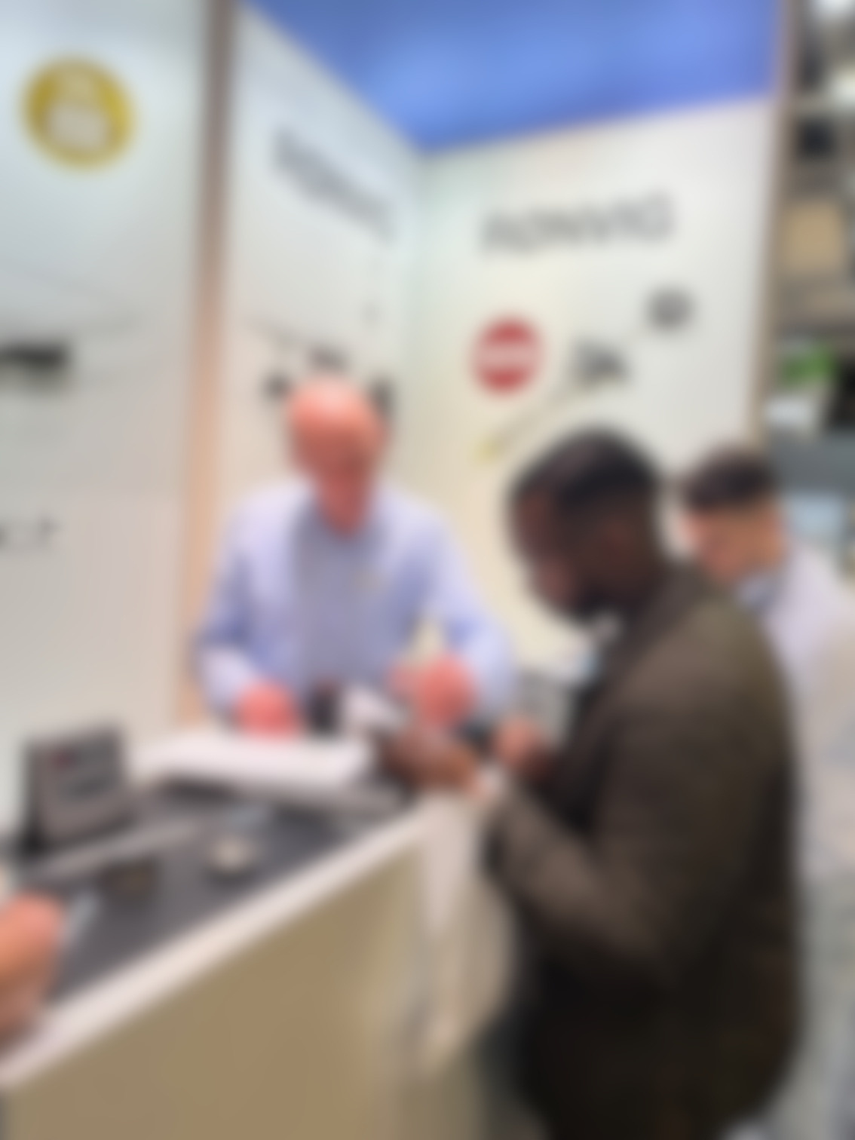
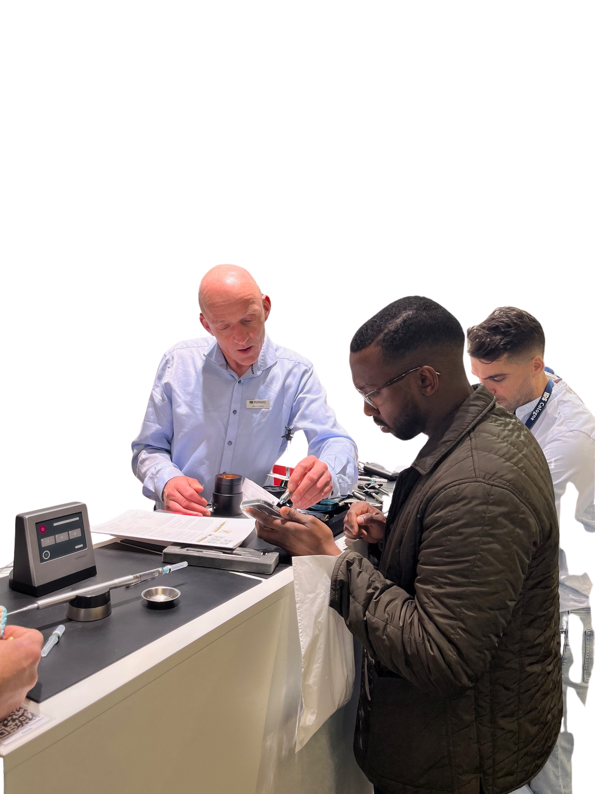

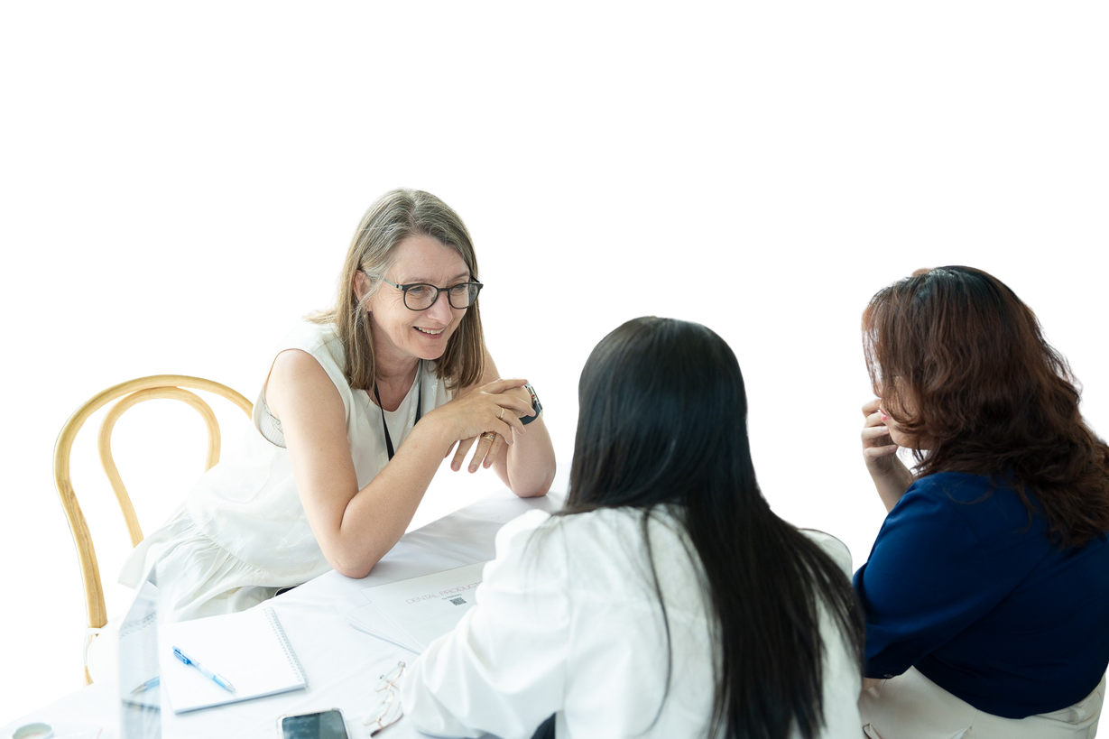
DESIGNED FOR PRECISION. MADE FOR TRUST.
Become a Partner
Join our network of distributors.
If you are interested in representing RØNVIG, we would love to hear from you.
Contact us to explore the opportunity.
E-mail: contact@ronvig.com
Phone: +45 70 23 34 11

Slide 10
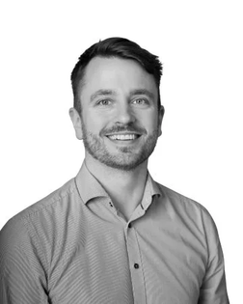
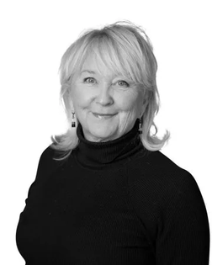
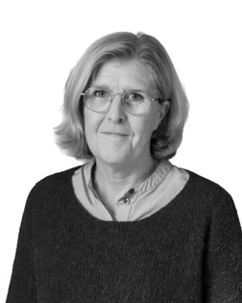
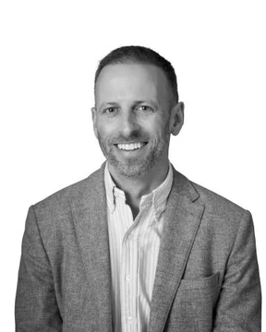
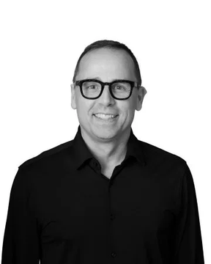
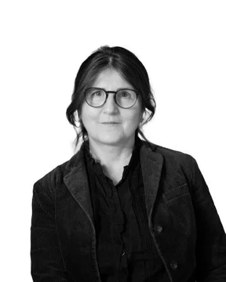
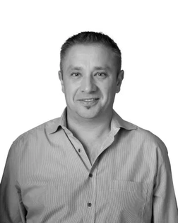
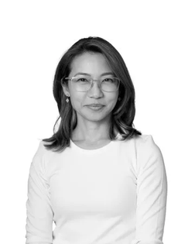
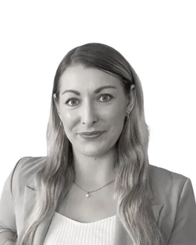
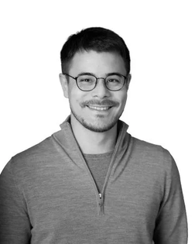
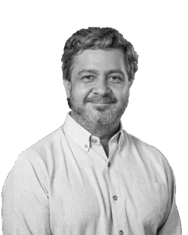
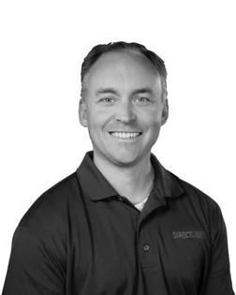
DESIGNED FOR PRECISION. MADE FOR TRUST.
Contact
GLOBAL PRESENCE • LOCAL SUPPORT
Daniel Rollén
Global Sales Director
Maria Flodin
Area Sales Manager
Sweden, Finland, Norway, Denmark, Iceland
Elisabet Jakobsson
Area Sales Manager
Sweden, Finland, Norway, Denmark, Iceland
Anne Graf Cache
Area Sales Manager
France, Belgium, Spain, Portugal
Russell Kilshaw
Area Sales Manager
UK, Ireland
Alexander Haid
Area Sales Manager
Germany, Austria, Switzerland
Wolfgang Hirsch
Area Sales Manager
Germany, Austria, Switzerland
Kookkik
Managing Director
Philippines, Thailand, Vietnam, Cambodia, India, Myanmar, Laos, Bangla-desh, Sri Lanka, Nepal
Yvonne Rieble
Area Sales Manager & Head of Marketing
Australia, New Zeeland, Indonesia, Malaysia, Singapore
Dan Fukushima
Area Sales Manager
Japan, South Korea, China, Hong Kong, Taiwan
Frank Cortes
President Directa Inc USA
Dave Brown
Sales Representative
North America

